Slide 1
The Adventure of editors leaving to find readers in the social network era
TRAN THI HOAI PHUONG
Editor/Deputy Director and Chief of Editorial Division of Vietnam Omega Books JSC
E-MAIL: Phuong.tran@omegaplus.vn
Cellphone: (8424)945724486
Homepage: omegaplus.vn
Notes:
I am so glad to be here to learn and to share experiences around topic “the adventure of editors leaving to find readers in social network era”

Slide 2
About me
My current job includes coordinating the workflow of Editorial Division, building the network of translators and writers, constantly communicating with them and managing the relationship between translators, writers and publishers.
2008-2013: Editor at Knowledge Publishing House
2013- 2016: Editor at Alpha Books Publishing Company
September 2016 to now: Chief of Editorial Division of Omega Plus.
August 2018 to now:
Production Deputy Director
Notes:
I have 10 years of experience in the publishing sector
I have been working at Omega Books JSC since September 2016.
My current job includes coordinating the workflow of Editorial Division, building the network of translators and writers, constantly communicating with them and managing the relationship between translators, writers and publishers.

Slide 3
About Us
Company name: Vietnam Omega Books JSC, also known as Omega Plus
Number of employees: 25
Book genres: politics, science, philosophy and history

Slide 4
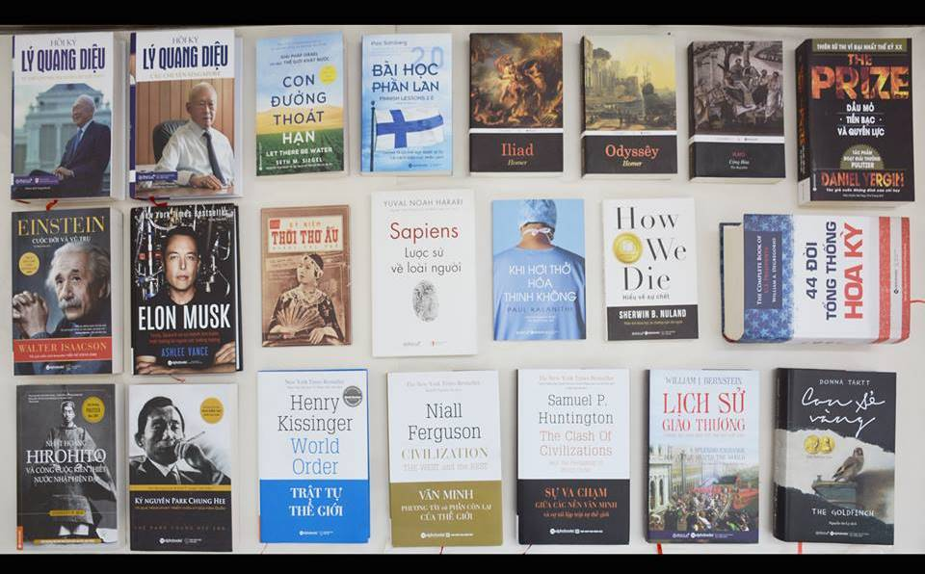
important titles
About Us
Notes:
We have published about 150 titles for now, including the Vietnamese translation of the following titles:
1. Republic, Plato
2. Politics, Aristotle
3. The Social Contract, Jean-Jacques Rousseau
4. The Spirit of the Laws, Montesquieu
5. The clash of civilizations, Samuel Huntington
6. World Order, Kissinger
7. Civilization: The West and the rest, Nial Ferguson
8. Elon Musk, Ashlee Vance
9. Finnish Lessons 2.0: What Can the World Learn from Educational Change in Finland?, Pasi Salhberg
10. Einstein: His Life and Universe, Walter Isaacson
11. Napoleon the Great, Andrew Roberts
12. Sapiens: A Brief History of Humankind, Yuval Noah Harari
13. Stem Cells: An Insider’s Guide, Paul Knoepfler
14. Stalingrad: The Fateful Siege 1942-1943, Antony Beevor
15. Margaret Thatcher: Autobiography, Margaret Thatcher…

Slide 5
important titles
About us
Notes:
Vietnam Omega Books JSC, also known as Omega Plus, was established in September 2016. We are a private publishing company and also an imprint of Alpha Publishing Corporation. We focus on non-fictional literature on politics, history, humanities, and science literature.
With the goal of spreading valuable knowledge Omega Plus wishes to not only publish more top-quality books but also create various informative activities for readers of all age.

Slide 6
About Us
January 2016, we created Omega Group
Currently, It has over 45.000 of members
Notes:
+ In January 2016, we created Omega Group on facebook. This is an online space where the readers who love to read books of science, philosophy, history could discuss and share their passion.
I was co-founder and administrator of Omega Group in the early time. For now, the number of members has reached more than 45,000 with diversified activities.

Slide 7
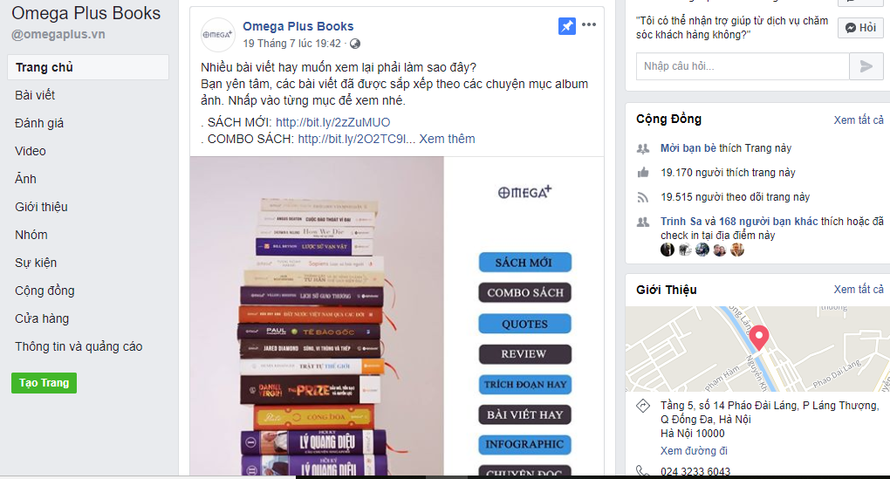
About Us
We created our Fanpage in 2017
Until now, it has reached about 20 thousand of followers

Slide 8
Publishing Industry in Vietnam
Private companies
Number:
14.000
100% state owned companies
Number: 63
2018
Notes:
In Vietnam, there are 2 types of publishers: 100% state-owned companies and Private companies.
Until 2018, there are sixty three 100% state-owned companies in Vietnam and fourteen thousand private companies

Slide 9
Co-operated Publication
Private companies:
Copyright contract
Translation
Editing
Printing and distributing
100% state owned companies:
Publishing license is issued (ISBN)
Notes:
In which, private company is responsible for copyright contract, translation, editing, printing and distributing
100% state owned company’s task is providing ISBN

Slide 10
Vietnam Publishing industry 2017
Number of copies
312,510,500
Number of titles
30,851 titles
Income
2,892.585 billions VND
Notes:
There is some data of Vietnam publishing industry in 2017

Slide 11
The transformation of Vietnam publishing industry in social network era
Vietnam Publishing industry is recently characterized by new forms, new approaches and new markets
publishing process is becoming more efficient by using technological application-based distribution and communicating through digital channels such as Youtube, Digital, Facebook, platform
There are more and more Publishing units develop digital marketing, social networks to expand net of readers

Slide 12
The transformation of Vietnam publishing industry in social network era
There are more and more:
Online book fairs
Marketing online forms
Facebook advertising
Landing pages
Advertising videos of (new) books on youtube
Communities of readers/ authors/translators
Traditional distributing channels are slowly replaced by new distributing channels
Notes:
In recent years, there are more and more publishing companies use social network to expand the net of readers.

Slide 13
The transformation of Vietnam publishing industry in social network era
Notes:
In which, facebook is the most popular. Almost publishing units have fanpage and facebook account

Slide 14
What social networks should we use?
There are some social networks that help us expanding the readers:
Facebook: include group, fanpage, private account, facebook advertising, etc
Instagram
Youtube
Google+, Twitter
Notes:
Next, I will talk about our experiences in using social network, at same time, i also want to open the think of how to use it more effectively

Slide 15
How we use facebook to reach the readers?
Omega Group’s activities
Holding a daily discussion
Holding a monthly mini game
Recruiting translators
Introducing some good/new books
Sharing attractive information
Holding “mini book club meetings”
Creating Poll to examine readers’ opinions
Notes:
Firstly, there are some activities to develop Omega Group:
Holding a daily discussion about the books in fields of science, history, philosophy…
Holding a monthly mini game about books with the hashtags hints.
Recruiting translators
Introducing some good/new books
Sharing information relating to books or political, cultural, scientific and social issues
Holding “mini book club meetings” during the course of the month, in which the book’ authors/translators answer questions from readers
In fact, for now, Omega Group is the most effective site in reaching readers and marketing products of us

Slide 16
How we use facebook to reach the readers?
Notes:
Introduce upcoming books

Slide 17
How we use facebook to reach the readers?
Creating Polls

Slide 18
How we use facebook to reach the readers?
Sale Policy:
High discount rate

Slide 19
How we use facebook to reach the readers?
Facebook fanpage
Updating regularly new books of Omega Plus
Updating Omega Plus’s activities, events
Sharing information of book fairs, sale off programs
Answering readers’ questions and criticisms
Selling books
Notes:
Secondly, there are basic activities on facebook fanpage

Slide 20
How we use facebook to reach the readers?
Facebook advertising - some following tips:
Creating landing page: not just send readers to our Facebook page’s wall but also landing page.
When people click on our Facebook advertisement, send them to a customized webpage that encourages them to “like” our Facebook’s page.
Revealing the first one or two chapters of the book
Notes:
Thirdly, about facebook ads

Slide 21
How we use facebook to reaching the readers?
With Facebook advertising, there are some requirements:
Make Ads Specific
Asking questions in your Facebook ads is one way to get people involved.
Growing Email List
Notes:
Facebook advertising
Make Ads Specific: When creating the text for ad, make sure that you keep it as specific as possible and clearly targeted to a particular demographic.
Asking questions in your Facebook ads is one way to get people involved.
Growing Email List: Email is the most direct and effective way to communicate with readers. Once you have got your own list, you will not depend on the quirks, updates, and changes in popularity of any social network.

Slide 22
How we use facebook to reaching the readers?
Easily target and reach a large number of potential readers. Do not have to spend too much money: You can set a daily budget to work.
You need to define your target readers, grab their attention with an attractive offer that will attracts them to your email list.
Notes:
With Facebook Ads, you can easily target and reach a large number of potential readers. And you do not have to spend too much money: You can set a daily budget to work.
You need to define your target readers, grab their attention with an attractive offer that will attracts them to your email list.
Such as a free chapter of a new book, a free copy of one of your books, a collection of your past writings, or any freebie that will lead them to your mailing list.

Slide 23
Building a Landing page for each new book
Notes:
This is image of a landing page

Slide 24
How to use youtube to find the readers?
Youtube: introducing books/ creating book summaries; noticing the followings:
a good title is very important: you need to keep it short, concise, and purposeful.
encouraging feedback and interaction
your brand needs to cover everything you touch: it is the background you use, or the style of movie trailer you produce, the lighting etc.
keeping it short, punchy, and getting people want it more.
Notes:
We can use youtube to introduce books, create book summaries

Slide 25
How about a platform that can help to connect publishers with readers?
To create a technology platform that can let the readers involve in the publishing process.
Publishers’ benefit: platform can help to expand the net of readers and collaborators
Readers’ benefit: platform can help them to find the books they need/love. It also provides them opportunities to find a job.
It is an opportunity for readers to experience the work of a publisher
Notes:
The idea is to create a technology platform that connects the editors to the readers, and makes the readers involve in the publishing process. Readers can become translators, editors, etc.
Publishers’ benefit: platform can help expanding the net of readers and collaborators
Readers’ benefit: platform can help finding the books they need/love. It also provides them opportunities to find a job.
It is an opportunity for readers to experience the work of a publisher
We are planning to build a plattform like that. Hope this idea useful for you.

Slide 26
Thank you for your kind attention!

