Slide 1
How Editor Get More Readers on Social Network Era

Slide 2
INTRODUCTION
THAILAND BOOK MARKET
WHAT EDITOR DO IN THE SOCIAL NETWORK ERA

Slide 3
INTRODUCTION
OF

Slide 4
KADOKAWA Amarin Company Limited is formed by Amarin Printing and Publishing Public Company Limited and KADOKAWA Group Holdings Inc. to jointly engage in publishing of Japanese light novel and comic in Thai Language, development of information media specializing in Japan tourism and reinforcement of the digital platform among others.

Slide 5
KADOKAWA is the leader of entertainment industry in Japan such as printing, animation, movie, game and digital content.
We have a strong point at the strategy named "Mixed Media". KADOKAWA Amarin Company Limited had launched "Your Name" by Makoto Shinkai for the first light novel on a company's grand opening in 2016, September.

Slide 6
General light novel and comic
Boy love and Yuri light novel and comic
Light Novel
Light Novel
Comic
Comic

Slide 7
Light Novel

Slide 8
Light Novel

Slide 9
Light Novel

Slide 10
Comics

Slide 11
Comics

Slide 12
Comics

Slide 13
Light Novel & Comic

Slide 14
Light Novel & Comic

Slide 15
Other Product >> Mixed Media
TV Programs
Events
Merchandises
Etc.

Slide 16
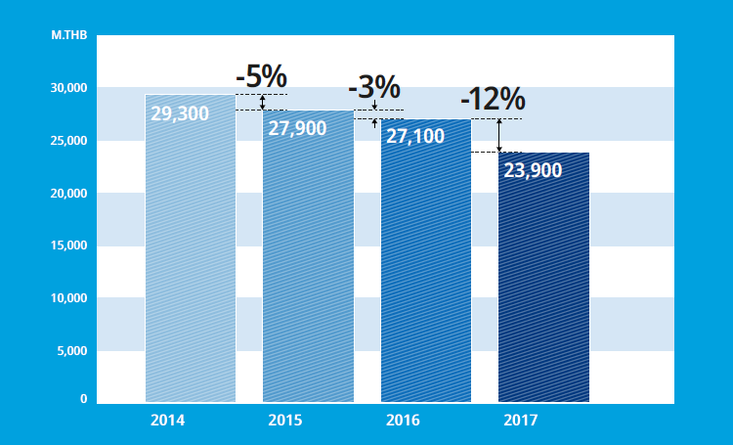
THAILAND BOOK MARKET
Overall, the publishing industry has been declining continuously for many years
Source: The Publishers and Booksellers Association of Thailand

Slide 17
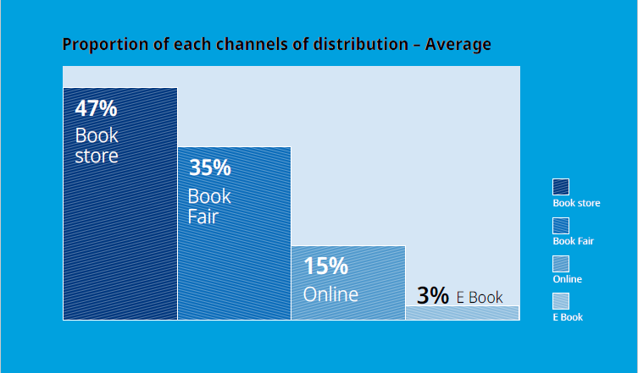
While the key channel of distributions is still physical bookstores
Source: The Publishers and Booksellers Association of Thailand

Slide 18
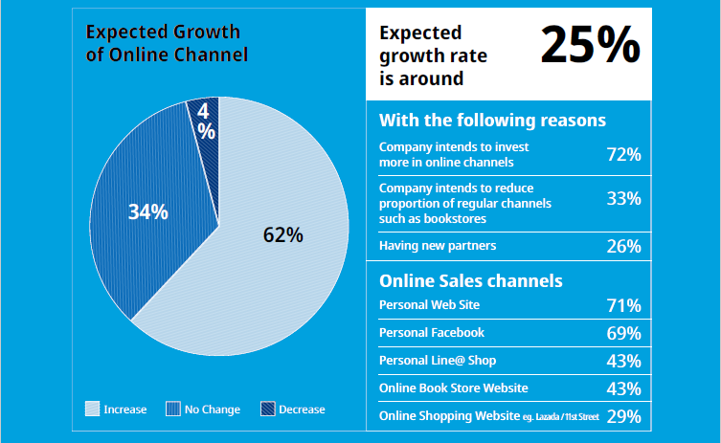
And online channel is also growing continuously as well
Source: The Publishers and Booksellers Association of Thailand

Slide 19
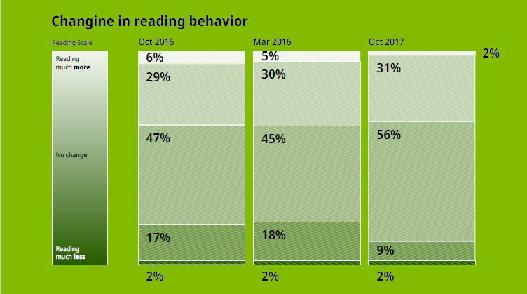
Readers’ Reading Behaviors
From the survey, it is found that amount of those who claimed to real less is decreased from the previous year
Source: The Publishers and Booksellers Association of Thailand

Slide 20
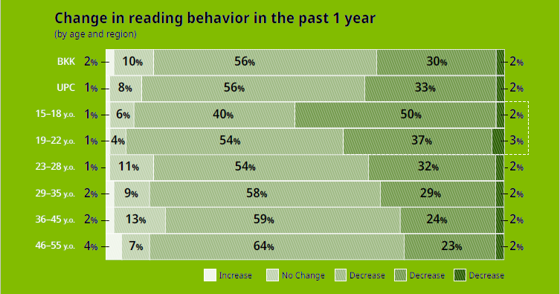
While the amount of those who claim to “read more” are mainly new generations aged 15-18 years old; who are the strategic target group that the association intends to recruit & maintain
Source: The Publishers and Booksellers Association of Thailand

Slide 21
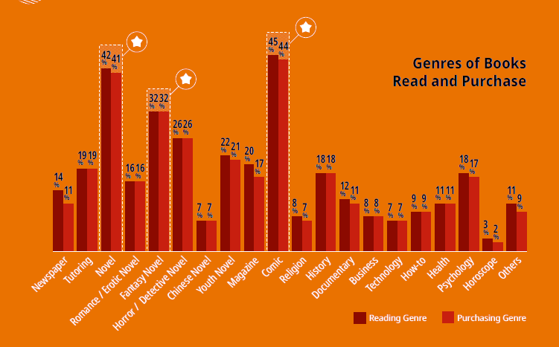
The “Key Category Driver” of the industry are Comics and Love Novels
Source: The Publishers and Booksellers Association of Thailand

Slide 22
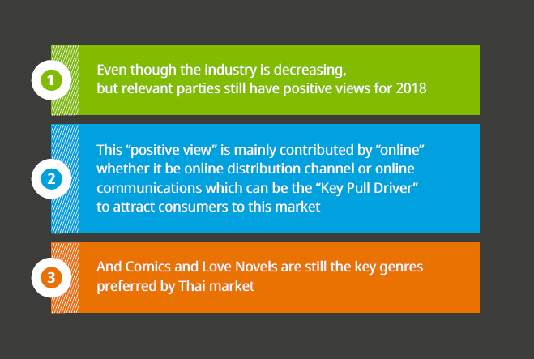
Key Takeaway

Slide 23
Light Novel Publishers in Thailand

Slide 24
WHAT EDITOR DO IN THE SOCIAL NETWORK ERA
Editor
Marketing
Multi-tasking
Reader
& Writer
Production

Slide 25
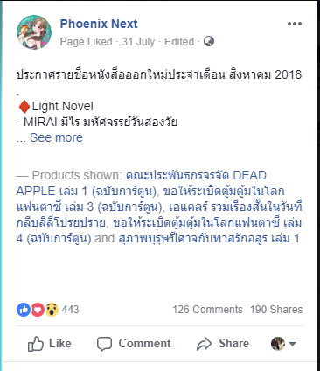
Online Channel = Source of information for new releases and events

Slide 26
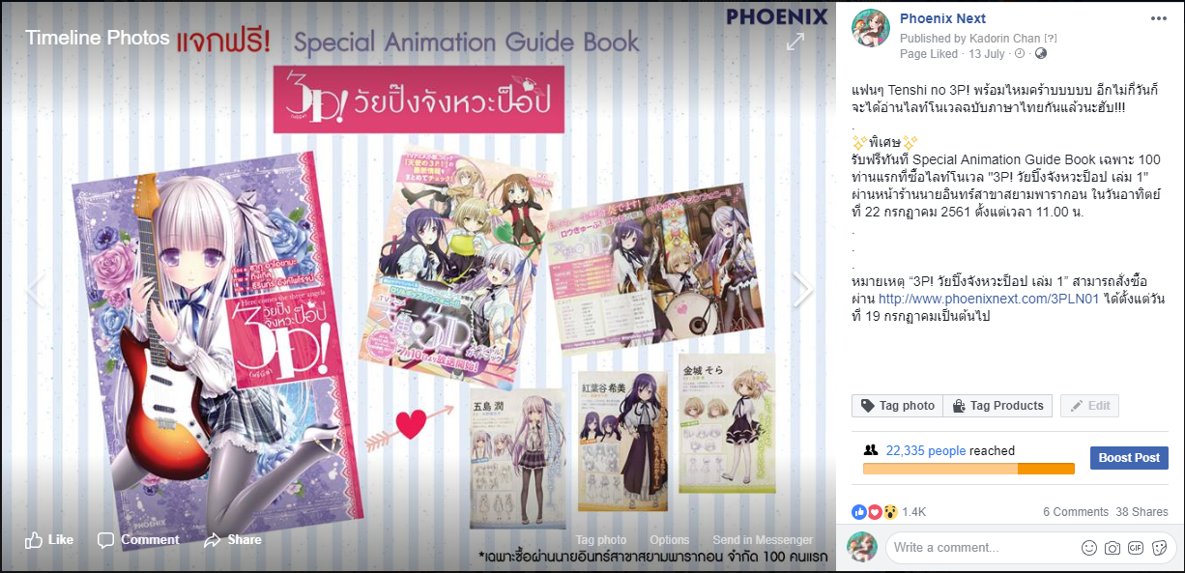

Slide 27
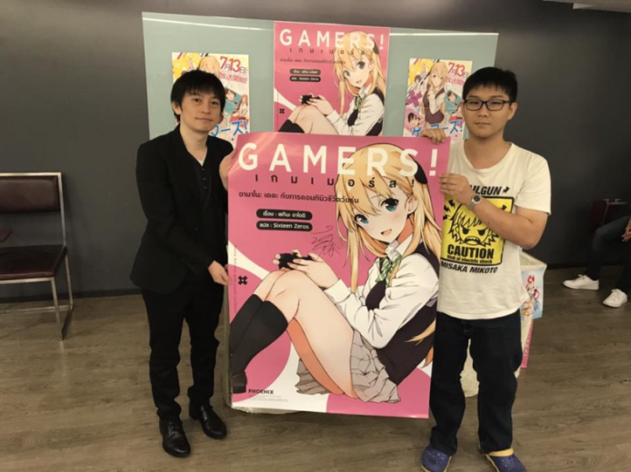
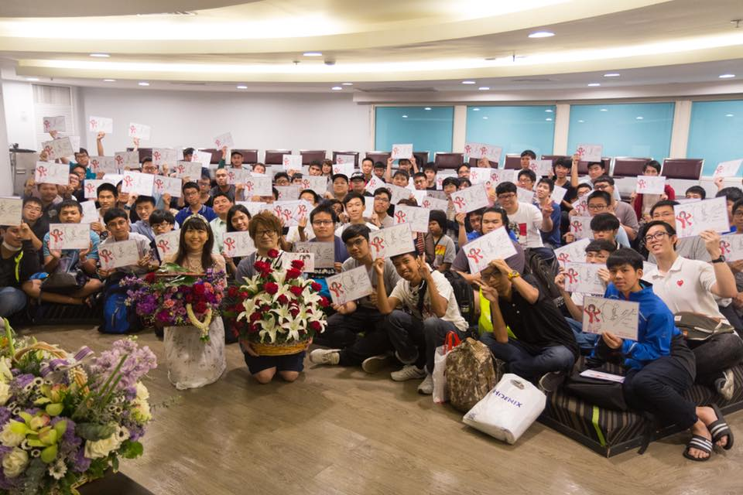
Events = Keep in touch with our readers and get new readers
Fan Sign

Slide 28
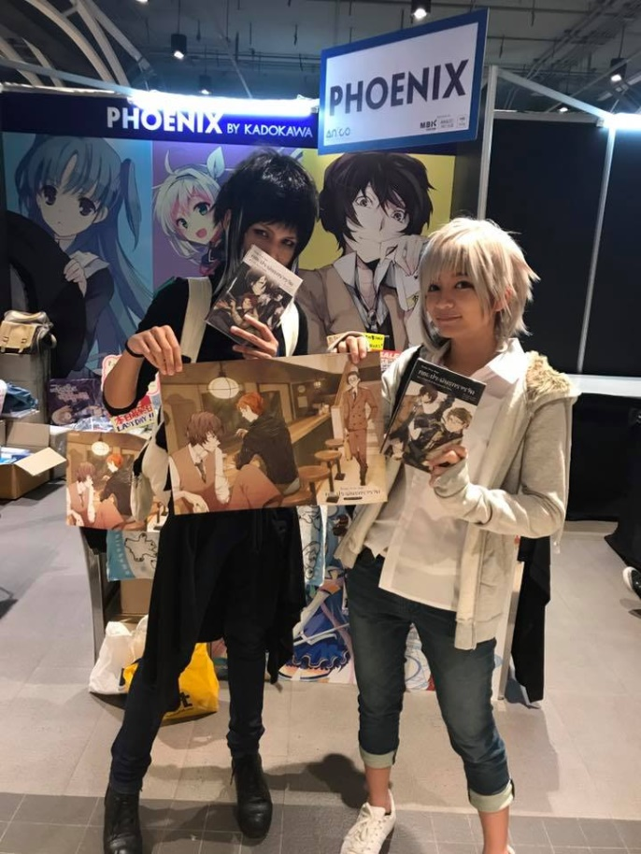
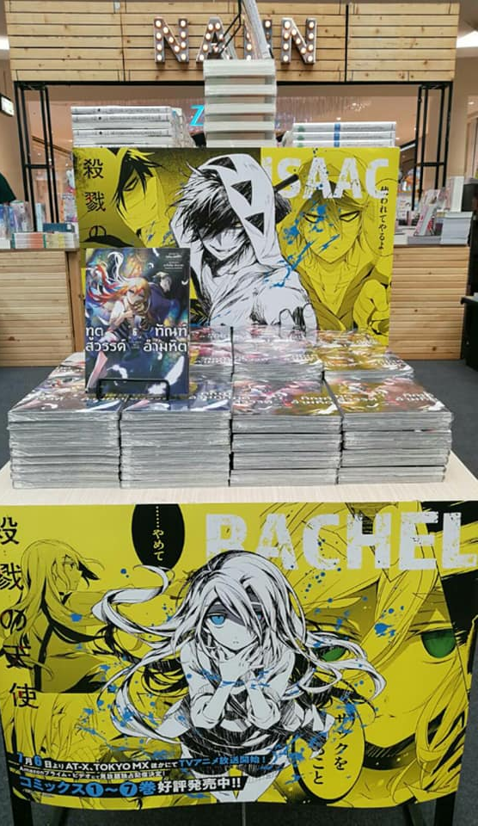
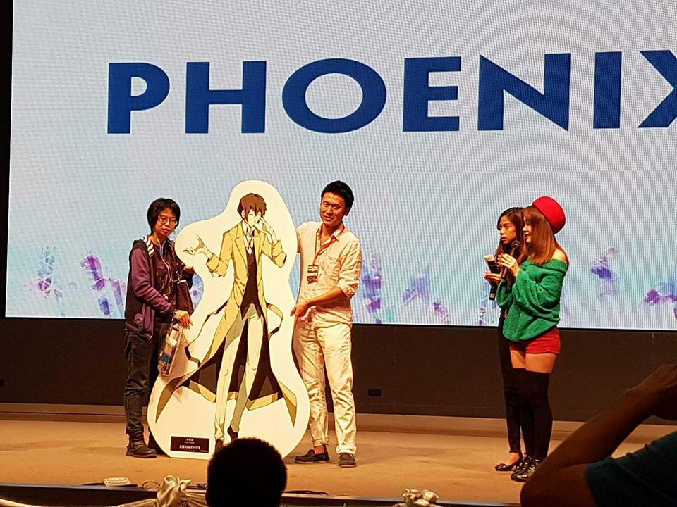
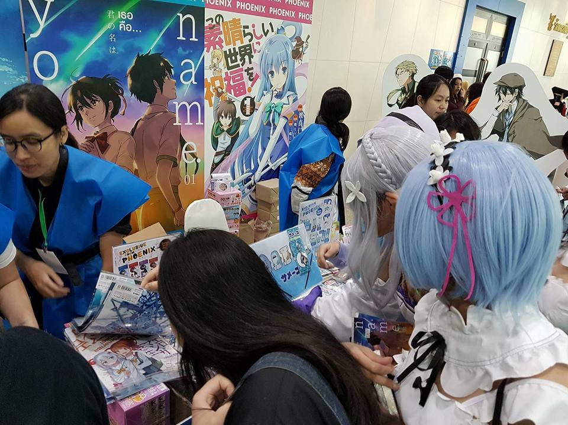
Road Show
&
Book Fair

Slide 29
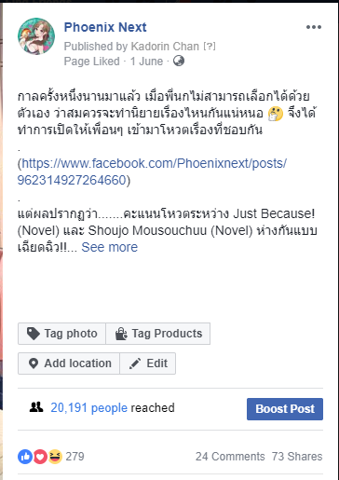
Online Channel = What’s the reader want to read?

Slide 30
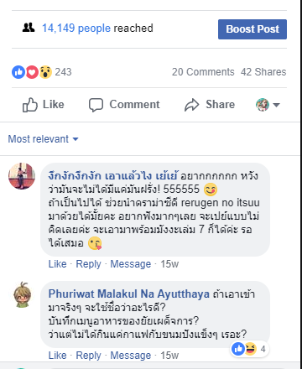
https://www.facebook.com/Phoenixnext/photos/a.658706237625532.1073741828.658286121000877/957182347777918/?type=3&theater

Slide 31
MIXED MEDIA
ONE CONTENT
MILLION PRODUCTS
Light Novel
Animation
Comic
Merchandise
Premium
Etc.

Slide 32
The phenomenon of YOUR NAME
6,220,000,000
results on google.com (at 15th August, 2018)
Animation
Comic
Light Novel
highest-grossing anime film
more
68,000copies
more
45,000 copies

Slide 33
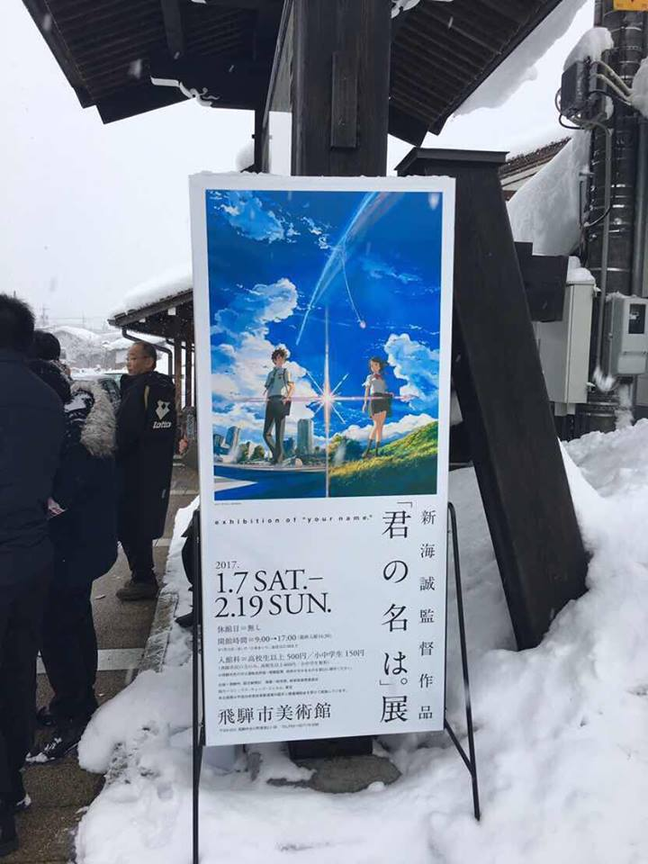
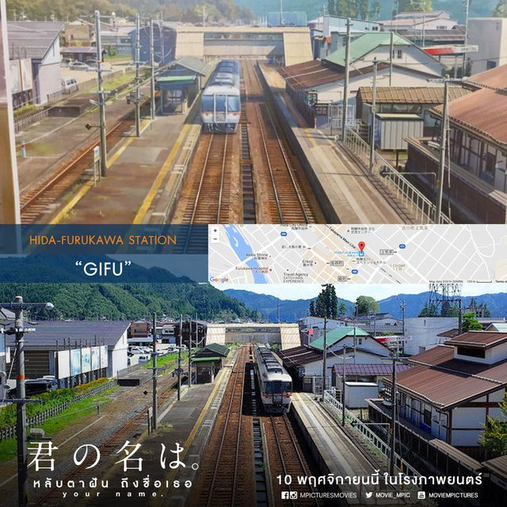
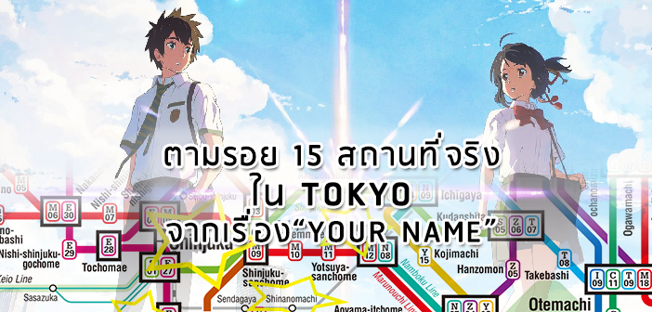
Tourism
Original Sound Track
Premium

Slide 34
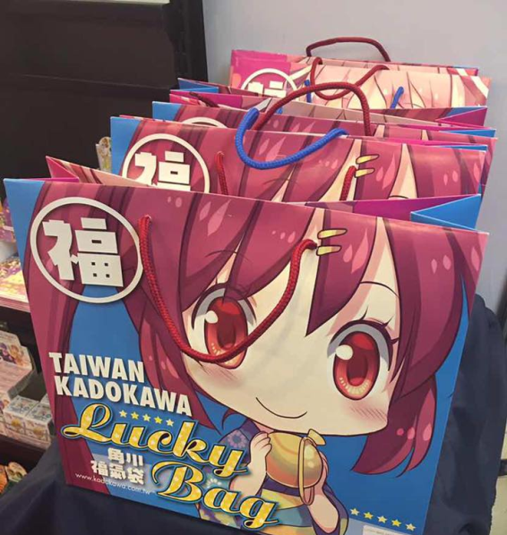
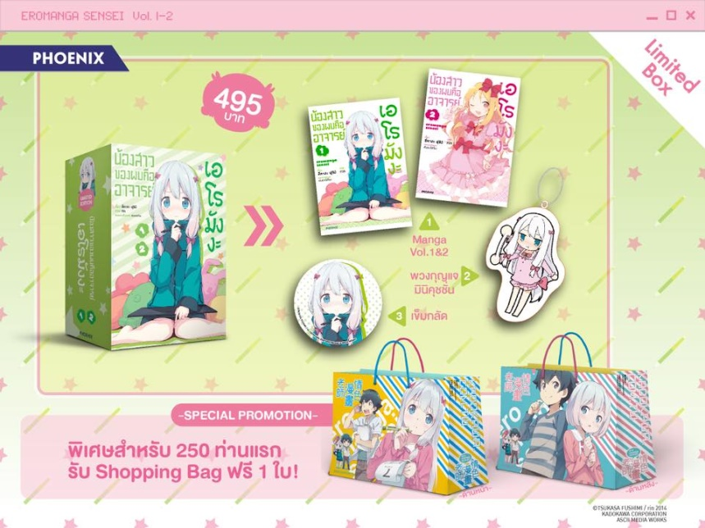
Limited Edition Box Set
Premium Products
Character Cushions
Lucky Bags

Slide 35
THANK YOU

