Slide 1
Being a Critic and an Editor on Social Network
Asian Publishers Fellowship Program in Seoul SEP 2018
QUYEN NGUYEN
Phanbook Publishing, Vietnam

Slide 2
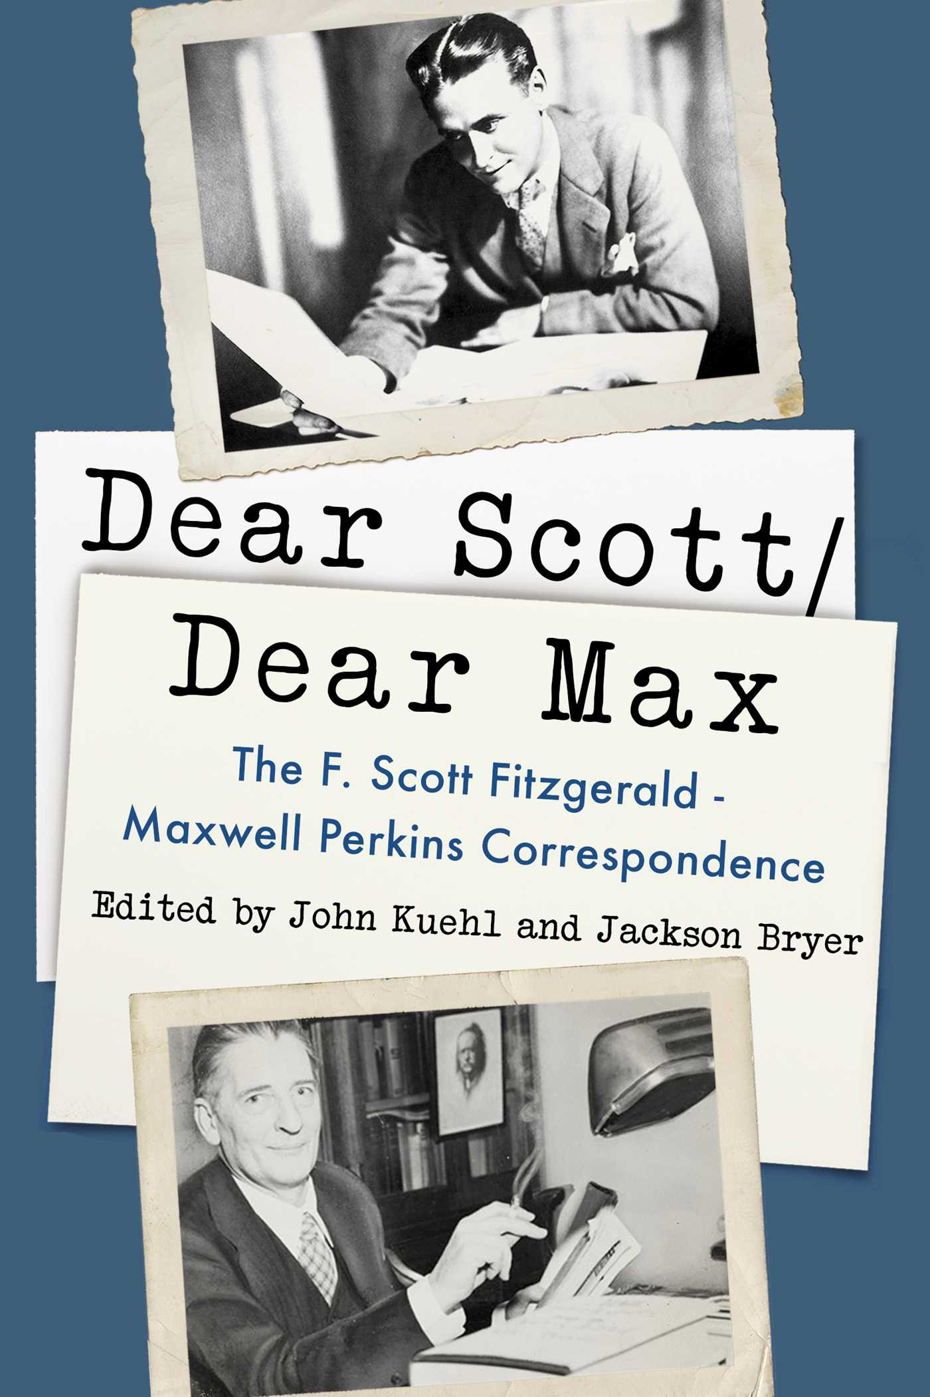
“Editors should remain invisible”

Slide 3
About me
BA in Literature, Vietnam National University, Hanoi, 2006
PhD in English, Nanyang Technological University, Singapore, 2017
Editor at Nha Nam Publishing 2007-2010
Editor and Representative of Phanbook Publishing in Hanoi 2018-present
Translator (English to Vietnamese)
Ian McEwan’s Atonement
Raymond Carver’s What We Talk About When We Talk About Love (co-translated)
Jeffrey Eugenides’s Middlesex

Slide 4
About us
Founded in 2017
First Batch of Books: June 2018
14 titles as of September 10 2018

Slide 5
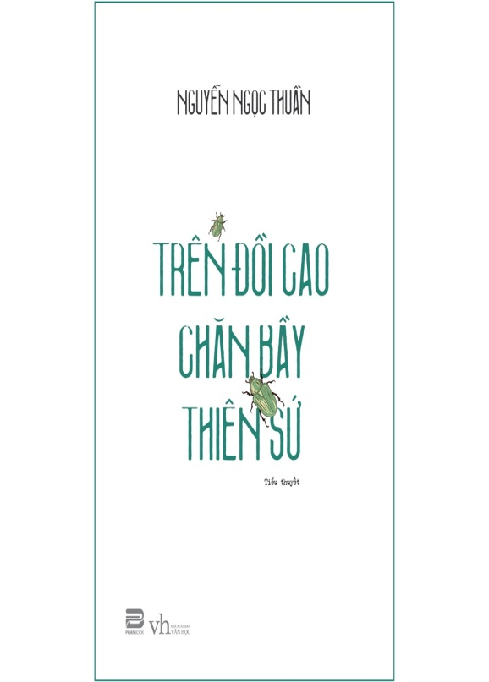
Vietnamese Literature collection
Du Tu Le, Lyricism
Tran Le Son Y, Loving is Freedom
Nguyen Ngoc Thuan, Upon the high hill taking care of herds of angels

Slide 6
Non-fiction Collection
Left to right: Wolff’s Fire and Fury, Nguyen’s Unfulfilled Life Dreams, Nguyen’s Living in the Fantastical Age, Saigon: Symbols

Slide 7
Asian (-American) Literature Collection
Ko Un, Little Pilgrim
Min Jin Lee, Pachinko
Ocean Vuong, Night Sky With Exit Wounds

Slide 8
Nobel Prize in Literature Collection
Left to right: Heinrich Boll’s And Never Says A Word and The Lost Honour of Katharina Blum; Gao XingJian’s Soul Mountain; Isaac Bashevis Singer’s Shosha

Slide 9
The Era of Online Social Media
How does it shape editors?

Slide 10
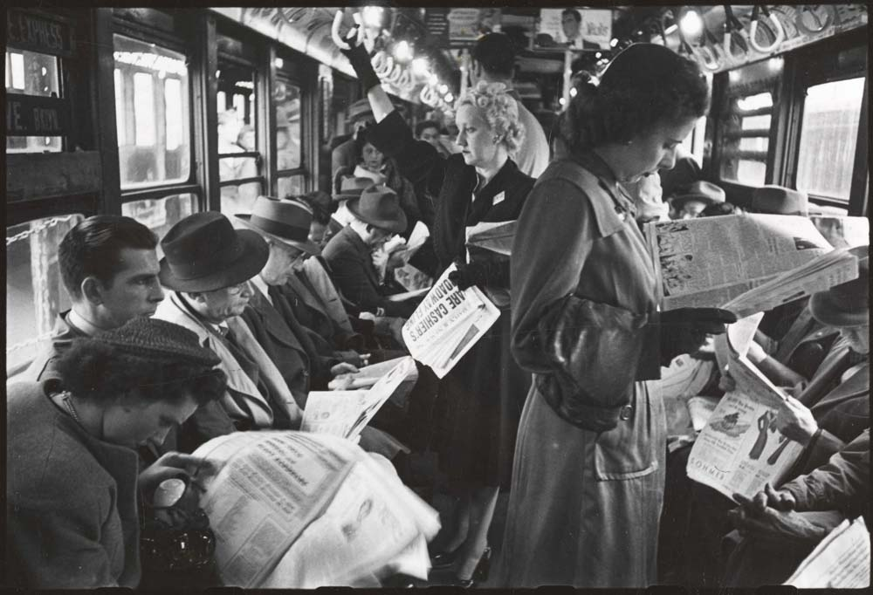
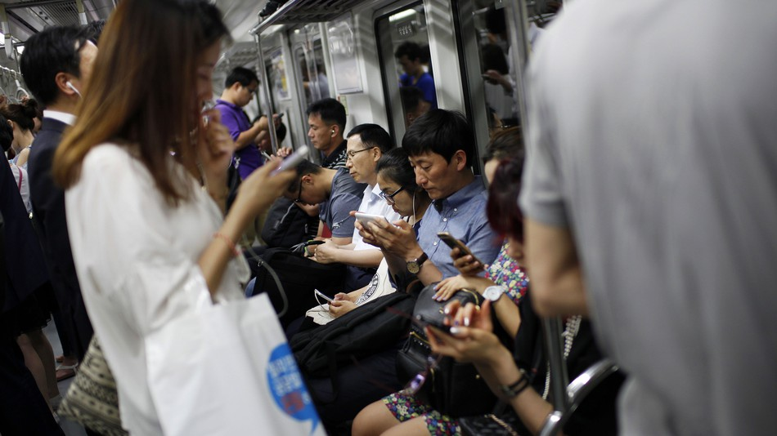
New Reading Experience
Reading in the New York city Subway. 1946. ©Kubrick
Using smartphones in a Seoul subway train. 2015. ©wooHAE CHO

Slide 11
Digital Landscape in Vietnam, 2018
Source: We are social, Hootsuite

Slide 12
The Facebook Era in Vietnam
Vietnam: ranks 7th in the leading countries based on numbers of Facebook users
Every 2 people, 1 is Facebook User
(Source: https://www.statista.com)

Slide 13
Social Network Scene in Vietnam
Number of 3 popular social network users in Vietnam (in millions)
(source: https://www.statista.com)

Slide 14
The New Readers
Platform: Digital
Demographics: young, educated, city dwellers
Consumer Book Buyer: eCommerce
Inclinations: Connect, Share, Discuss via Social Network
Taste : cosmopolitan, reading as a new experience
Expectations: fast, accessible, eager for information

Slide 15
Manuscripts and Beyond
Old days: “Editors should remain invisible”
Information revolution: Editors Go Beyond Manuscripts, to Online Social Networking

Slide 16
Adapt or Perish
Traditional Editors
Mostly involved in production process
Never meet the readers
Passive in circulating information
Play one role in the publishing house
New Era Editors
Actively participate in PR events
Constantly reach out to the audience online/offline
Freely pass out information
Serve as multiple roles

Slide 17
Z’s Ways
How to capture the reader’s attention?

Slide 18
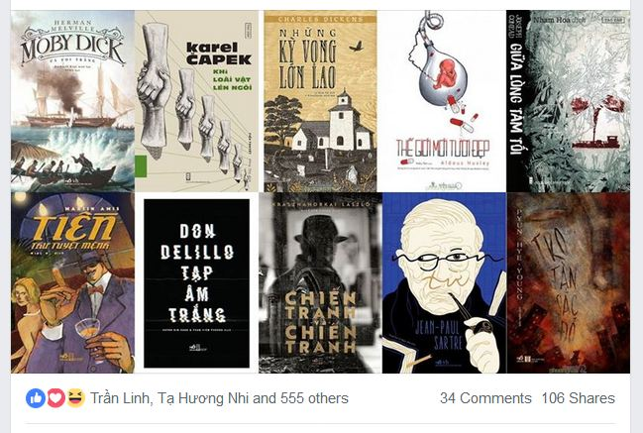
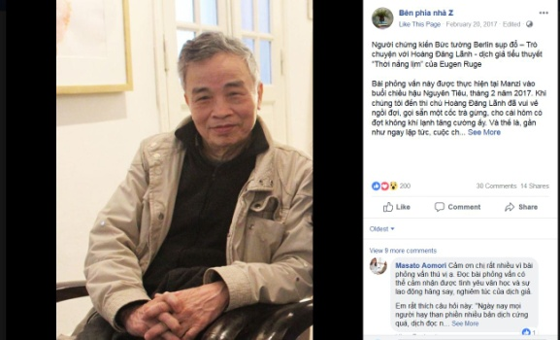
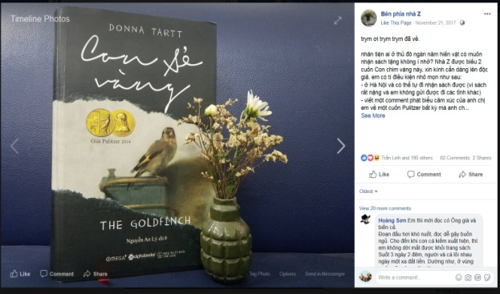
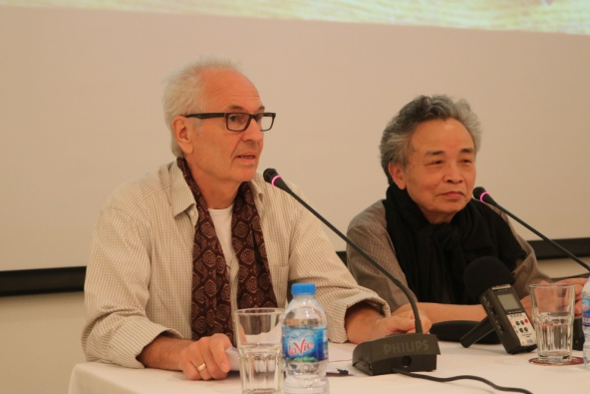
- Facebook since November 2016
8,570 followers
94 in-depth reviews, translations, interviews
5,000 reached readers on average
Z’s Ways
Book Reviews
Interviews with translators
Give-Away (Minigames)
Interviews with authors
(As of 09 Sept 2018)

Slide 19
Tactics
Diversity of posts (editors’ choices, quotes, reports, excerpts, reviews, interviews, mini games etc.)
Listicle is the best
Original reviews with inimitable writing style
Tongue-in-cheek language
Strong interactive with fans
Friendly
Content
Form

Slide 20
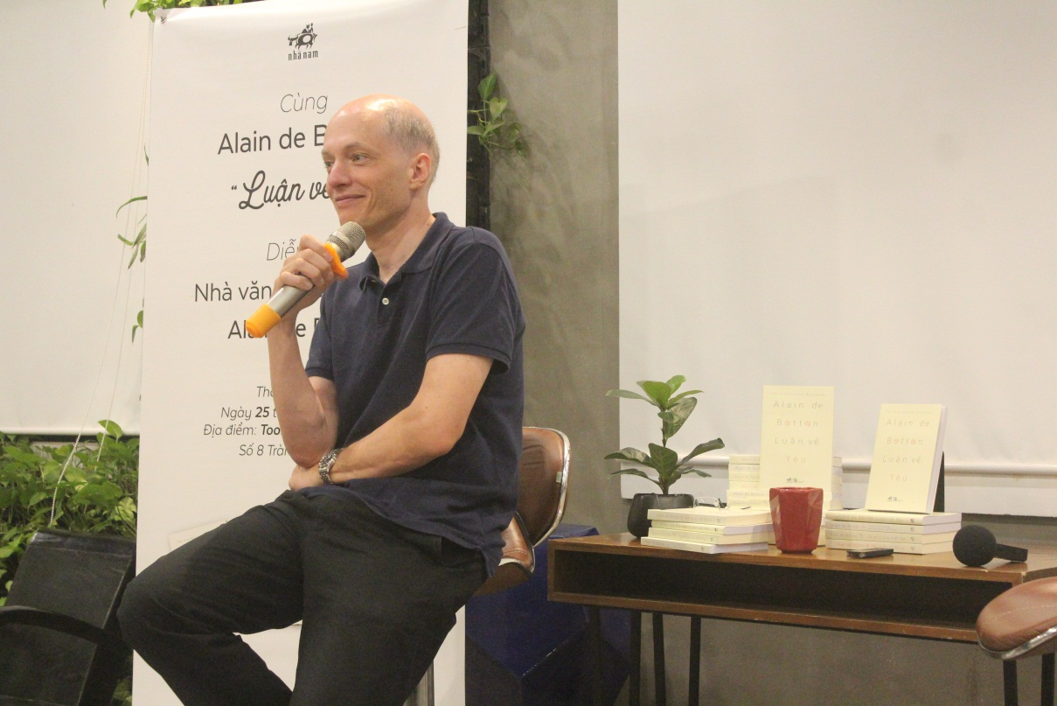
On Meeting Alain de Botton: A Report
18,421 People Reached
2,862 Post Clicks
- 895 Reactions, comments & shares
One of the most popular posts on Z’s Way Facebook Page

Slide 21
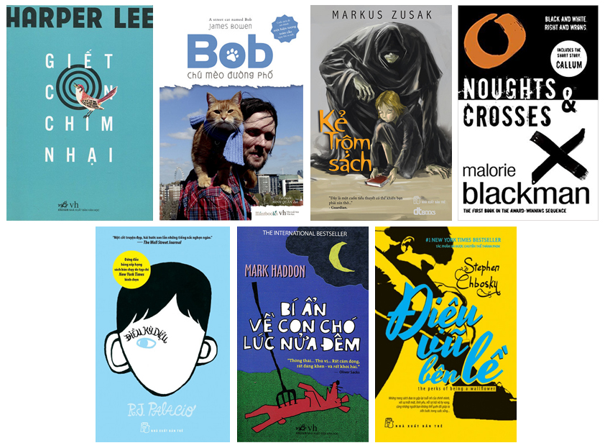
“50 books that will CHANGE your life” list:
Change the way you think
Help you understand you
Make you cry
Make you laugh
Scare you
Teach you about love
Thrill you
Transport you
Another popular post on Z’s Ways Facebook Page
22,009 People Reached
- 876 Reactions, comments & shares

Slide 22
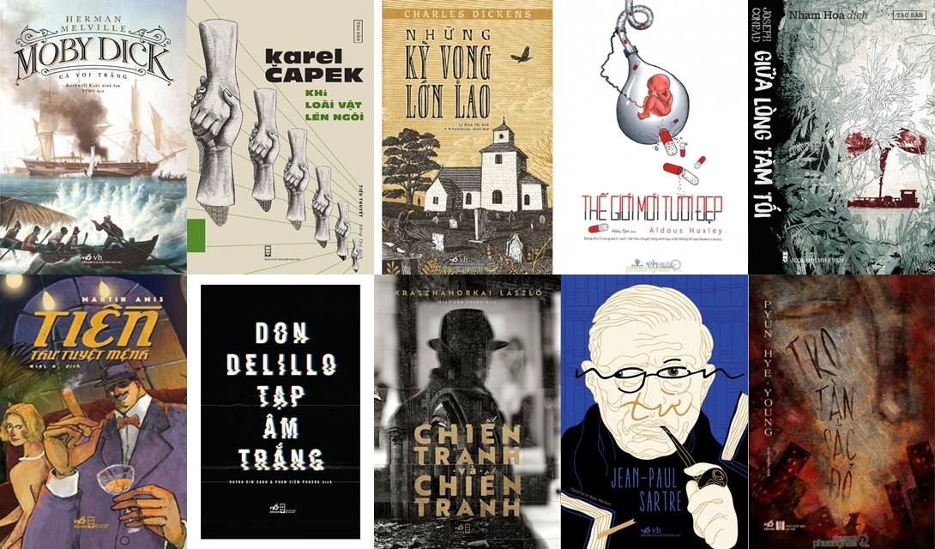
Another popular post on Z’s Ways Facebook Page
Editors’ Picks: The 10 Best Books of 2017
18,008 People Reached
- 715 Reactions, comments & shares

Slide 23
Facebook: Vibrant Online Reading Community
Self-expression
Exchange of ideas
Playground for like-minded people
Sense of empowerment

Slide 24
On Using Facebook: Play with Fire
Huge readership
Free
Fast
Convenient: Just One-Click-Away
Easily reach readers on massive scale
Too much information
Difficulty in finding old posts
Unsuitable for long forms
Facebook frequently changes its News Feed algorithm
Upsides
Downsides
Notes:
(a degree of talent is taken for granted)
Young, hip, modern, cosmopolitan, media-savvy: many talents, no specialization
Have a strong, ongoing, interactive relationship with fan (and anti-fan as well): power in number
Already courted by many publishers, have their pick
Lack of professionalism and/or awareness of ethical standards: inflated egos, ready to quit, noncommittal, failure to fulfill contracts etc.

Slide 25
Thank you for listening
For inquiries please contact quyen.nguyen@phanbook.vn.

Slide 26
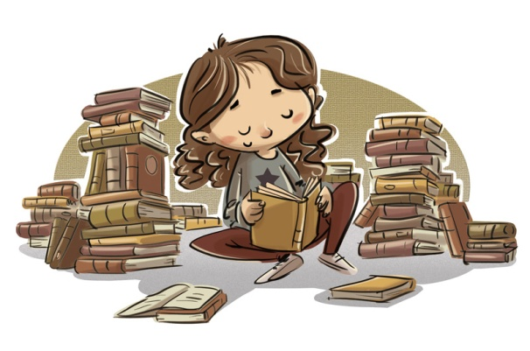
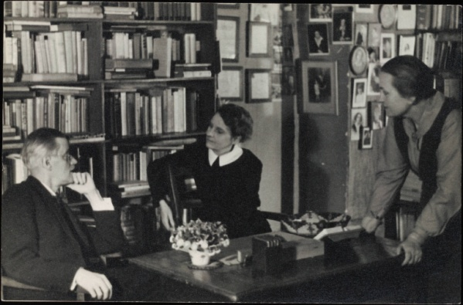
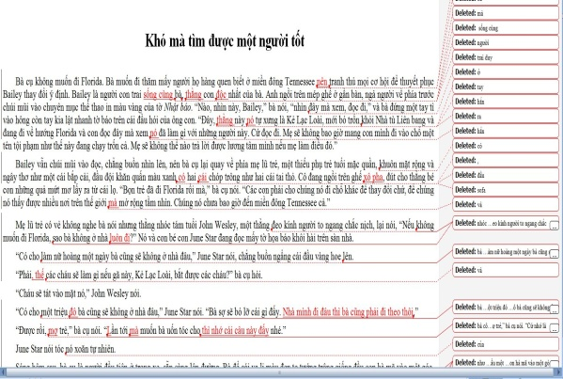
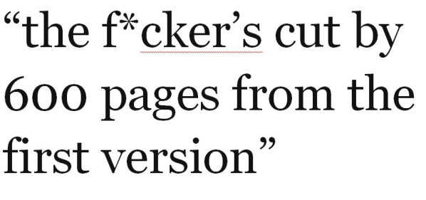
EDITOR
What my friends think I do
What my family thinks I do
What I think I do
What society think I do
What authors think I do
What I actually do

