Slide 4
"The adventure of editors leaving to find readers in the social network era"

Slide 5
www.aradman.ir
انتشارات آرادمان

Slide 6
ARADMAN
Aradman was founded by cooperation of a group of specialist who had many years of experience in the field of publication, literature and media.
The result of such cooperation led to high quality products and intellectual ideas.

Slide 7
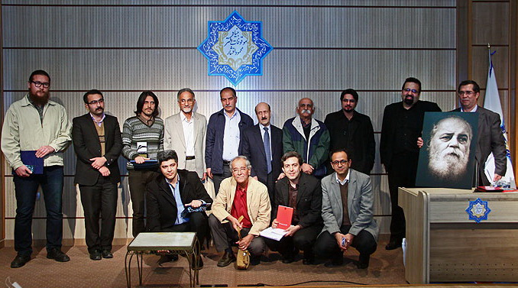

Slide 8
Aradman publishing company was established in 2010. Books published in Aradman are particularly about culture, literature, art and children. 121 books were published in mentioned fields till now.
The goal and strategy is cultural exchange between the country and outside country. For example: Ukraine, Armenia, Arab countries…

Slide 9
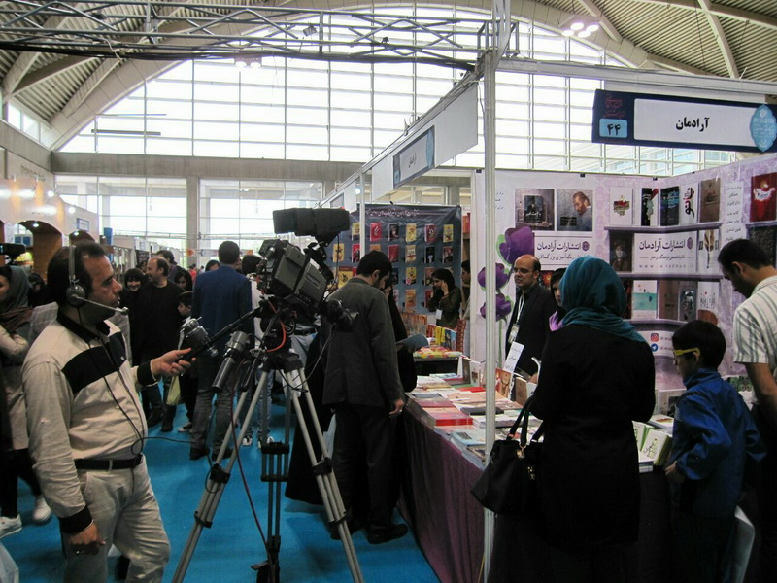
Aradman participates in Tehran international book fair and province book fairs every year.

Slide 10
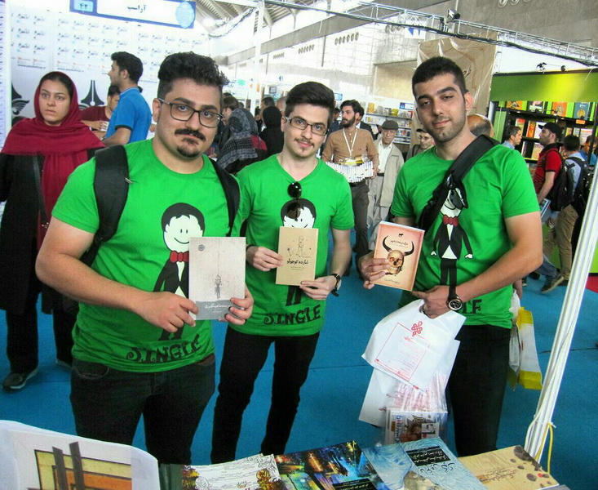

Slide 11
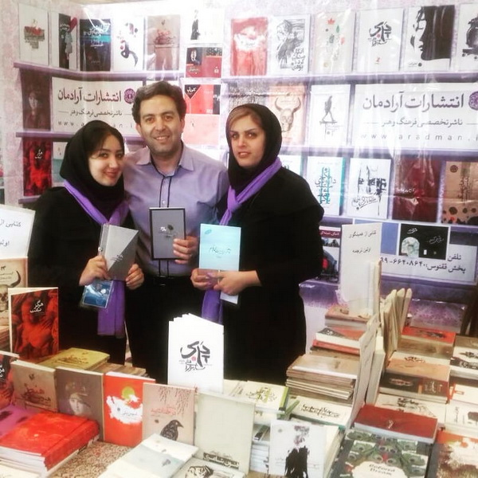

Slide 12
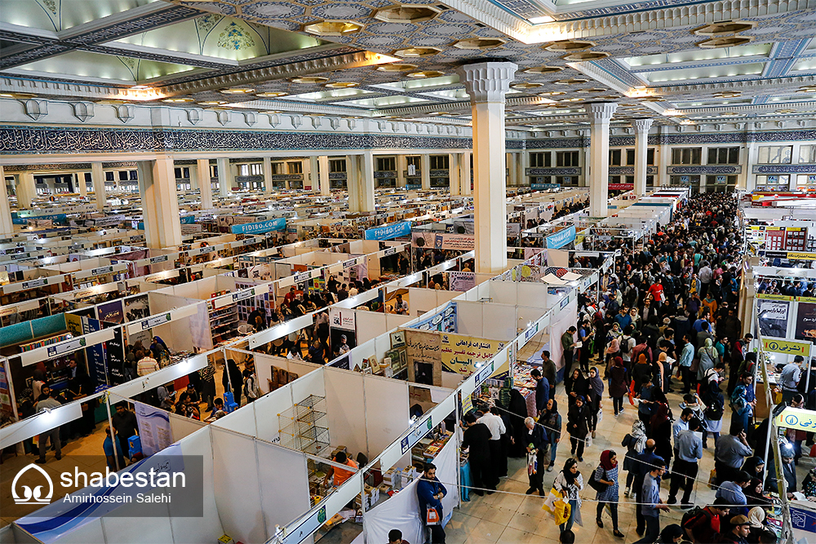
Tehran International Book Fiar: 10-11 days, 1800 publishers + 54 countries

Slide 13
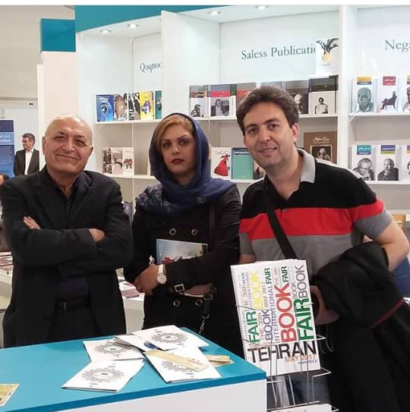
Aradman had participant in Moscow book fair in 2015 and in Frankfurt book fair in 2016 - 2017.

Slide 14
IRAN
As you know, the population of Iran is more than 80 million while the circulation of books is less than 1000 copies; more than 4000 publishers publish more than 80000 first edition books each year.

Slide 15
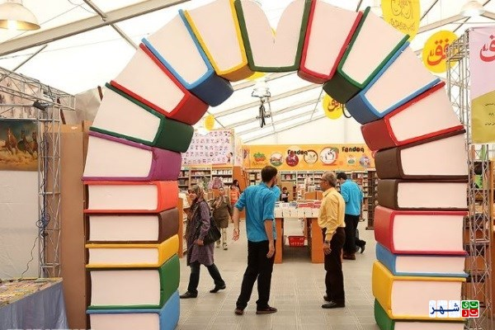

Slide 16
Islamic Republic of Iran
We have low circulation and high quantity of books along with political and economical situation; for example, at the moment, the market of paper is in crisis for the sake of sanctions imposed by US.

Slide 18
In such a situation, programming for usual advertisings cannot lead publishers to be successful in promoting their books.

Slide 19
We have even more obstacles;
but at the same time, we have other crisis such as unfair competition between private and governmental publishers.
This means that the governmental publishers have more subsidy and privileges for presenting their books, although there have been serious challenges for changing this situation within authorities and intellectuals.
03
among which is that our country has not joined to WTO and copyright as well.
Some of social media like facebook, tweeter and telegram are filtered due to political changes.
That is why hard copies of books are keeping their traditional position with fewer changes. Although publishing audio and digital books among private publishers is growing, …
01
02

Slide 20
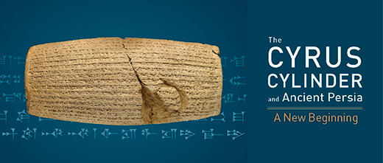
Of course, Iran has had a long history in publishing books and newspapers among Middle East and Asian countries and nowadays Iranian cultural products like cinema have achieved global success.

Slide 21
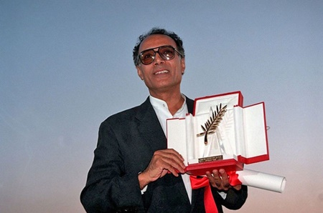
Abbas Kiarostami

Slide 22
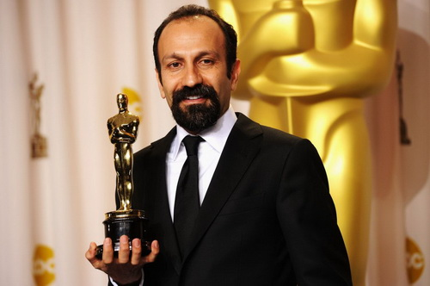
Asghar Farhadi

Slide 23
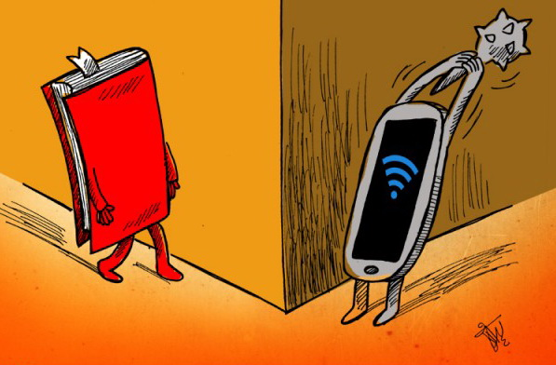
محل تصویر شما
In such an indigenous and global situation, for better activity in social media there factors to be adhered:

Slide 24
1. It used to be said that books will be replaced by television, and at the time of internet development we heard about such beliefs. But it is proved that social networks are complementary opportunity for books.
Producing theme and data is due to official Media but social networks are reproducing them.
So editors should keep their communication with media and journalism.

Slide 25
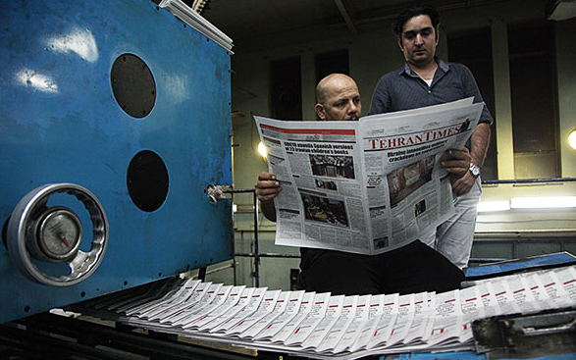

Slide 26
2. Semi – traditional tools for advertising like email marketing has its own role. Editors should remind their colleagues to consider the importance of Email marketing and media.

Slide 27
3-1. Editors should manage their activity in social networks as follows:
Social networks can be used to vote for books to be published; from comments and posts, we can recognize the choice of readers.
In addition, we can find out audiences need which kind of books; Editors should also notice the choice of audience, but should go beyond them to raise their knowledge and choice.

Slide 28
3-2. editors should not cling to direct advertizing, because direct advertising could not be more successful.
Even in official pages of publishing companies, indirect advertisement works better.
Editors can encourage their colleagues to
participate in special dialogue in different
pages. This is a good strategy for reflecting
our identity to attract
audience to our company.

Slide 29
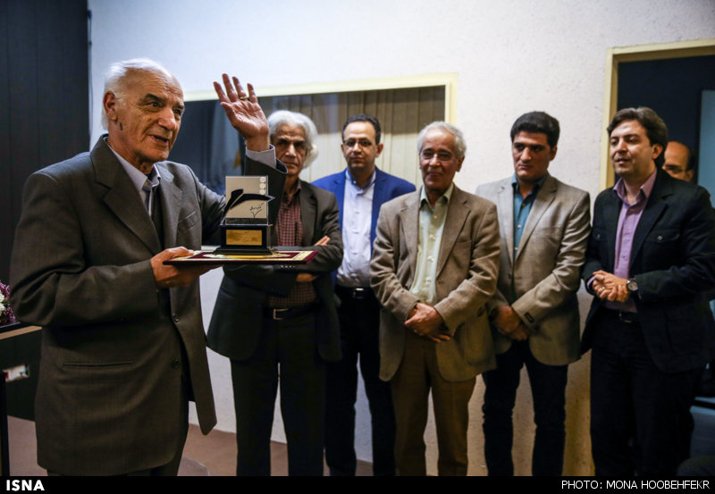
Another way is to produce data from making literary awards, cultural seminars and…

Slide 30
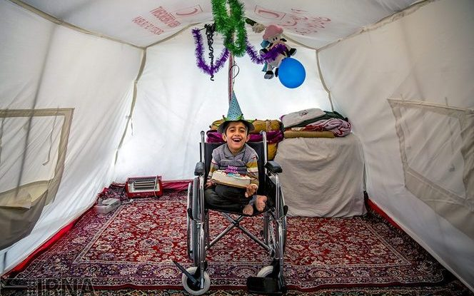
… charity activities.

Slide 31
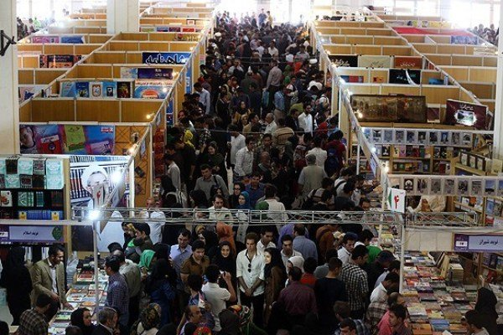
The other useful way is to form social network groups in each province to find out the choice of each region in order to publish and marketing books.

Slide 32
Thank you
bahrami@aradman.ir
aradman.pub@gmail.com

