Slide 1
2017 Asian Publishers Fellowship How Publishers Manage Writers?
Kim, Tae Hee from Sakyejul

Slide 2
About Me
＊Sakyejul (2004.09. ~ )
: Chief of Planning and Editing Dept. & Executive Editor
＊Changbi (1997.09. ~ 2004.08)
: Editor (Picture Books, Children’s Books, Humanity Books)

Slide 3
About Sakyejul
Established as Humanity, Social Science Publishing Company in 1982
picture books, Children/Youth books, Humanity, etc.

Slide 4
About Sakyejul
Think of the meaning of growth
Contain the spirit of the times in the bowl of books
The proportion of Korean vs. Foreign published books is 7 vs. 3
1,300 published books until now
70 new books publishing every year

Slide 5
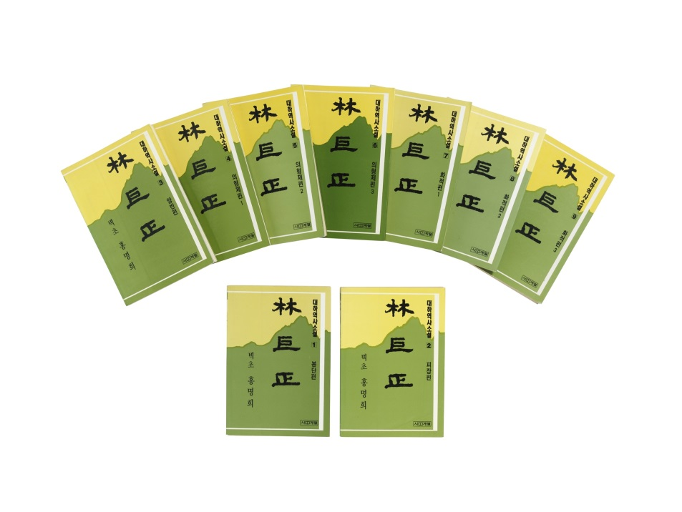
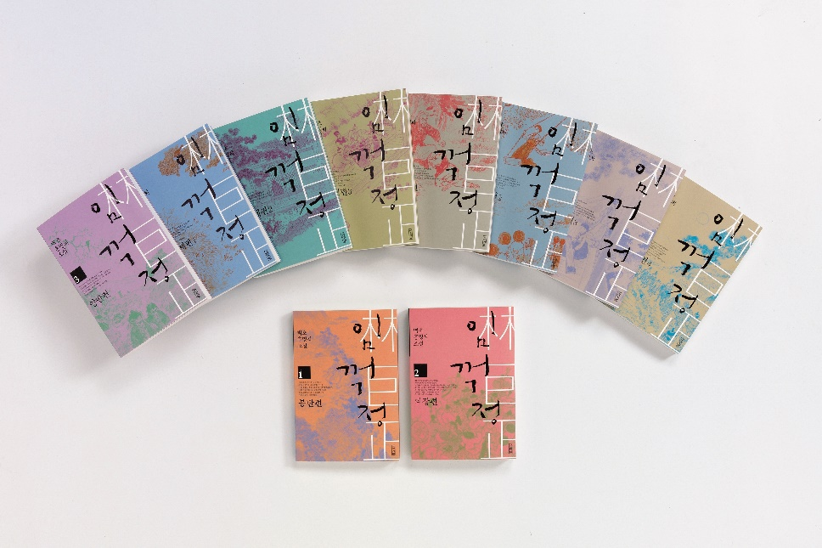
Major Books of Sakyejul
Lim, Kkeokjeong
1st publish in 1985
4th republish in 2008

Slide 6
Major Books of Sakyejul
The Hen Who Dreamed She Could Fly (2000)
The Museum of Everyday Life of Korean History (Total 12 Volumes, 2004)

Slide 7
Major Books of Sakyejul
Atlas series (Total 5 Volumes, 2004~2016)
The Series of Job & People
(Total 20 Volumes, 2010~2016)

Slide 8
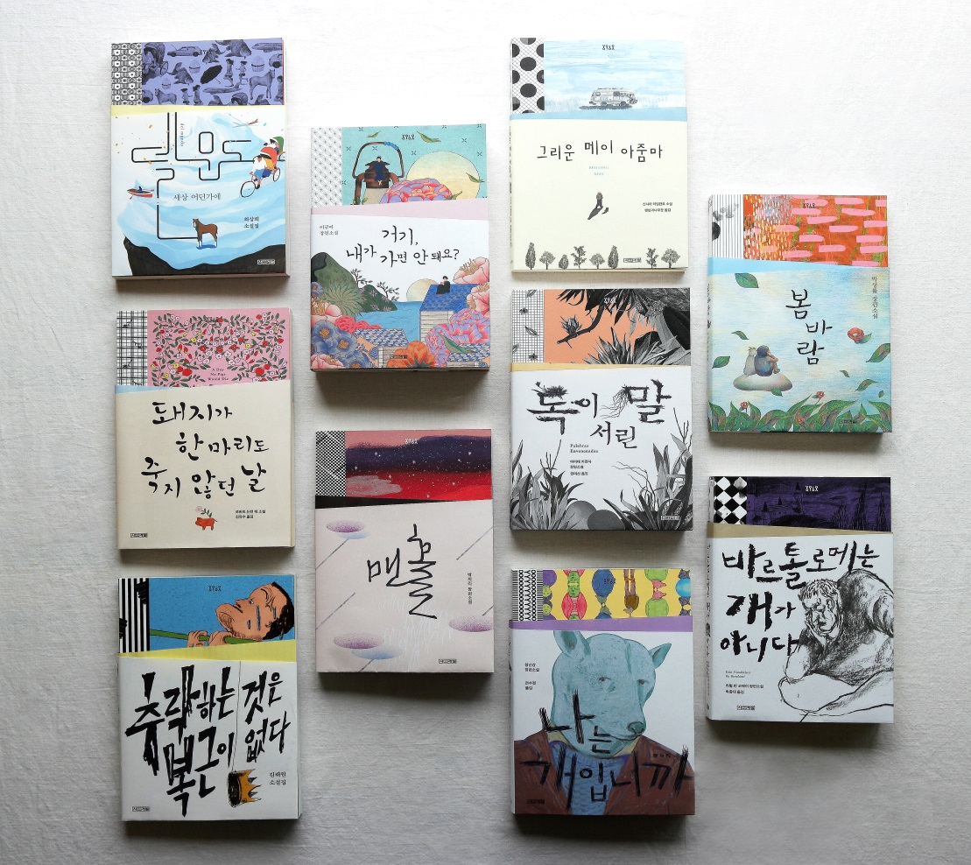
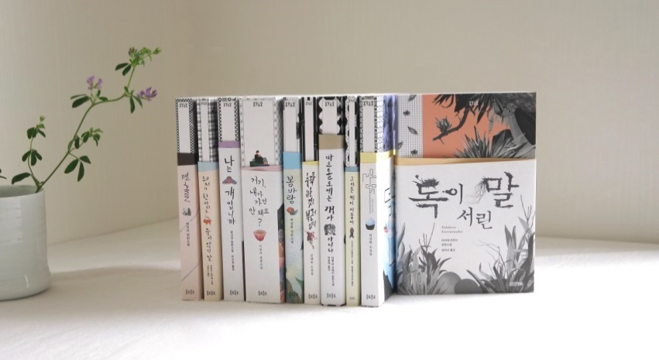
Major Books of Sakyejul
The Series of Yolo Yolo (Total 10 Volumes, 2017)

Slide 9
Relationship Change between Publisher & Writer: How Editors Manage Writers?

Slide 10
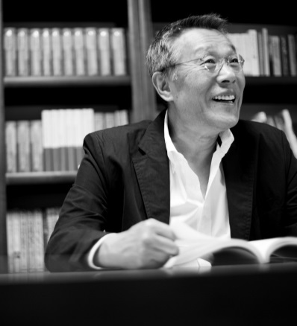
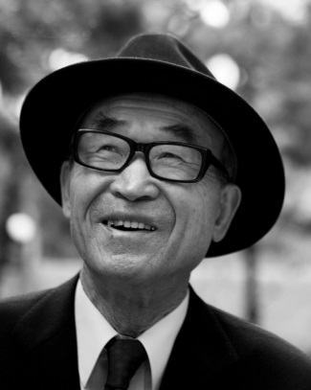
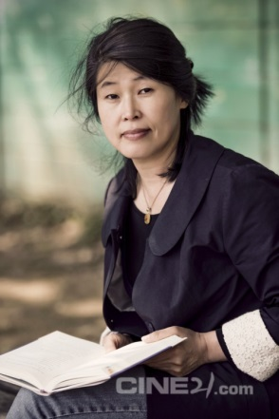
From Friend to Partner
1980s, 1990s – Comrade relationship
Fighting back the military dictatorship
Creating books containing the passion to democracy
Hwang Seok Young
Go Eun
Gong Seon Ok

Slide 11
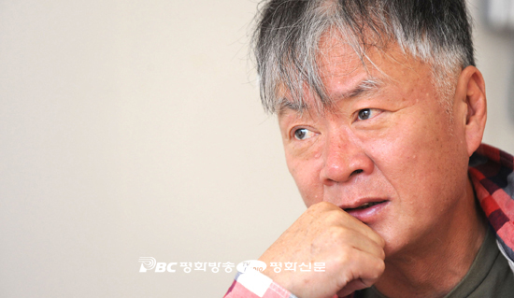
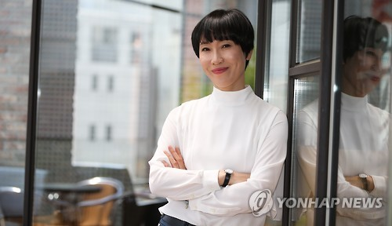
From Friend to Partner
Since 2000s – Brand Value
Focusing on the number of sold books
Boosting up author’s brand values
Kim Hoon
Kim Yeon Su
Jung Yu Jung

Slide 12
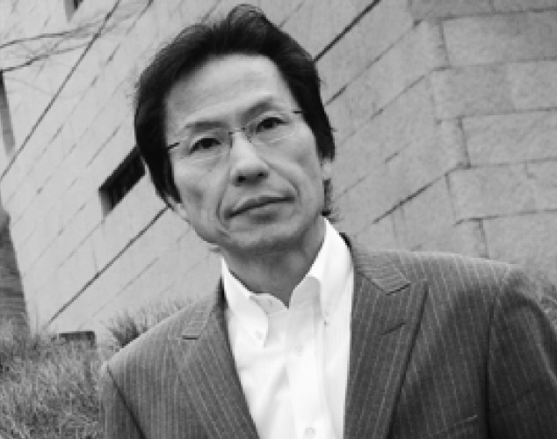
Writer Management of Sakyejul
Humanity
Kang, Sang Joong 姜尙中
( 2nd generation of Korean Resident in Japan,
Critical intellectual in Japan)
- Books: <How to Work Protecting Myself>, <Power going through the Times of Evil>, <An art museum of Salvation>, <Power of Consideration>, <Reason to Live>, <Power of Heart>, <Walkers in Tokyo>, etc.

Slide 13
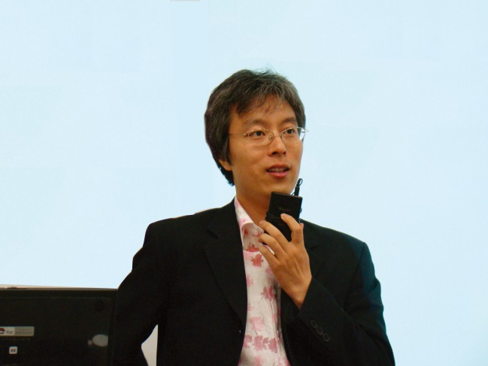
Writer Management of Sakyejul
Youth General
Lee, Nam Seok
(Psychologist)
- Books: <It’s OK to be crooked sometimes>, <It’s OK to do anything you want>, <Can I ask what love is?>, <Is violence necessary?>, <Self-entertaining Theme Park>, etc.

Slide 14
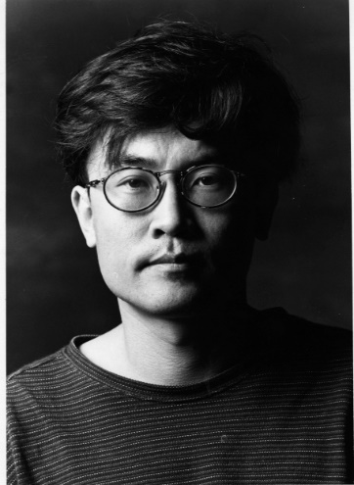
Writer Management of Sakyejul
Children’s Books
Wee, Gi Cheol
(Children’s book writer, novel writer)
- Books: <The story from Life>, <The day when a sleeping grandpa wakes up>, <A crocodile living in shoes>, <A green cat>, <My dad, The giant in the woods>, <Nice to meet you, Logic> ( Three Volumes), etc.

Slide 15
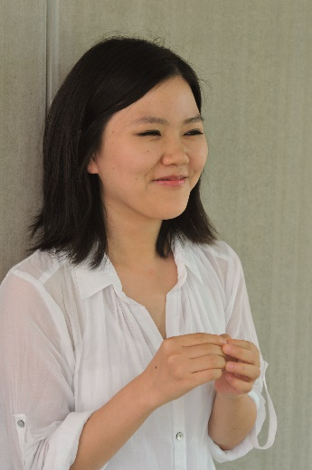
Writer Management of Sakyejul
Youth Novel and General Novel
Park, Ji Ri
(novel writer)
- Books: <Union>, <Manhole>, <Field trip to College of Yangchoondan>, <Seventeen Seventeen>, <The origin of evil by Darwin Young>

Slide 16
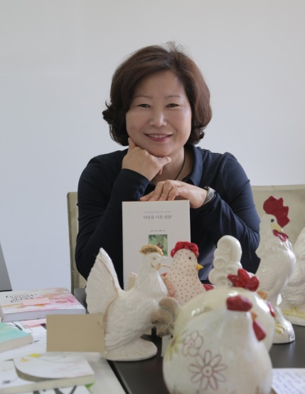
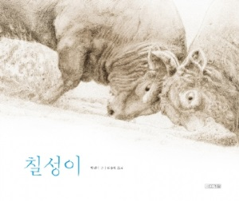
Writer Management of Sakyejul
Children and Youth Literature
Hwang, Seon Mi
(Children’s book writer)
- Books: <The Hen Who Dreamed She Could Fly>, <Take the orchard>, <Ggeokdari House where the wind lives>, <A Trouble lives in my backyard>, <Chil Sung>, etc.

Slide 17
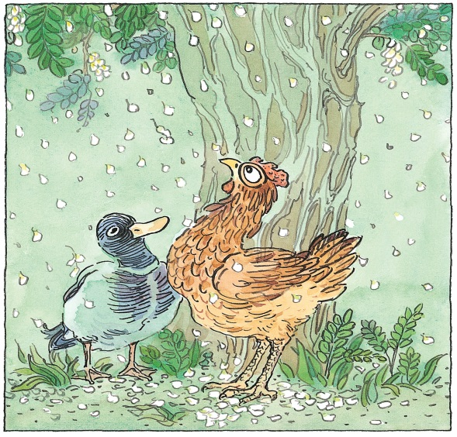
Hwang, Seon Mi / The Hen Who Dreamed She Could Fly
Published in May, 2000 (Illustrated by Kim, Hwan Young)
Published hardcover for adults in Dec, 2000

Slide 18
Hwang, Seon Mi / The Hen Who Dreamed She Could Fly
Hosted the essay competition nationwide for the title
Produced play, musical, and movie
animation
play
musical
Movie animation

Slide 19
Hwang, Seon Mi / The Hen Who Dreamed She Could Fly
Hosted a concert for readers, commemorating the anniversary of million-selling record
Publisher managed the exhibition of original illustration, and lecture of the writer

Slide 20
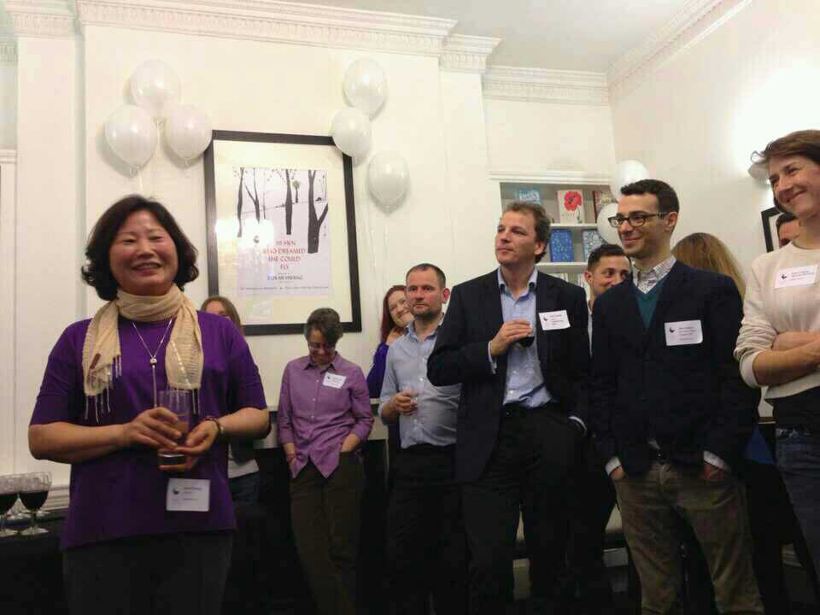
Hwang, Seon Mi / The Hen Who Dreamed She Could Fly
-Amazon Book of this Month (USA)
-the Book of this Year, Top 10 Best-sellers of Independent Publishers (UK)
-the Best Children’s Book of 2013(Poland)

Slide 21
Hwang, Seon Mi / The Hen Who Dreamed She Could Fly
Exported to 39 overseas countries, including Penguin Books in US
Greece
Japan
Brazil
Hungary
Thailand
Czech
Mongolia
Taiwan
China
England
Indonesia

Slide 22
Publishing Ability for Writer Management
Traditional Role of Publisher: 1st reader, a fan who knows, understands, and cares the writer, a person who is good at publishing the script of the writer into a book
Organized and Systematic Management: Need the company’s efforts to boost up the writer brand value in combination with money
Editors have to be a ‘Manager’, who actively manages the schedule, foreign publication rights, the second copyrights, selling and promotion

Slide 23
Thank you www.sakyejul.net

