Slide 1
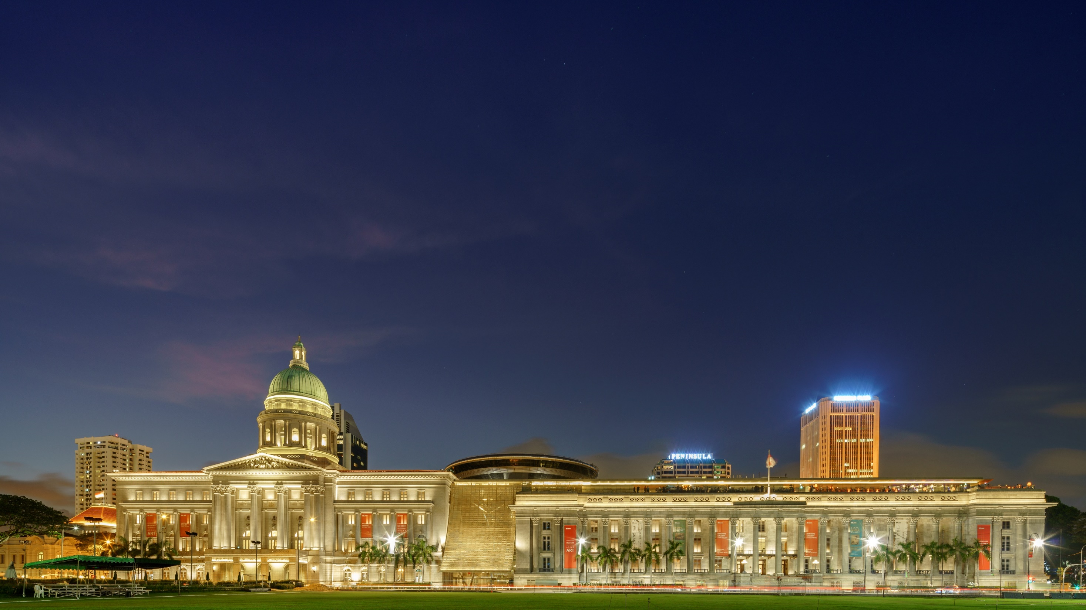
THE SINGAPORE BOOK MARKET
National Gallery Singapore

Slide 2
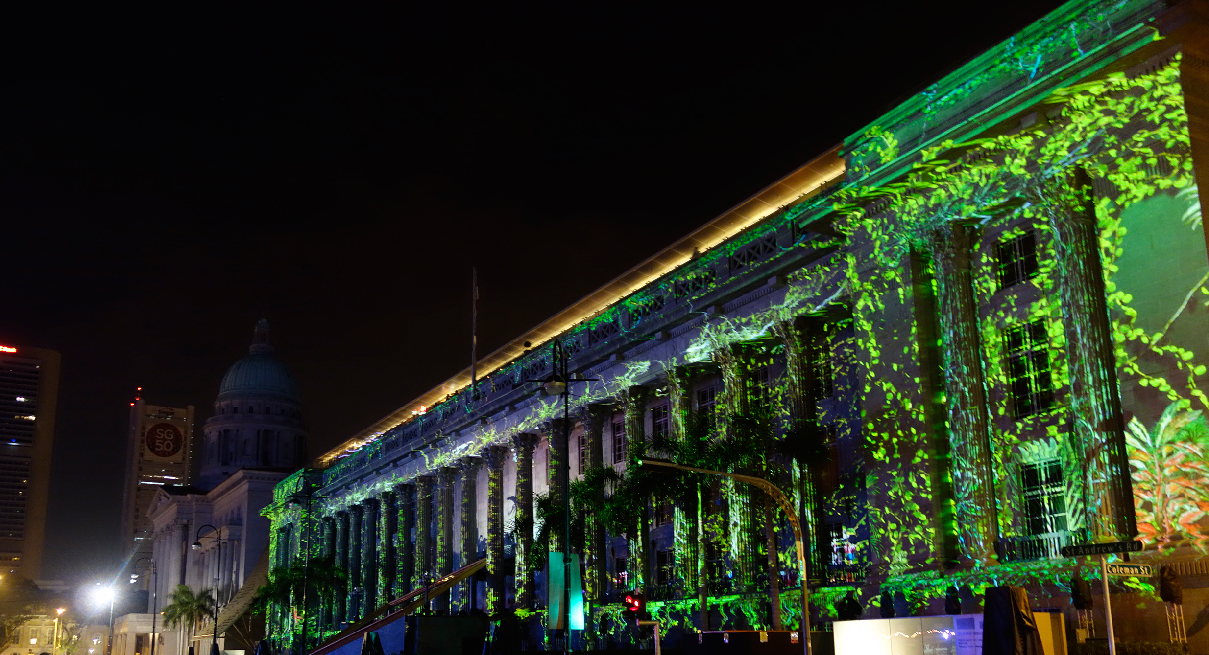
National Gallery Singapore Opens 24 Nov 2015
Notes:
Building history traces the buildings’ architectural and spatial histories, and their connections to the multiple historical events and memories associated with the buildings.

Slide 3
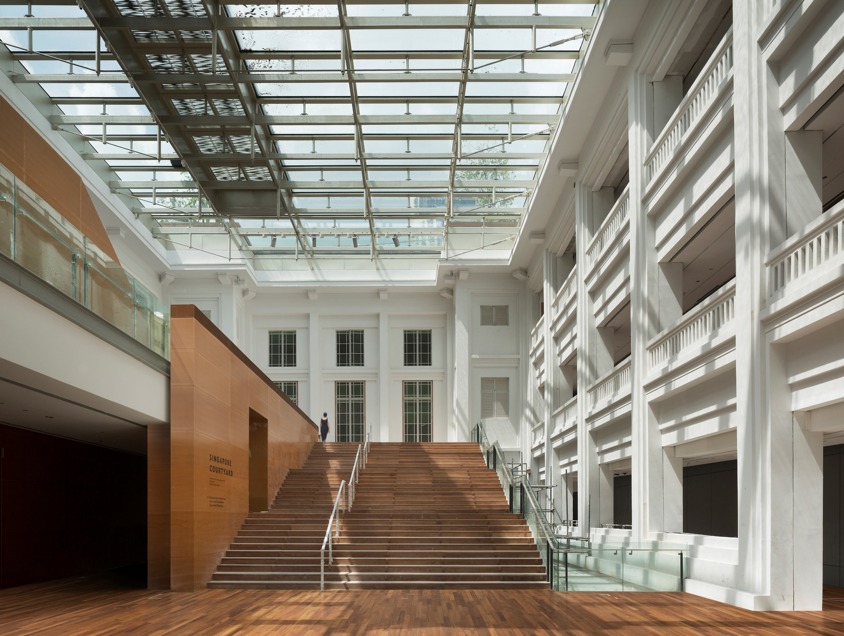
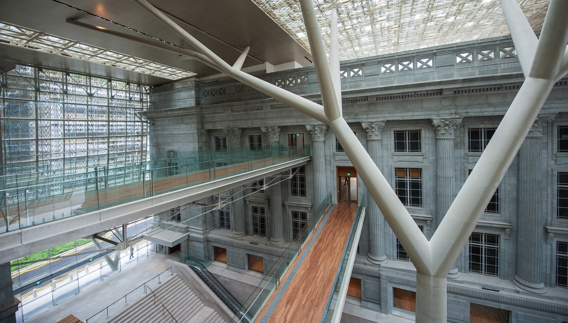
WHAT MAKES US SPECIAL
The Art
World’s largest public display of modern Southeast Asian art
Over 10,000 art pieces in our national collection with about 1,000 works on display at any one time
The first dedicated art education centre in the region
Housed in two iconic historical buildings
Innovative programming
Unique merchandise and F&B offerings
The Experience

Slide 4
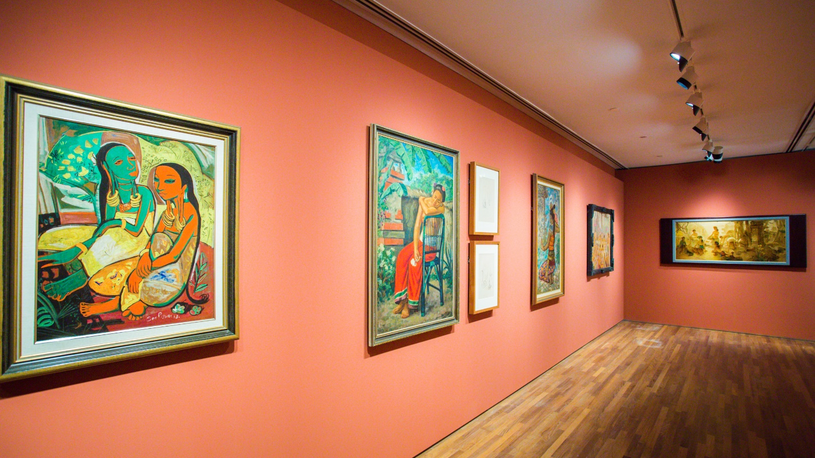
DBS Singapore Gallery presents: Siapa Nama Kamu?
ART IN SINGAPORE SINCE THE 19TH CENTURY
The Singapore Gallery aims to give its visitors a critical understanding and appreciation of Singapore art, its development and links with Southeast Asia, Asia and the world.
Notes:
Upon arrival at Level 2, visitors will have their first encounter with site specific artwork installed at the Singapore Courtyard which is also the main programing space leading into the Singapore Gallery.
When National Gallery opens its door to the public in Nov 2015, our Singapore and Southeast Asia Collection will be the inaugural exhibitions.
Siapa Nama Kamu?
Art in Singapore since the 19th Century
The most endearing fact about Singapore is her location: set in a vast archipelago of island neighbours, she raises questions of scale and proportion whenever she is contemplated. Geographically, she appears dwarfed by the immensity of her surroundings, leading her sea-locked inhabitants to constantly look outwards to the world at large. Yet her position in the world belies her physical size.
This exhibition examines how artists in Singapore have grappled with similar issues since the 19th century, when much of Southeast Asia was under European colonial rule. With diverse values and systems coming into close contact with the region’s existing beliefs and social structures, the 19th century represents a break with what came before. It also marks the beginning of the modern condition and the rise of modern art in Southeast Asia and Singapore.
In Malay, “Siapa Nama Kamu?” means “What is your name?” This question is taken from National Language Class, a painting that hung on the walls of City Hall in the 1960s, where the Ministry of Culture was located. It was painted in 1959, the year Singapore gained self-governance from the British, and came to resonate with that historical change.
The display of about 400 works drawn from the National Collection and other sources provides a way to understand the history of Singapore art. Each artwork taken individually provides insights into why and how an artist responded to his surroundings and circumstances. Taken as a whole, the wide range of artworks reflects the complexities involved in telling this story.
Siapa Nama Kamu? is then a question and an invitation—to consider how art can operate as a mirror to but also complicate our reality.
The DBS Singapore Gallery is made possible through a gift by DBS.

Slide 5
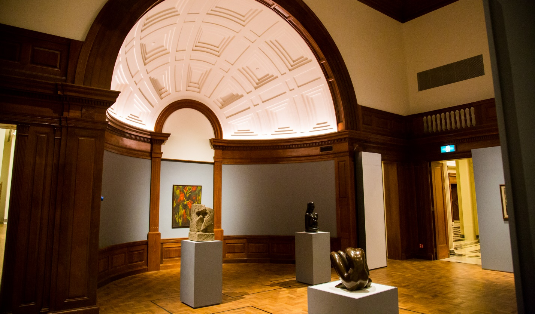
UOB Southeast Asia Gallery presents: Between Declarations and Dreams
ART OF SOUTHEAST ASIA SINCE THE 19TH CENTURY
A regional narrative of modern art in Southeast Asia from the 19th century to the present.
To give a sense of richness and diversity in Southeast Asia through shared historical experiences, highlighting the key impulses to art making across the region.
Notes:
This double volume foyer will feature artworks from leading SEA artists that excite visitors to discover the history of art from SEA. With a working title “SEA art – Regional perspective”, the SEA collection will also form the inaugural exhibition presented at the National Gallery.

Slide 6
11 Changing Exhibitions since Nov 2015
Wu Guanzhong: Beauty Beyond Form (Nov 2016-Sep 2017)
Chua Ek Kay: After the Rain (Nov 2015-Oct 2016)
Earthwork 1979 (Jan-May 2016)
A Fact Has No Appearance: Art Beyond the Object (Jan-Jun 2016)
Reframing Modernism (Mar-Jul 2016)
Iskandar Jalil: Kembara Tanah Liat (Sep 2016-Feb 2017)
Artist and Empire: (En)countering Colonial Legacies (Oct 2016-Mar 2017)
Wu Guanzhong: A Walk Through Nature (Dec 2016-Dec 2017)
Strokes of Life: The Art of Chen Chong Swee (Mar-Dec 2017)
Rediscovering Treasures: Ink Art from the Xiu Hai Lou Collection (Mar-Dec 2017)
YAYOI KUSAMA: Life is the Heart of a Rainbow (Jun-Sep 2017)

Slide 7
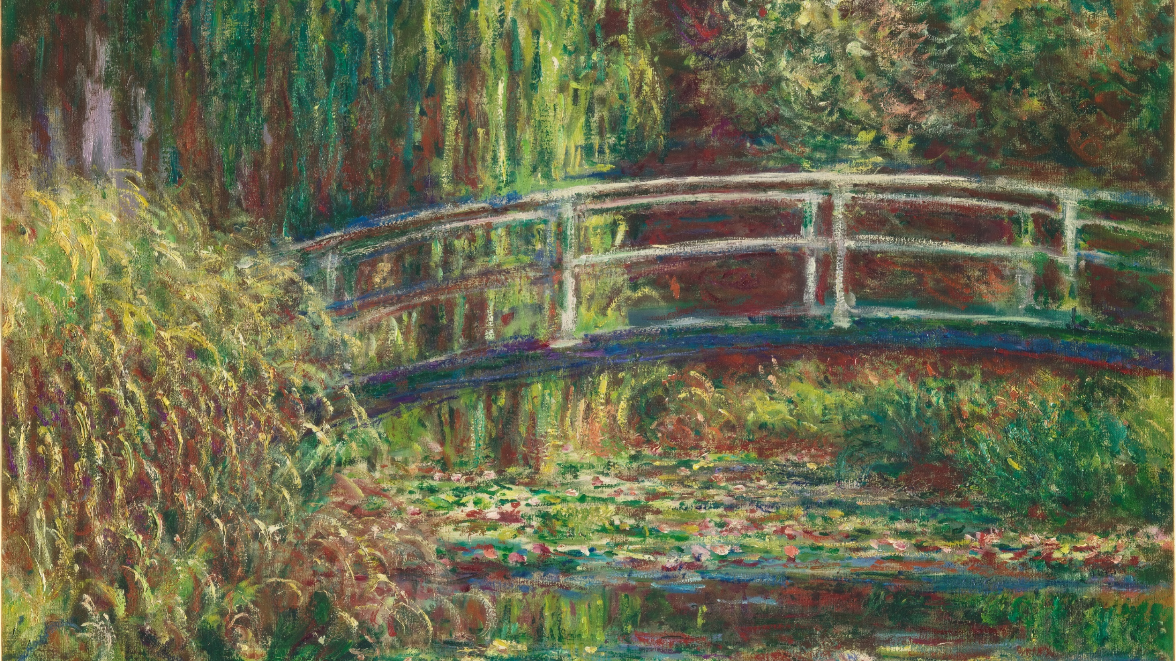
Opening in Nov 2018 Colours of Impressionism: Masterpieces from the Musée d'Orsay

Slide 8
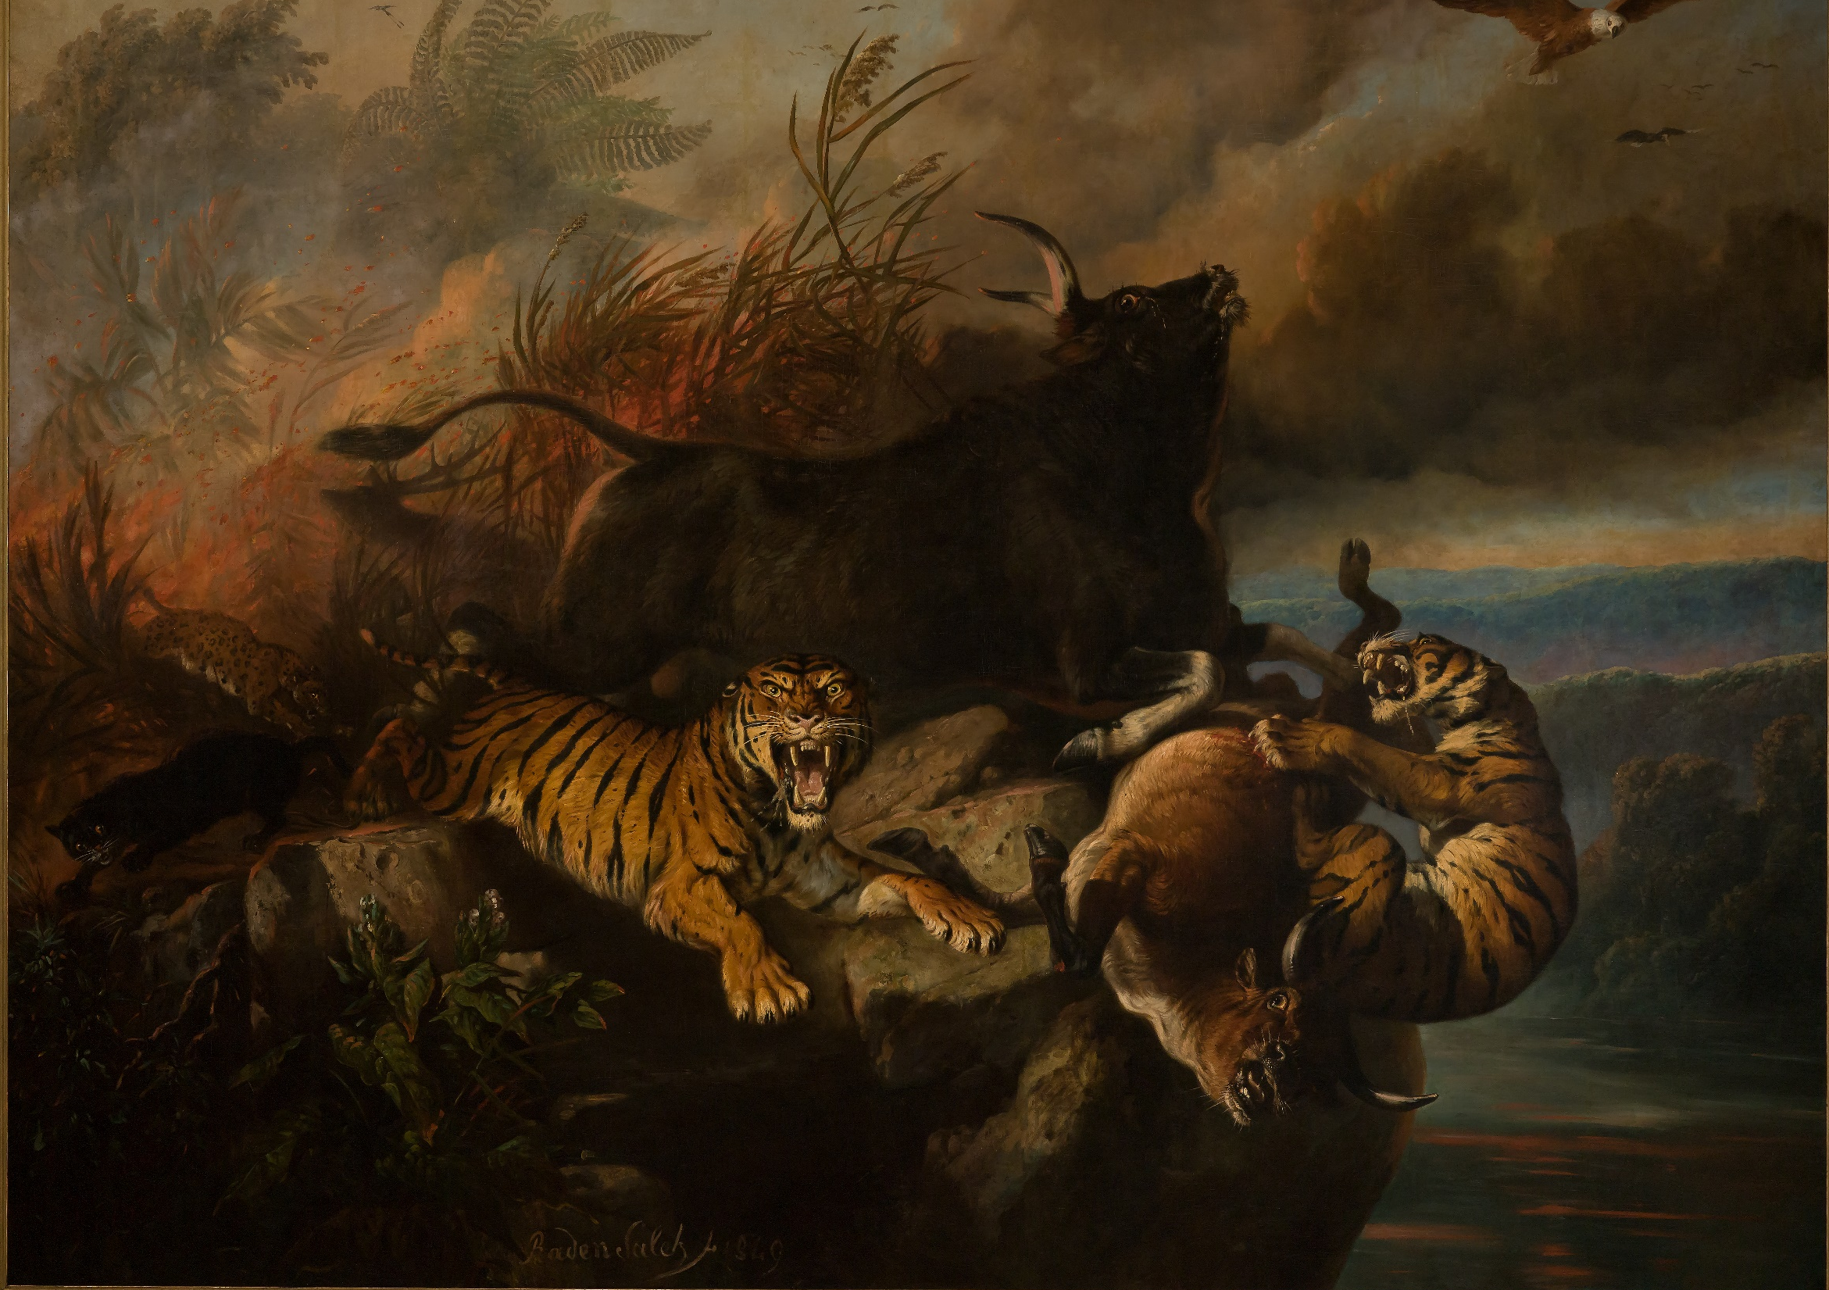
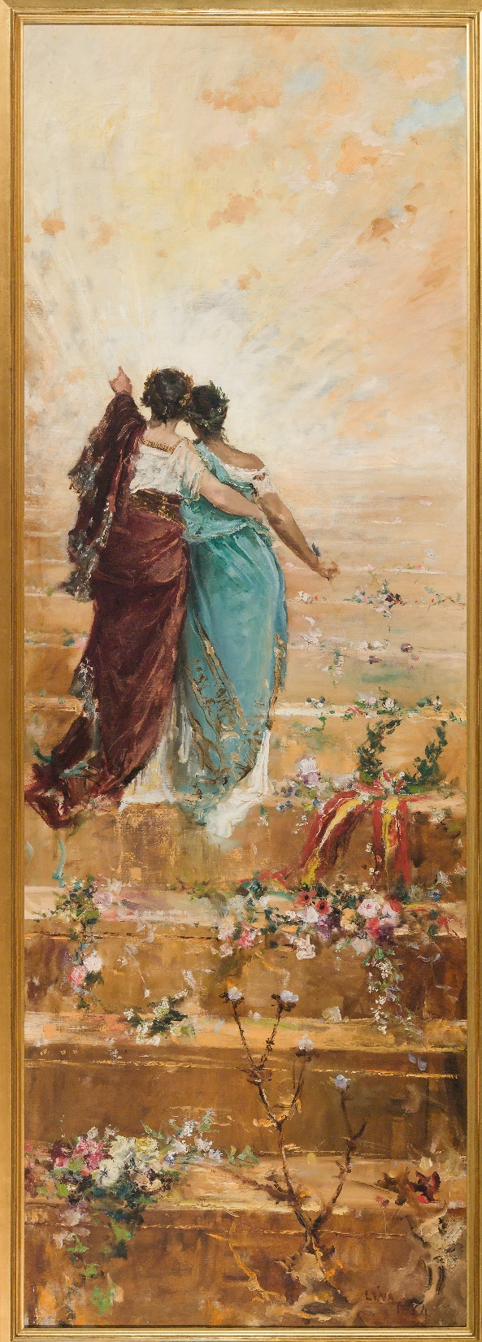
Opening in Nov 2018 Between Worlds: Raden Saleh and Juan Luna

Slide 9
Children’s Biennale 2017

Slide 10
Light to Night 2016 & 2017

Slide 11
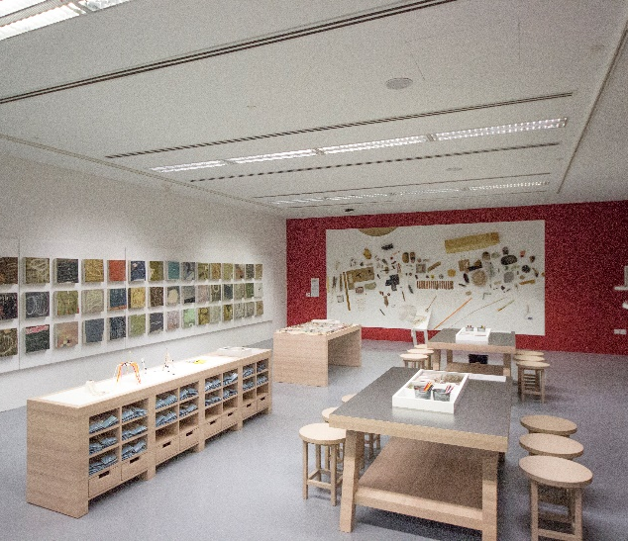
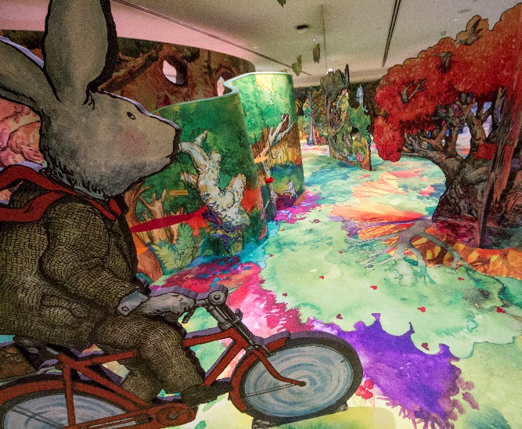
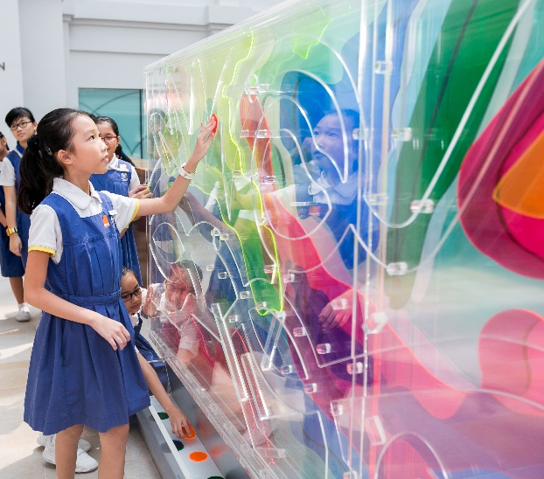
KEPPEL CENTRE FOR ART EDUCATION
Cultivate a generation of critical thinkers through Art Programmes
PROJECT GALLERY
CHILDREN’S MUSEUM
ART PLAYSCAPE
ART CORRIDOR
Features collaborative and cutting-edge works
Develops creative processes and critical thinking skills
A multi-sensorial environment to learn and play in
Touch Art programme to engage young audiences and the visually impaired

Slide 12
Publications
35 titles to date
About 10 new titles a year
Highly illustrated art books
Exhibition catalogues
Scholarly titles
General titles
Children’s books
Average print run 1,500 copies
Distribution is via our museum shop, local and international distributors

Slide 13
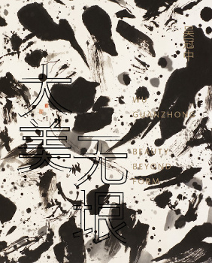
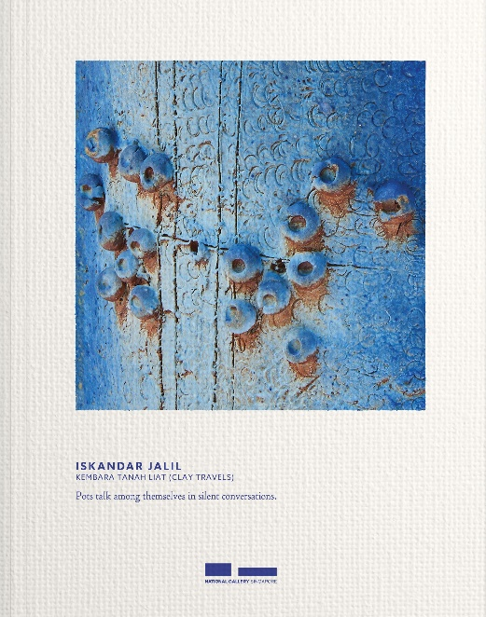
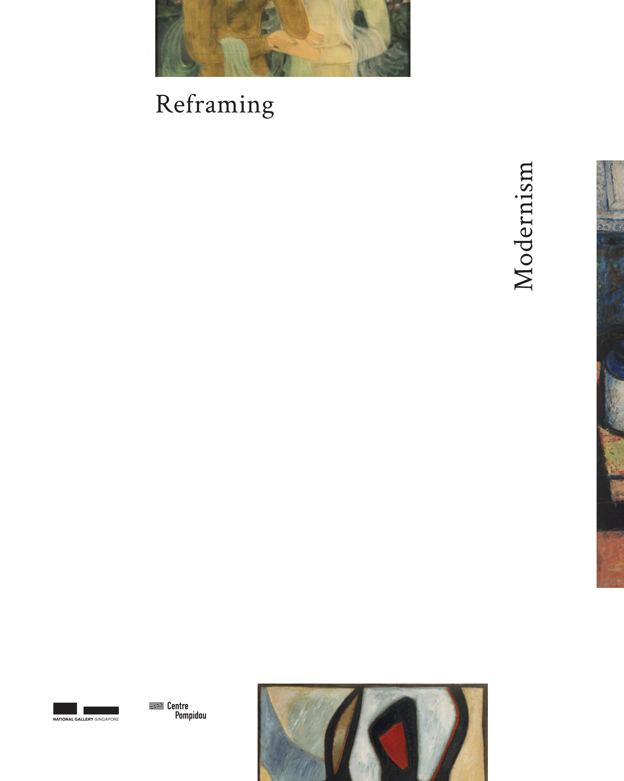
Exhibition catalogues

Slide 14
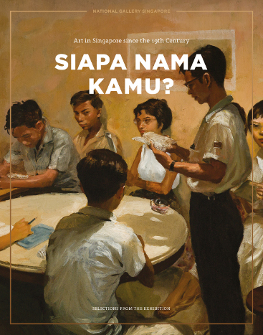
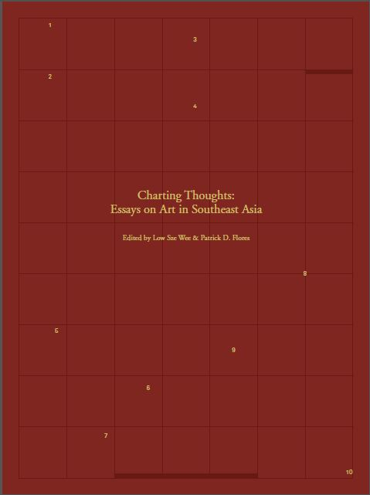
Scholarly and general titles

Slide 15
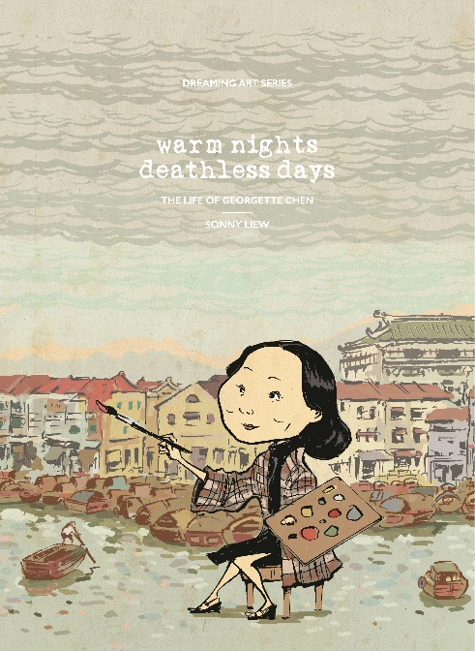
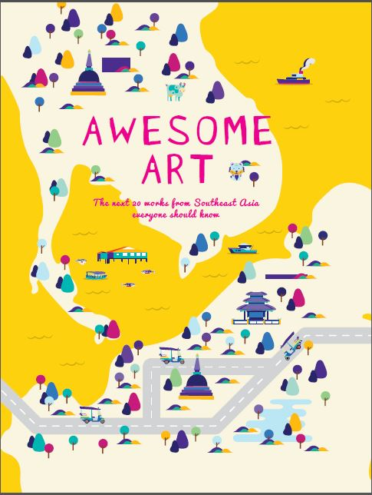
Children’s titles

Slide 16
THE SINGAPORE BOOK MARKET

Slide 17
Singapore’s Book Market
Singapore is building a knowledge-based economy and its globally competitive publishing industry support that.
Singapore Book Publishers Association has 67 members.
23 children’s publishers
8 also publish for young adults
18 education publishers

Slide 19
Market Comparison
Singapore’s media and entertainment market is identified as “higher growth and smaller scale” by PWC’s outlook through 2018.
COUNTRY | PUBLISHERS’ NET REV (MILLION EUR) | MARKET VALUE (MILLION EUR)
India | - | 1,680
Indonesia | 415 (growing at 16%/annum) | -
Thailand | 414 | 528
Malaysia | 263 | -
Singapore | 337 | 230

Slide 20
Source: McKinsey & Co.
Notes:
The number of ASEAN households in the consuming class is expected to double by 2030.

Slide 22
30% decline from the $210 spent in 2007/2008
Household Expenditure Survey 2012/2013

Slide 23
Reading Habits
95%
56%
physical books
libraries
23%
online
41%
53%
69%
of people read at least 1 book in 12 mths
e-books
bookshops
“I find reading relaxing and enjoyable.”
“I prefer using the Internet, watching TV.”
54%
The Internet and computers will replace books in 20 years*
22%
don’t read*
Source: National Reading Survey 2016, 3,515 respondents
*Source: National Arts Council Reading & Writing Survey 2015
1,024 respondents

Slide 24
Source: National Arts Council Reading & Writing Survey 2015
444 respondents

Slide 25
Copyright
Singapore’s Copyright Act (1987)
Revised in 2004 for SG-US FTA to include American-style open-ended, fair use
Review announced in 2016 to take into account new ways of “creating, distributing, accessing and using content.”:
Exemptions for: text and data mining, educational use, libraries, archives, museums, galleries
Factors used in determining “fair use”
Copyright registry?
Clarifying ownership of commissioned works
Orphan works
Copyright in Singapore is acknowledged and respected, but inconsistently enforced.
Draft of new Act to be submitted to Parliament in late 2018 after extensive public consultation
https://www.mlaw.gov.sg/CopyrightReview
Notes:
Our Board and Chairman of the Board Executive Committee has approved our mission statement in 2012. This was also presented to both PS and SMS.
The mission statement, when de-constructed into its core components emphases:
The presentation and research of our collection
Communicating the way we present our works to Singaporean, residents and visitors
Our collaborative role in working with scholars, collectors and art institutions in the region
Placing Singapore and SEA VA in a global context by creating dialogues between artworks of global artists and the region

Slide 26
Challenges
COMMON | SINGAPORE
Making space and time for reading in a world of mobile media and clickstream addiction | Dealing with a small domestic market and the need to scale
Guarding and building more respect for copyright | Overcoming structural, historical and cultural impediments to valuing local cultural production
Protecting bookshops without skewing the market

Slide 27
Responses
NATIONAL READING MOVEMENT to promote reading and book culture in Singapore
#BUYSINGLIT promotion and campaign to recognise the importance of bookshops as cultural assets and stress the importance of owning books for life-long learning
INTERNATIONALISATION for local publishers, to continue momentum and build regional platform for publishing cooperation
BUILD SINGAPORE AS A HUB for international publishing businesses
ENGAGING WITH STAKEHOLDERS via Singapore Book Publishers’ Association

Slide 28
NATIONAL READING MOVEMENT
Read Fest 2017
150 events in 4 languages
Book clubs
Storytelling
Film pairings
Literary walks
Workshops, readings, performances
National Reading Day
Special programming for children and teens
http://www.nationalreadingmovement.sg/
In 2016, the National Reading Movement received 430,632 pledges from people to read more, read widely and read together.
Notes:
Our Board and Chairman of the Board Executive Committee has approved our mission statement in 2012. This was also presented to both PS and SMS.
The mission statement, when de-constructed into its core components emphases:
The presentation and research of our collection
Communicating the way we present our works to Singaporean, residents and visitors
Our collaborative role in working with scholars, collectors and art institutions in the region
Placing Singapore and SEA VA in a global context by creating dialogues between artworks of global artists and the region

Slide 29
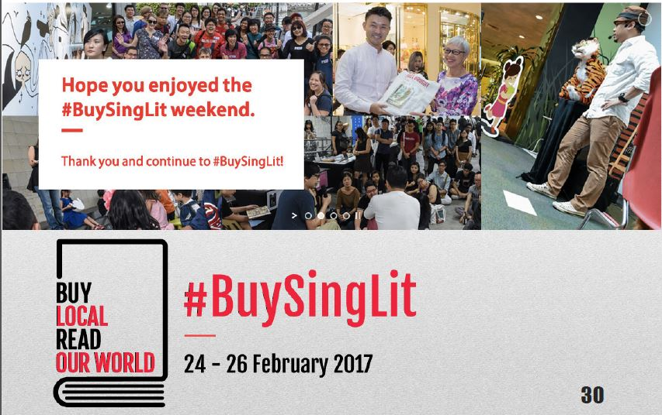

Slide 30
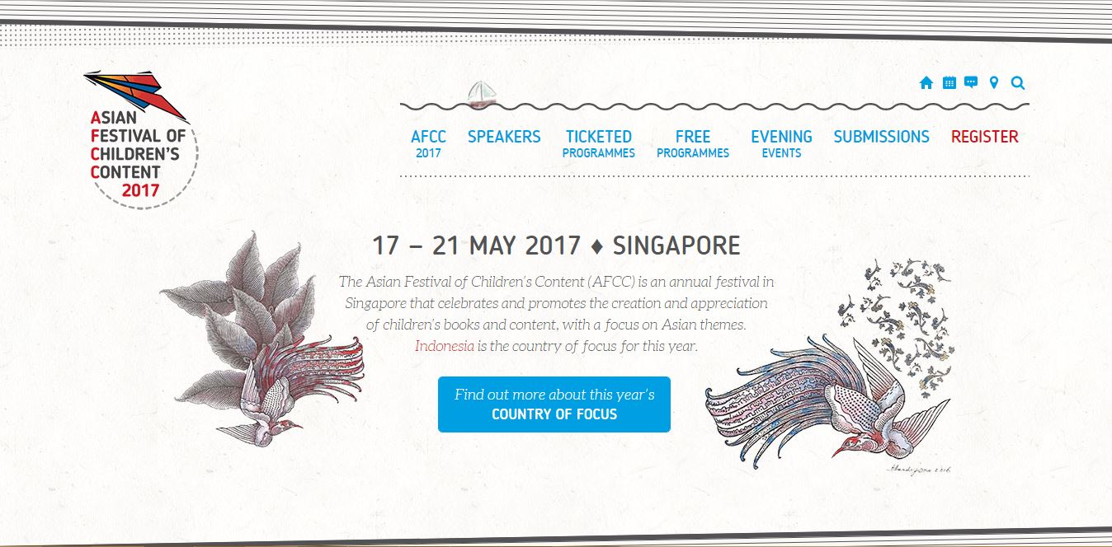

Slide 31
Managing Writers
Communicate effectively
Choosing your author
Relationship with your authors
Developing a clear brief
Manage your project

Slide 32
Choosing your author
Area of expertise
Profile: Will they lend prestige to your publication? Do they help position your brand?
Past writing
Temperament and character (calm, sensitive, reliable, disorganised, collaborative, solitary)
What fee do they command?
Are they a professional writer or not? This shapes how you handle them. Authors who are not professional writers might need more guidance from you.

Slide 33
Developing a clear brief
What is the topic to be covered?
Who is the audience? What tone do you want?
What materials should the author provide: images?
Who is responsible for clearing image copyright?
Word count
Deadline
Fee
Who has copyright of the manuscript?
Special terms, e.g. complimentary copies, discounts, kill fee

Slide 34
Communicate effectively
Be pro-active
Be positive and firm: encourage and support your authors, but be clear about the expectations and deliverables
Be clear about edits: what you want to achieve, how much more the author needs to do
Be open: talk to your author about what they are trying to convey
The better you and your author understand each other, the more likely you will succeed together

Slide 35
Manage your project
Know your project schedule and budget
Meet your own deadlines
Pay promptly

Slide 36
Thank you

