Slide 1
Ivy Jin Rights Manager jieli publishing house co ltd.
KOPUS Asian Publishers Fellowship Program 2017

Slide 2
Index
Introduction
How to manage writers
Conflict
Resolution
Chinese Book Market

Slide 3
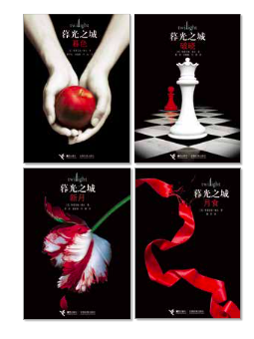
Introduction
Self-Introduction
Rights Manager
Main Responsibility: International Rights Cooperation
Main Project:

Slide 4
Introduction
Company Introduction:
Jieli Publishing House
Founded in 1990
Specializing in children and adolescence literature
An average of nearly 500 books every year
To synchronize the readings of Chinese children and young adults with the world and to let the world get to know a wonderful China.

Slide 5
Partners
Usborne Publishing Ltd.
HarperCollins Publishers
Random House
Scholastic Co.
Simon & Schuster Inc
Penguin Books (UK)
DK
Thienemann (Germany)
Ravensburger Buchverlag (Germany)
Editions Gallimard (France)
Hachette (France)
Nathan (France)
Doshinsha (Japan)
Fukuinkan Shoten Publishers (Japan)
Kaiseisha (Japan) Kodansha (Japan)
Hong Kong Bliss Press Ltd.

Slide 6
Brands

Slide 7
Original Titles

Slide 8
How to manage writers
Main Differences:
Not only domestic Projects (international)
Not only direct Communication (indirect)
Not only writers (illustrator, agency)

Slide 9
Conflict
Differences
Different Culture
Different Business Model
Different Request

Slide 10
Resolution
THE ONLY WAY:
MORE COMMUNICATION AND UNDERSTANDING!
*When the authors visit your country*

Slide 11
Chinese Book Market
Statistics of 2016
17.25 Million Kinds in total
Over 210 thousand kinds of new books
Children’s Books: 23.51% of the whole market
Info from OpenBook

Slide 12
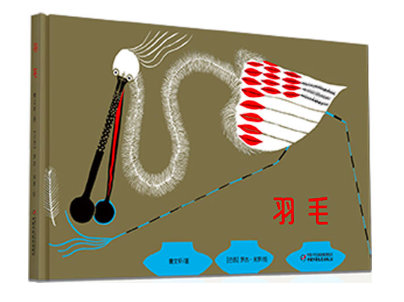
Main Trend
Different ways to cooperate, not only simply sell or buy copyrights.
Pay more attention to original titles.
More international projects.
Text by Chinese writer
Illustration by Brazilian Illustrator

Slide 13
Contact Me
Mail: ivy_jin@foxmail.com
Tel: 0086-10-65543067
QQ: 2037528366
Wechat: xianxian101

Slide 14
Thanks a lot !

