Slide 1
Hello!

Slide 2
www.nourabooks.co.id
Penerbit Noura Books
@NouraBooks
@nourabooks

Slide 3
Mizan was founded in 1983
Currently, Mizan publish more than 600 titles per year

Slide 4
Mizan Pustaka DAR! Bentang Pustaka Pelangi Mizan Al-Mizan Expose
Distributor
Mizan Media Utama (conventional)
Mandira Dian Semesta (direct selling)
Publisher
Printing House
Mizan Grafika Sarana
Noura Books
Production House
Mizan Productions
Digital Application Publisher
Mizan Applications Publisher

Slide 5
Publishing Division
General
Fiction (Classics, YA, Middle Grade)
Nonfiction (Traveling, Parenting, Memoir, Creative Thinking, Self-help, Leadership, Business and Management)
Children’s Book (picture book series, educational book)
Religion
Novels
Self-help
Memoirs
Reference

Slide 6
Our Best Selling Books

Slide 7
Local Fiction
Dahlan’s Smile
Dahlan’s Letter
Dahlan’s Shoes
Based on the true story of Indonesia ex-Minister
for State Owned Enterprises.

Slide 8
Indonesian Literary Masterpiece
Sukab’s World
The Bloomington People
The Forbidden Love of Flower

Slide 9
Translated Fiction
Will be a movie by this year

Slide 10
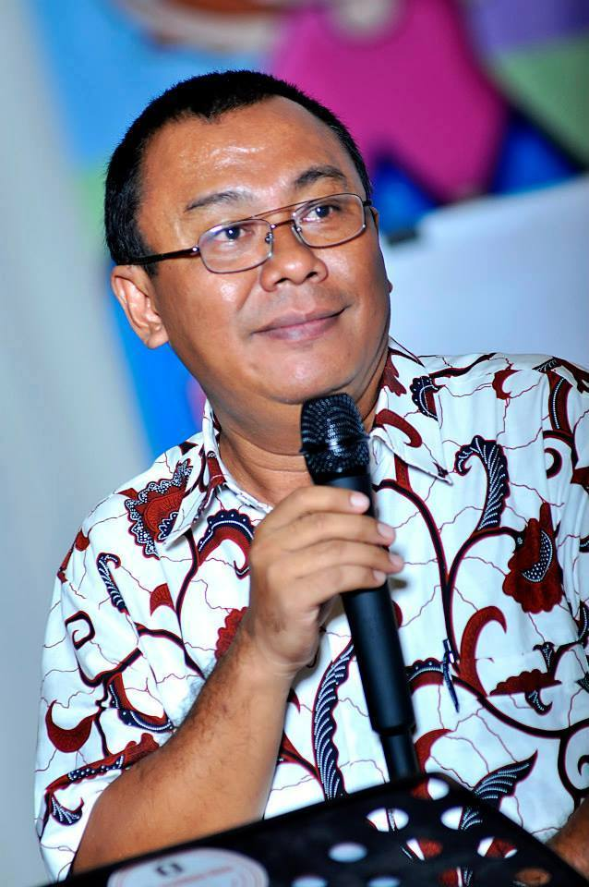
Parenting Series
Ayah Edy, Parenting Consultant
101 Ultimate Parenting Questions
Inspiring Parenting Stories
Answering Parents & Teens Problem

Slide 11
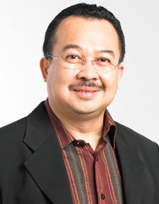
Leadership Series
How to be a leader for ourselves
Be a driver, not a passanger
Rhenald Kasali,
Indonesia’ Management Guru
30 Passports in The Professor Class
Stories of college students who do solo traveling in various countries and learn many things to survive

Slide 12
Creative Thinking

Slide 13
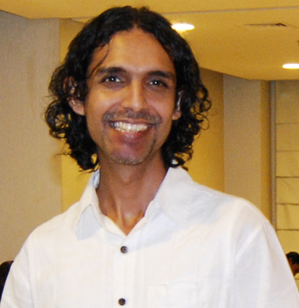
Self Improvement
Gobind Vashdev answers the source of the emptiness we often feel in our lives and gives a solution on how to find happiness inside us.

Slide 14
Children’s Health Series
Cican Have an Itchy Scalp
Cican Caught a Cold
Cican Have a Toothache

Slide 15
Children’s Self-help Series
Introducing good first words for children

Slide 16
A Cart of Stories Series
Popular fables retold with simplicity and
unique illustrations.
Provides children with open ended
questions that will enhance their
imagination and creativity.

Slide 17
Value Series
Told in rhymes with beautiful illustrations
Chosen as one of many beautiful illustration in The
Book Illustration Gallery at The Singapore Asian
Festival of Children’s Content 2013

Slide 18
Children’s Educational Book
Stimulates children on the main aspects of child development:
motoric, cognitive, language, and
social emotional.
The set consists of: books, board
game, Augmented Reality

Slide 19
Religion & Spiritual
Islam Q&A Series
God in a Cup of Coffee

Slide 20
New Trends in Nonfiction

Slide 21
National Bestselling Nonfiction

Slide 22
Self Improvement
How to think possitively

Slide 23
Woman nowadays: a leader at her field,
inspiring figure, a game changer
Written by Indonesia’s Ask.fm celeb
The author use Ask.fm as the medium for
researching on alpha female phenomenon

Slide 24
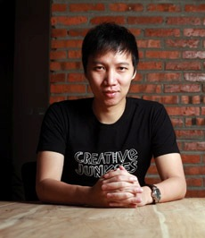
Creative Thinking
Yoris Sebastian, Indonesia’s creative consultant. He was notable as one of the youngest GM in the world.
Creative or Die!

Slide 26
Traveling
Adventures around the world in compilations of entertaining short stories
Written by Indonesia’s leading travel blogger
Inspired the young generation of Indonesians to expand their horizons
through travel
Soon to be a major motion picture

Slide 27
Quotes Book
The compilation of quotable text on many bestselling novels written by Indonesia’s famous author, Tere Liye
Inspiring quotes told in lovely design written by Diana Rikasari, Indonesia’s fashion blogger

Slide 28
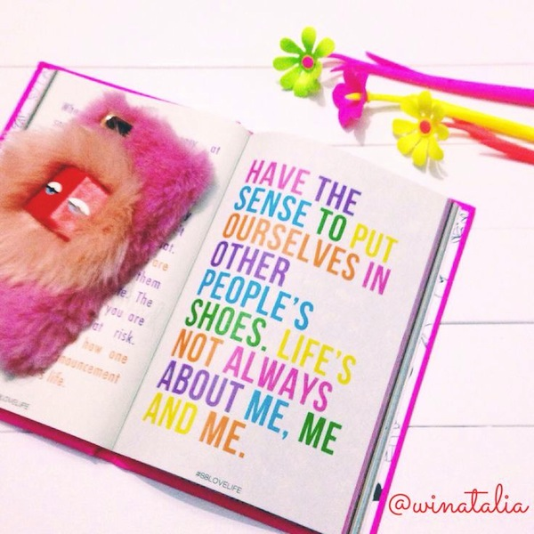

Slide 29
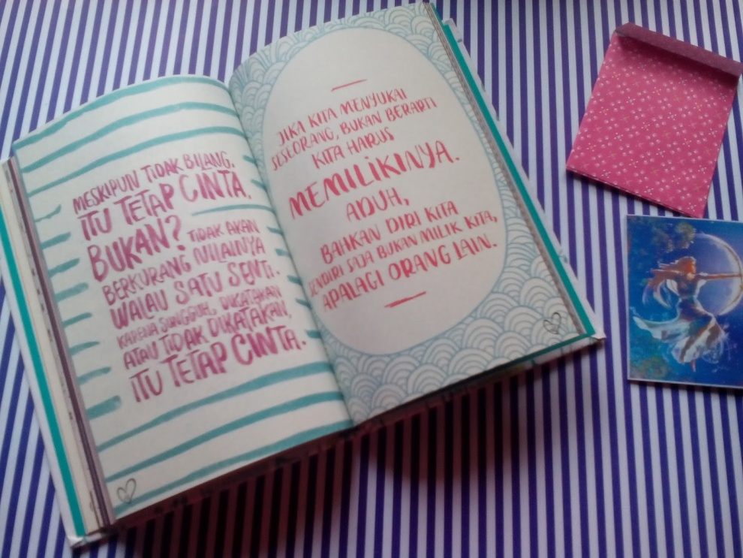

Slide 30
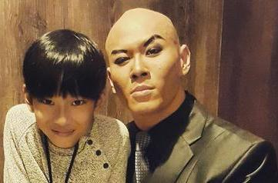
Graphic Diary
Daily stories of a kid on the idea “how a broken home kid can be a happy kid.”

Slide 31
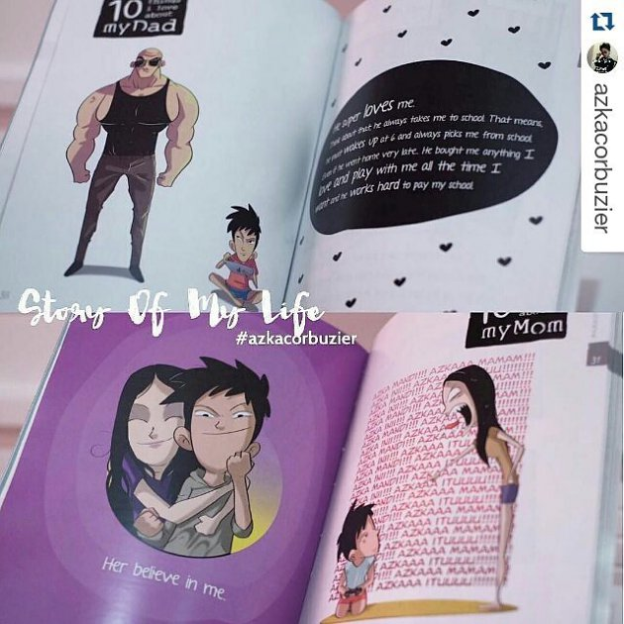
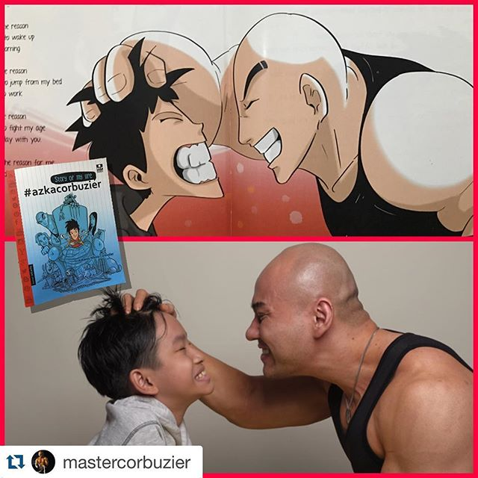

Slide 32
Popular Psychology
Personality traits based on the blood type told in comical ways

Slide 33
Movie tie-in
Memoirs of Indonesia’s
life-time inspiring engineer
Formerly did not sold well
As the movie adaptation came, the
sales increase many times over

Slide 34
What’s trending?
Social Media Friendly
Quotable Text
Social Media Celebs
Social Media Conversations
Eye-catching Design
Movie tie-in

Slide 35
Themes
Self Improvement
Creative Thinking & Entrepreneurship
Popular Psychology
Traveling

Slide 36
Thank you Terima kasih
Richanadia
halo.icha@gmail.com

