Slide 1
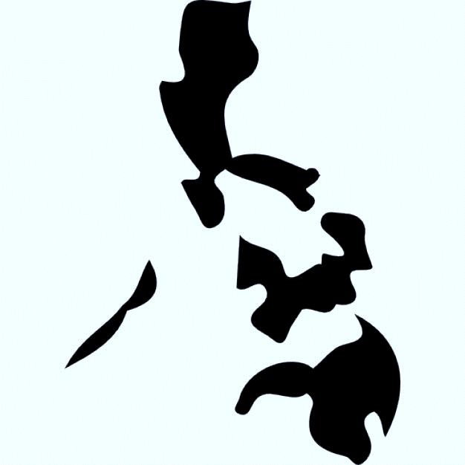
Publishing in the Philippines
Nonfiction
trend publishing
Presentation by
Annaleah (Ani) V. Habúlan
Anvil Publishing Inc.
Philippines
2016
Notes:
cover

Slide 2
1986: A Turning Point
Before 1986, the publishing industry was under an “umbrella of fear.” Writers were afraid to write the truth: “If you couldn’t write the truth, what need was there to write?”
Coffee-table books (government patronage; status symbols)
Textbooks (conservative captive market; publishers were cautious)

Slide 3
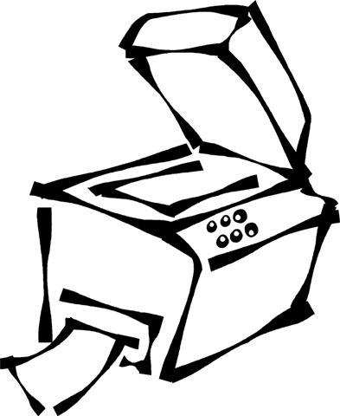
> 1986: A Turning Point
Underground publishing
Photocopying machine: the first desktop system (excerpts of articles on the local political and economic situation from foreign publications)

Slide 4
> 1986: A Turning Point
EDSA Revolution
Press freedom gave birth to a slew of newspapers and books.
A repressed culture led to a renaissance in Philippine publishing.
The public was hungry for information.

Slide 5
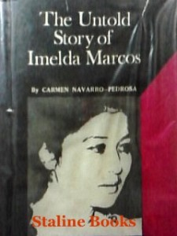
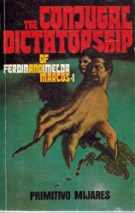
> 1986: A Turning Point

Slide 6
More English?
English-language books still dominate the Philippine commercial market.
The language of the educated class
The language of the consumer
Publishers looking at the global market

Slide 7
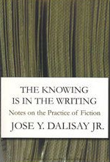
> More English?

Slide 8
Filipino, Philippine English, Taglish
Department of Education
Classroom instruction on basic education to be conducted in major Philippine languages:
Tagalog Hiligaynon
Kapampangan Waray
Pangasinense Tausug
Iloko Maguindanaoan
Bikol Maranao
Cebuano Chabacano

Slide 9
> Filipino, Philippine English, Taglish
Average commercial/trade-book print runs by traditional Philippine book publishers:
500 copies to 3,000 copies

Slide 10
Popular Literature (PopLit): Romance—the game-changer
Changing preferences; focus on non-English books
Popular literature in Tagalog and Taglish
Valentine Romances
Precious Pages

Slide 11
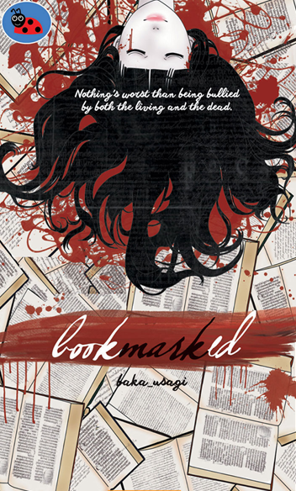
> PopLit: Romance—the game-changer

Slide 12
PopLit: The Confessional
Bob Ong (from “Bobong Pinoy” or “Dumb Filipino”)
Famous for writing in informal, conversational Filipino (street language) to humorously—but still with self-reflection—share his ordinary, everyday life as a Filipino. The way he writes replicates Filipino culture and ways without being overly didactic.

Slide 13
> PopLit: The Confessional
Personal revelation
Humor
Self-reflection, thus, life-coaching
Reflection of nation
The language of the masses (Taglish, gay lingo, Internet jargon)

Slide 14
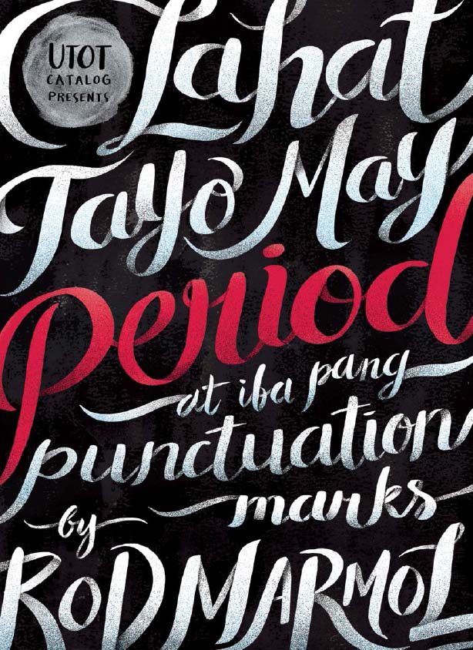
> PopLit: The Confessional

Slide 15
PopLit: Celebrity editions
Photo books (fashion, travel, food)
Cookbooks (recipes, diets, entertaining)
Baby/Family books
Hobby books (art, crafts, gardening)
Advice books (beauty, home styling, relationships, health, finances)
Scrap books/ magazine books

Slide 16
> PopLit: Celebrity editions

Slide 17
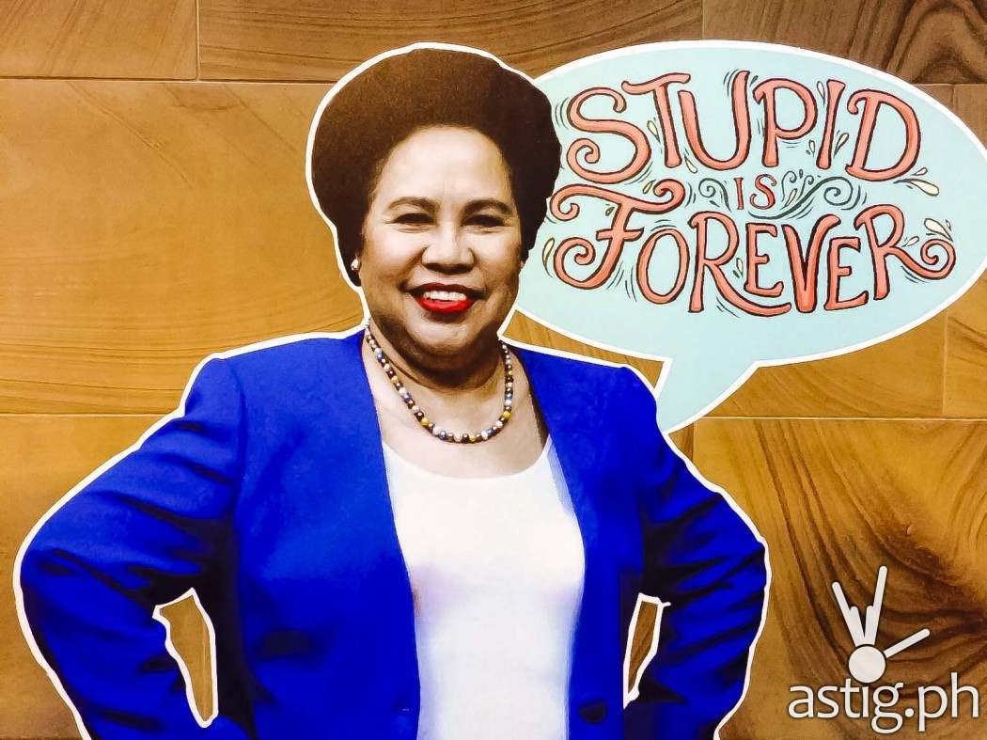
> PopLit: Celebrity editions
“They should be chopped into a thousand pieces and fed to the sharks in Manila Bay. But it is problematic whether the sharks will eat them, out of a sense of professional courtesy!”
-Miriam Defensor Santiago,
on corrupt politicians

Slide 18
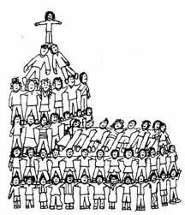
Mainstream: Religious, inspirational titles
Philippine population: 100M (2015 data).
Eighty-three percent (83%) is Roman Catholic.

Slide 19
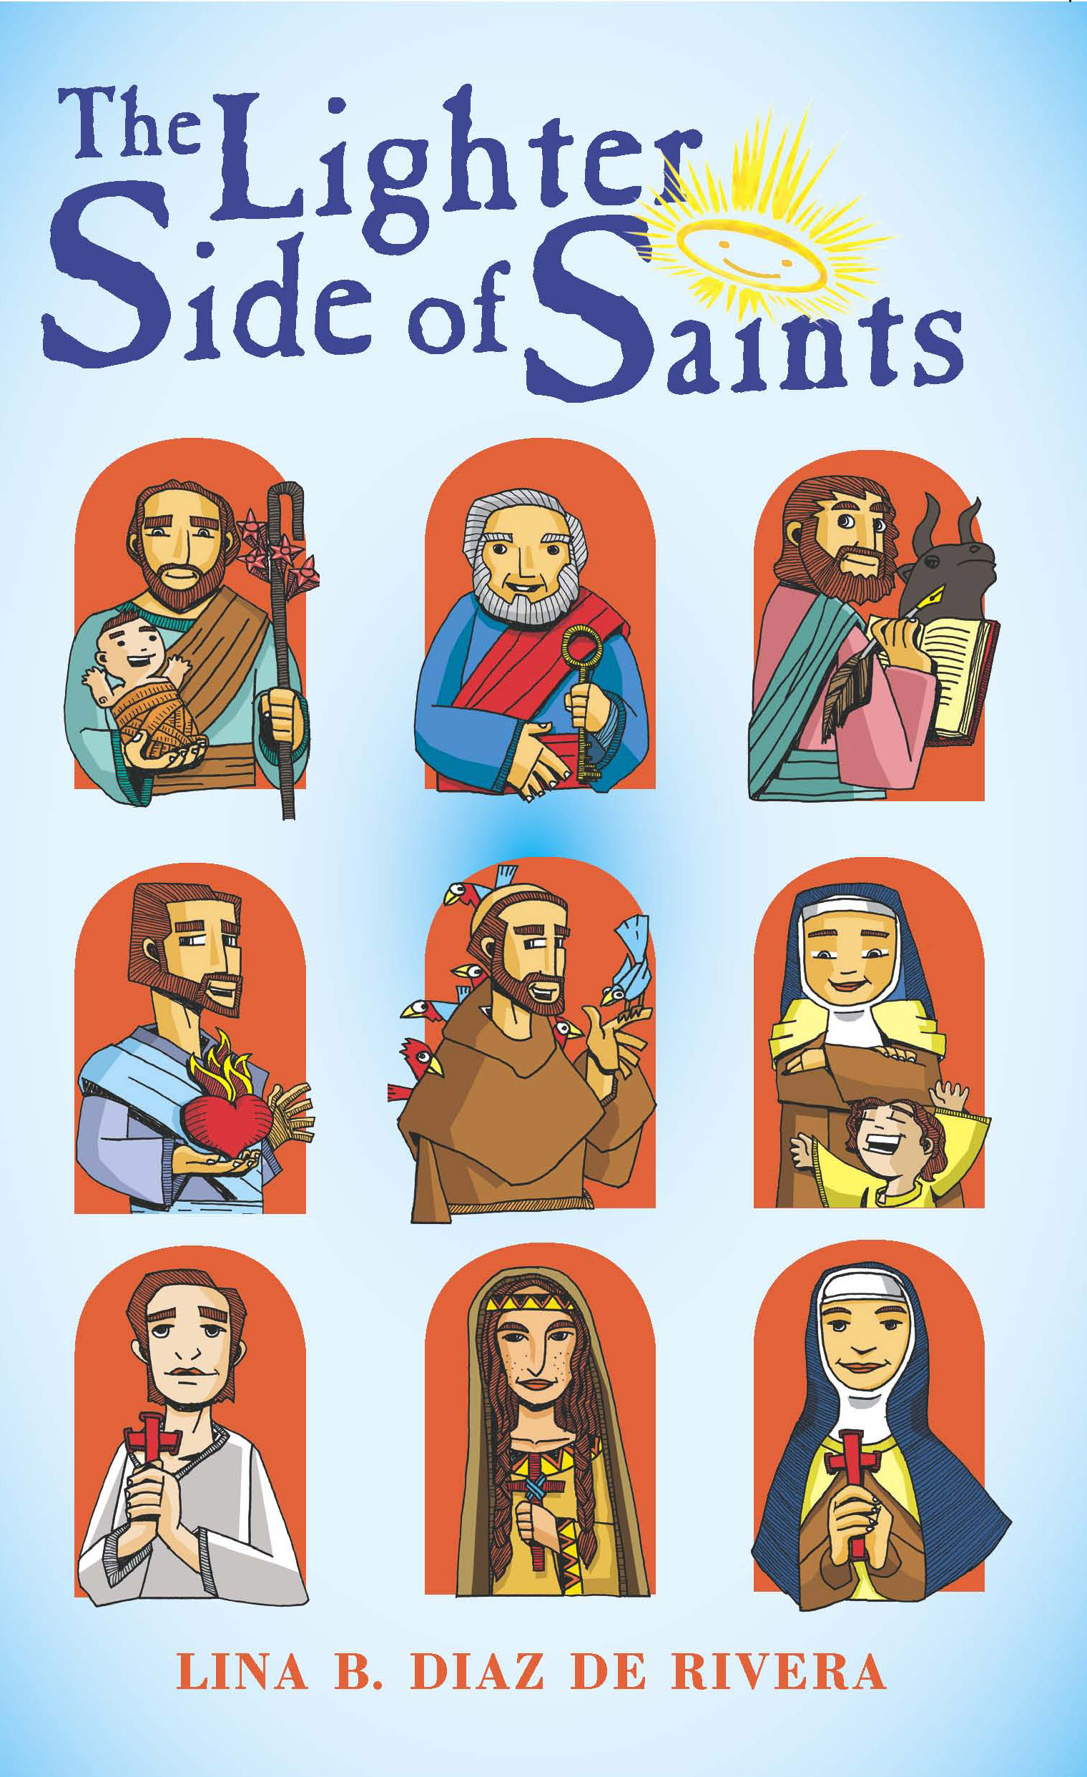
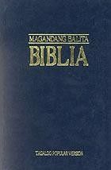
> Mainstream: Religious, inspirational titles

Slide 20
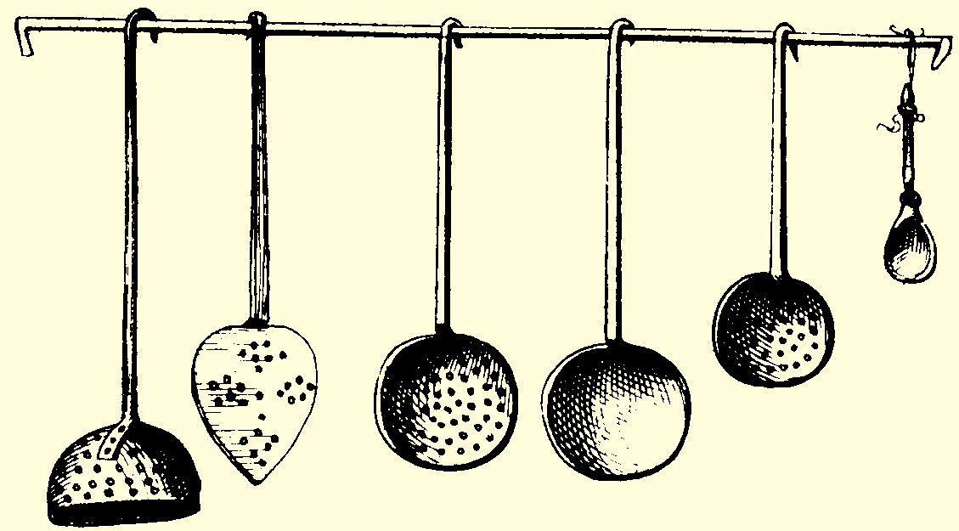
Mainstream: Food
Cookbooks (cooking and baking)
Food culture and ways (regional cooking, history)
Food photography
Agricultural journalism

Slide 21
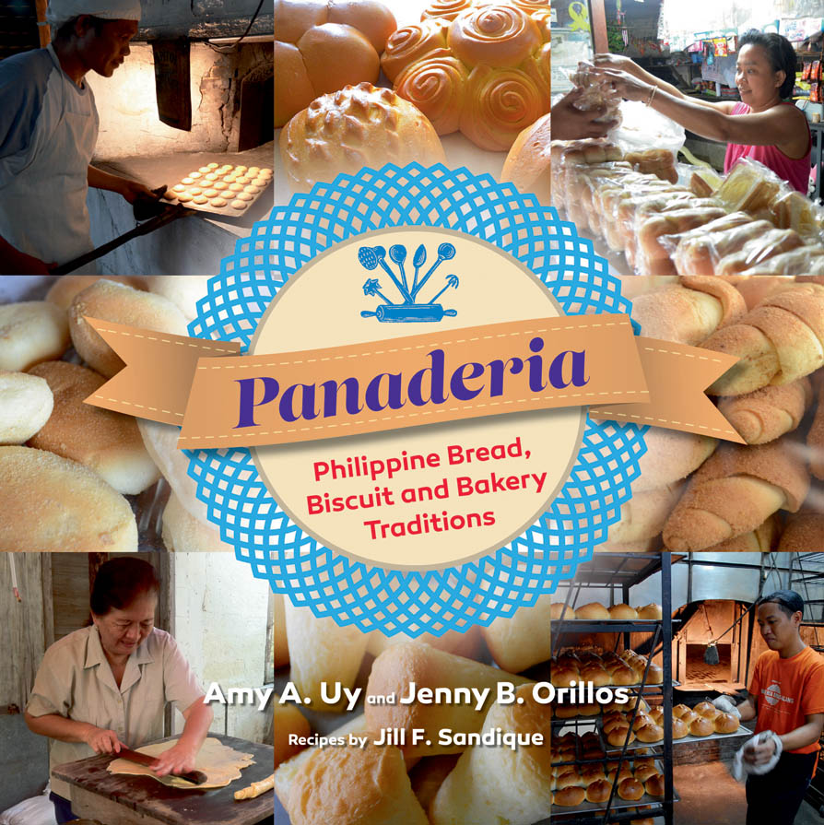
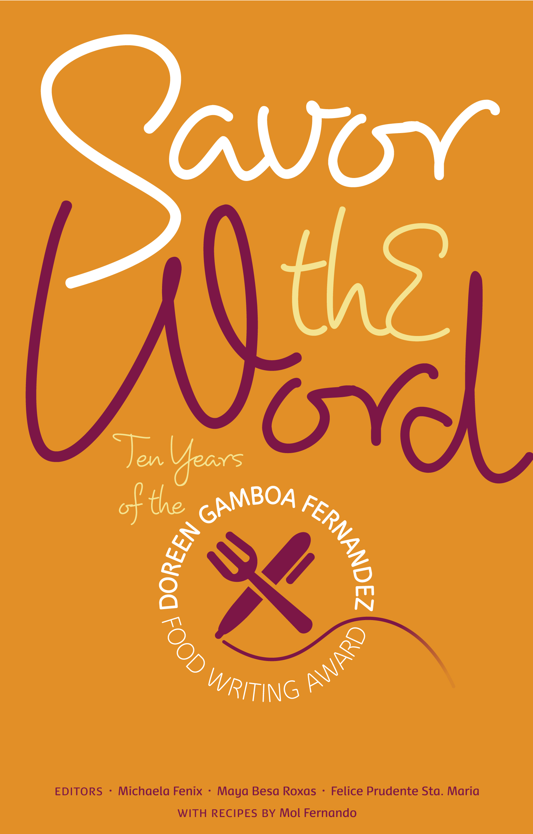
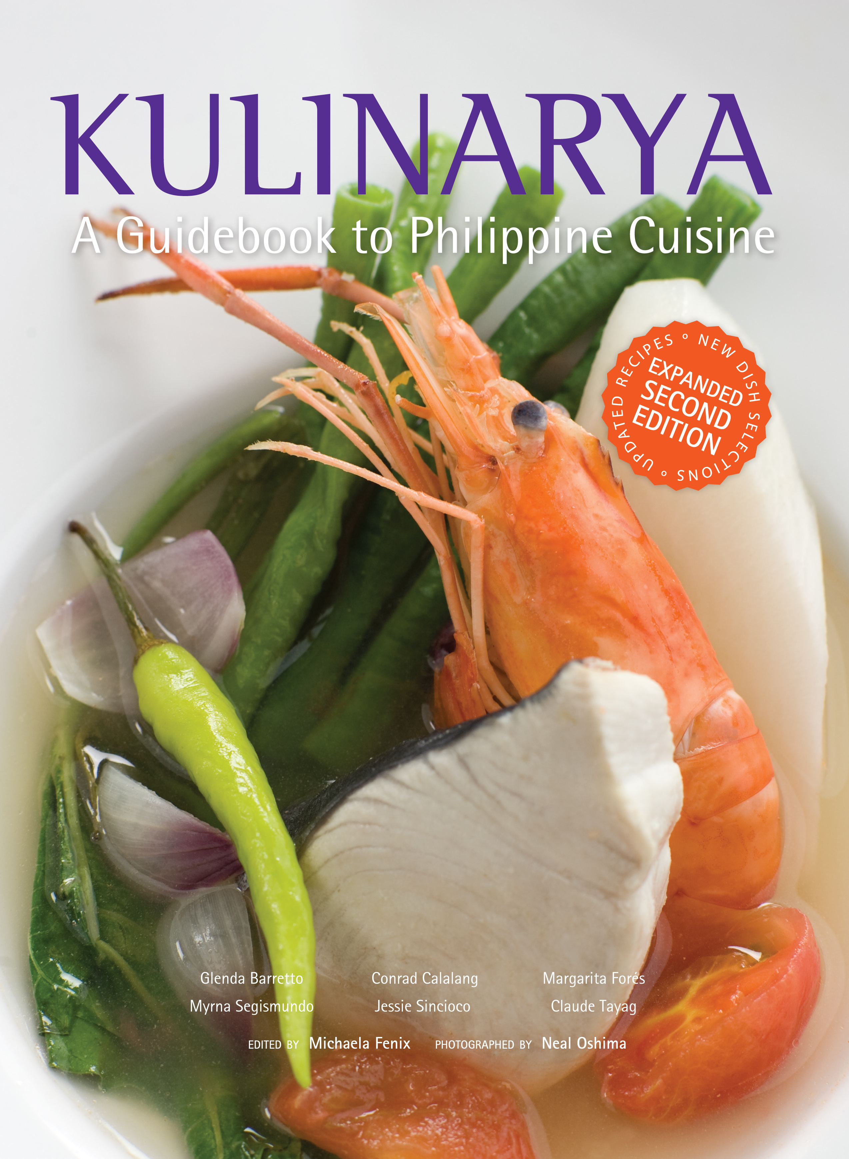
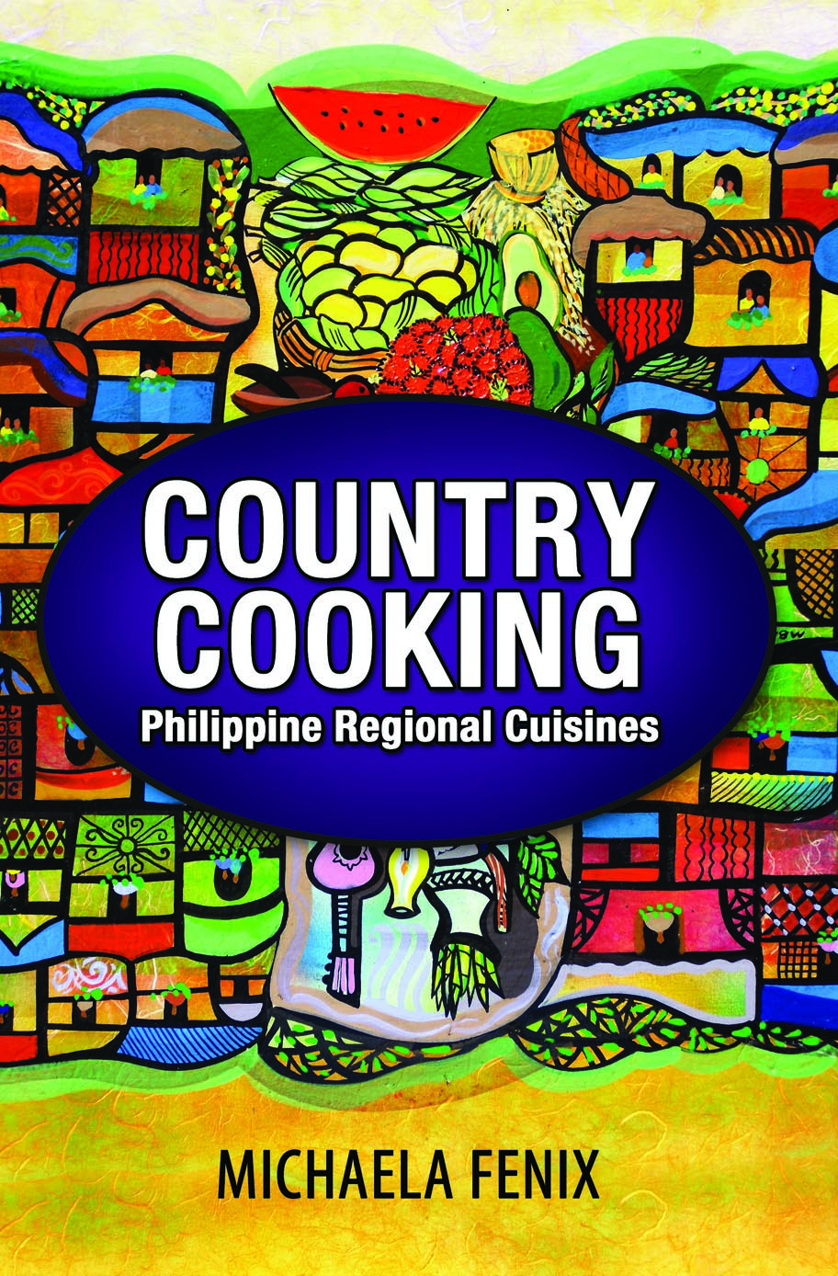
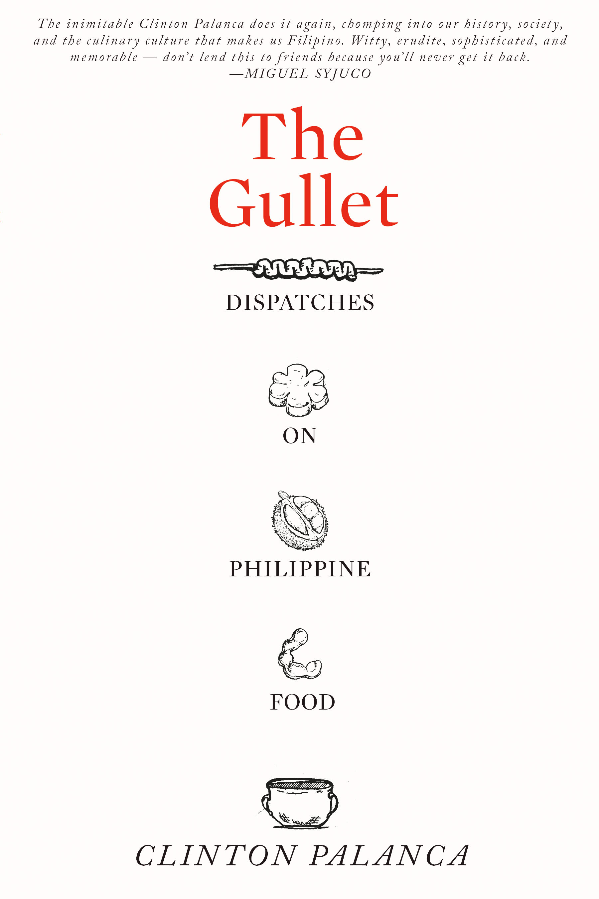
> Mainstream: Food

Slide 22
Mainstream: History
“We have lost our appreciation of ‘useless information.’” –Ambeth Ocampo
Stories of our past not recorded in textbooks
Trivia and anecdotes gathered from actual archives and artifacts

Slide 23
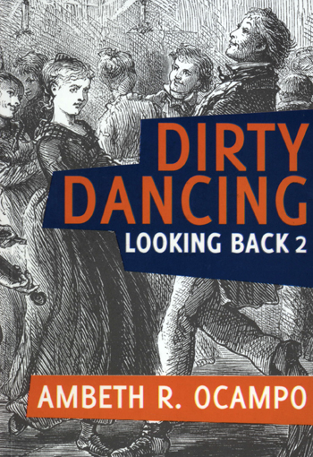
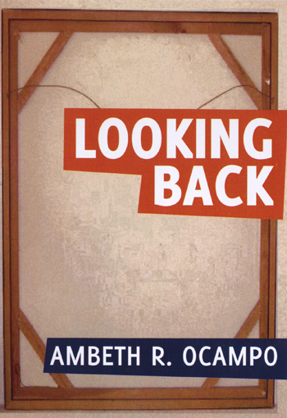
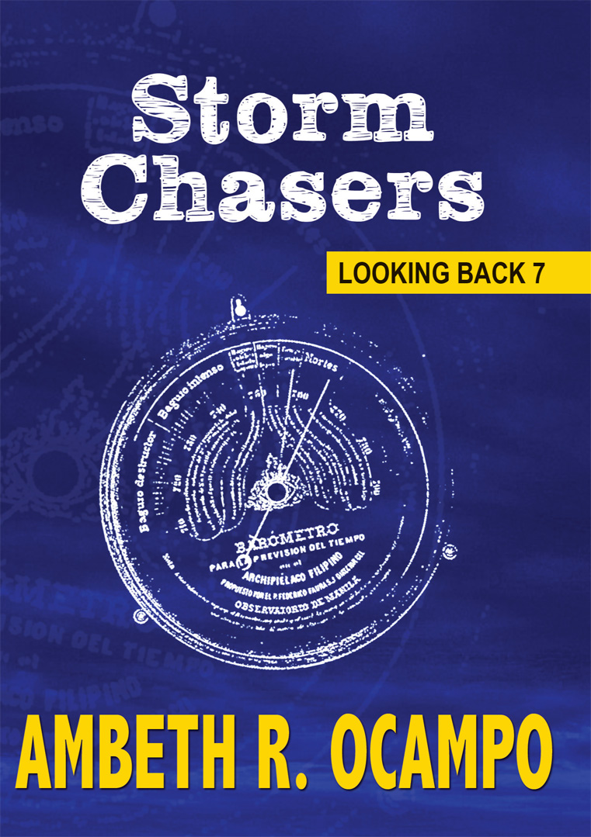
> Mainstream: History

Slide 24
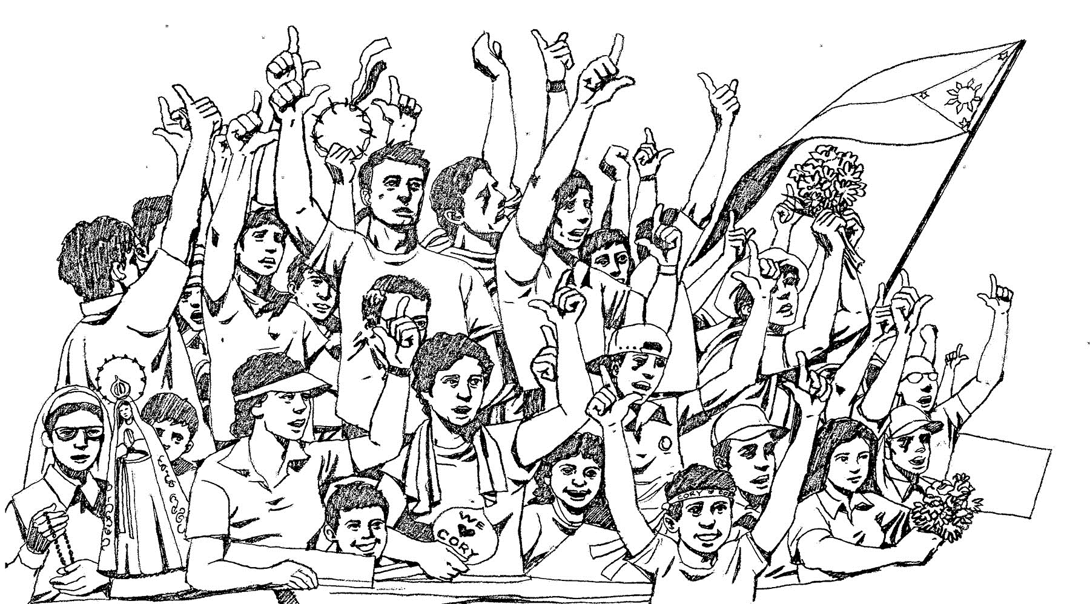
> Mainstream: History
A sudden interest by the current generation; a chance for re-examination by older generations of:
Martial law under the Marcos administration
Edsa Revolution/People Power

Slide 25
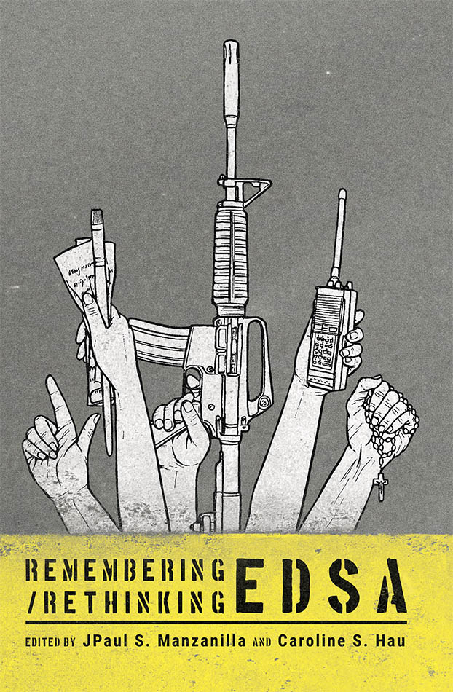
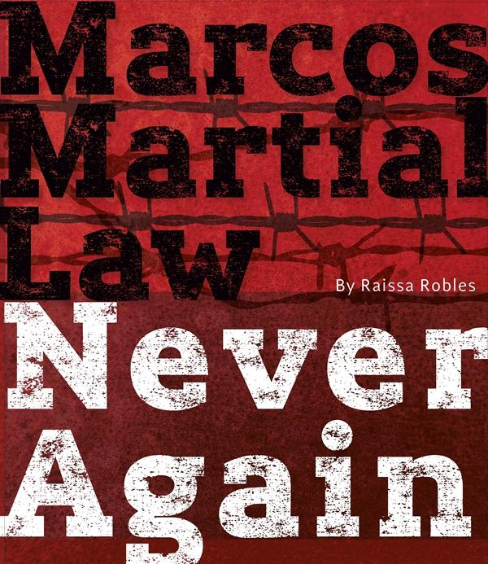
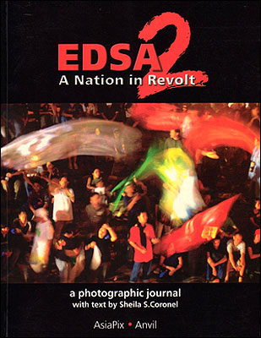
> Mainstream: History

Slide 26
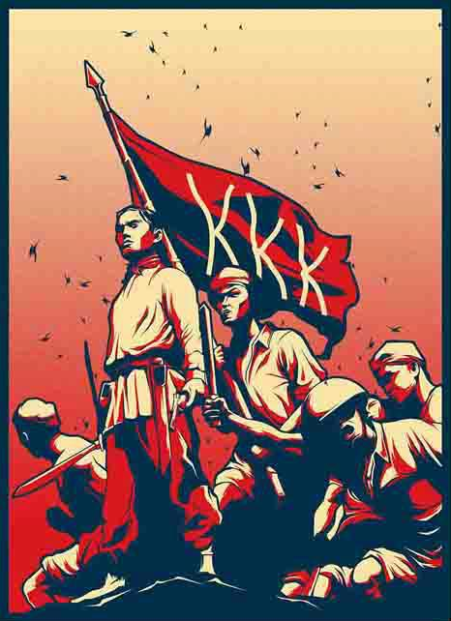
> Mainstream: History
History into films
into books

Slide 27
> Mainstream: History

Slide 28
> Mainstream: History
“May mas malaki tayong kalaban sa mga Amerikano–ang ating sarili.” (We have a bigger enemy than the Americans—ourselves.)
“Ang taong may damdamin ay hindi alipin.” (A human being who has feelings is not a slave.)
“Bayan o sarili, pumili ka!” (Nation or self, you choose!)

Slide 29
Emerging: Health and wellness
Healthy diets
Daily fitness
Natural lifestyle
Inner wellness

Slide 30
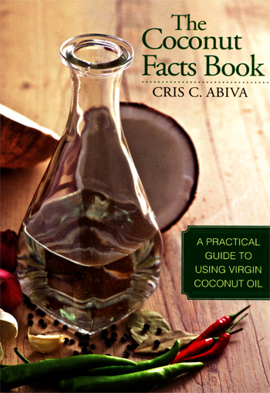
> Emerging: Health and wellness

Slide 31
Emerging: Parenting, family
Pregnancy
Motherhood/Fatherhood
Family

Slide 32
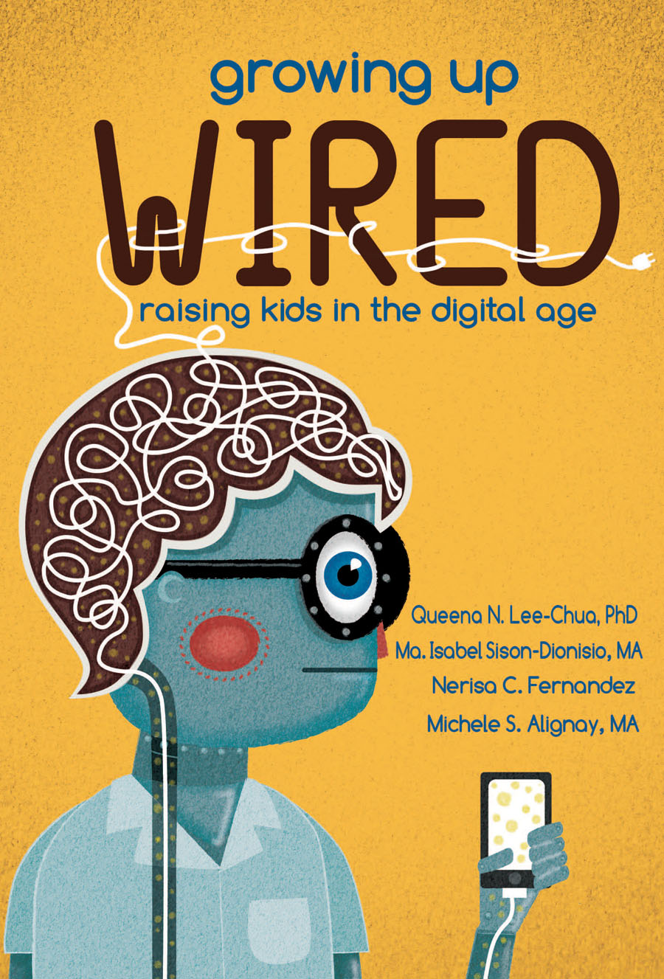
> Emerging: Parenting, family

Slide 33
Emerging: LGBTQ+
The Philippines is still conservative when it comes to LGBTQ+ issues
Emerging, small movements to educate the public about this sector in society
Where are the readers?

Slide 34
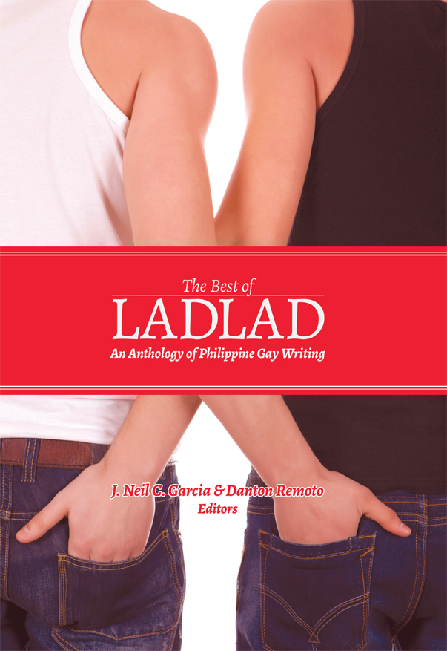
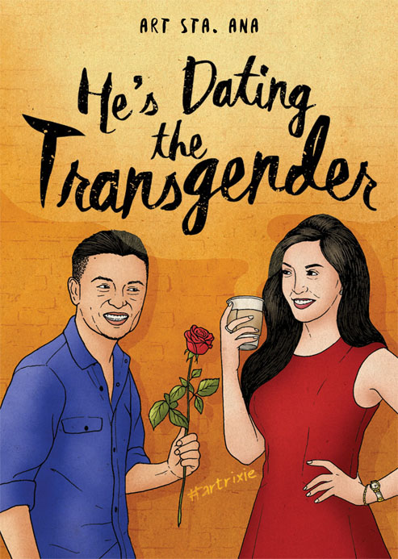
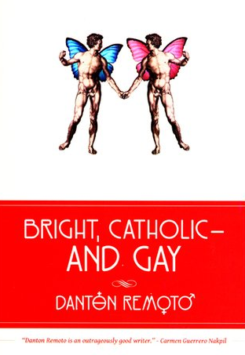
> Emerging: LGBTQ+

Slide 35
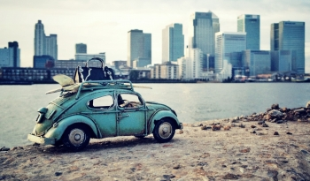
Emerging: Self-help, lifestyle books
Finance and personal-wealth management
Home management
Lifestyle (home/office design, hobbies, mid-career/after-career passions)
Travel

Slide 36
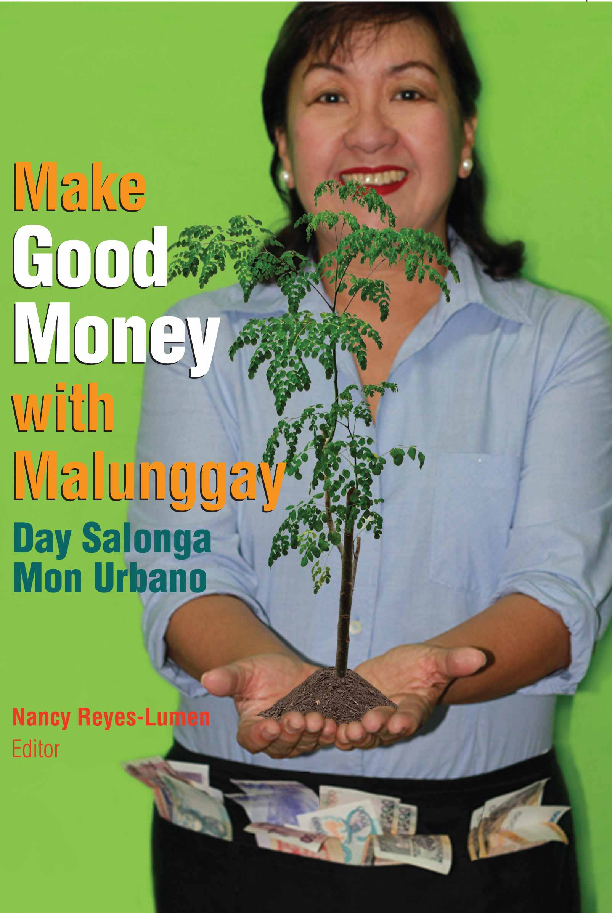
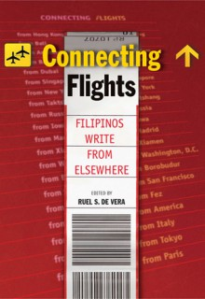
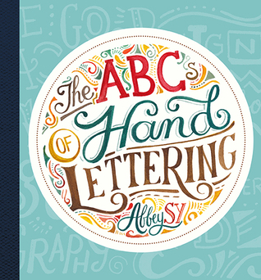
> Emerging: Self-help, lifestyle books

Slide 37
Emerging: Nonfiction for Children
Early learning (alphabet books, counting books, visual dictionaries)
Older children (books on general information and daily-life applications)

Slide 38
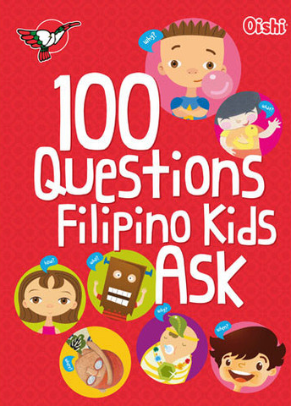
> Emerging: Nonfiction for Children

Slide 39
Trending: Short text, less costly
Short text = small books = savings
From a corpus work to several small editions

Slide 40
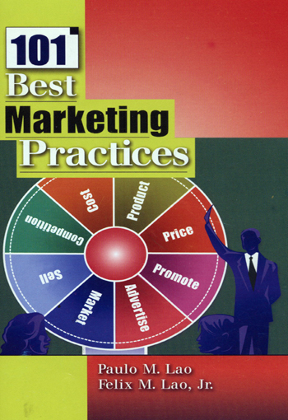
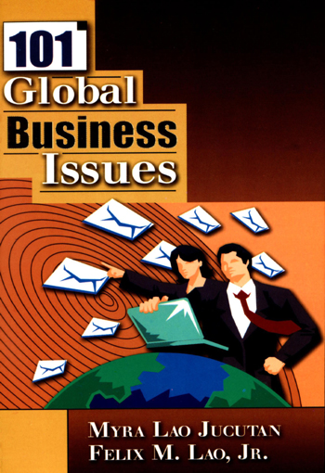
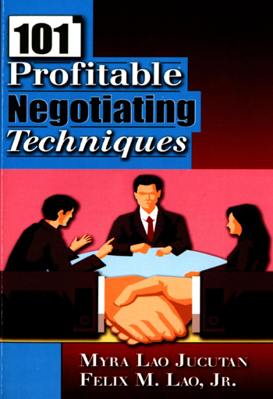
> Trending: Short text, less costly

Slide 41
Trending: Quirky titles
Wordplay is the name of the (marketing) game.
Idiomatic expressions, sayings
“Hugot”
Quotable quotes
Gay lingo

Slide 42
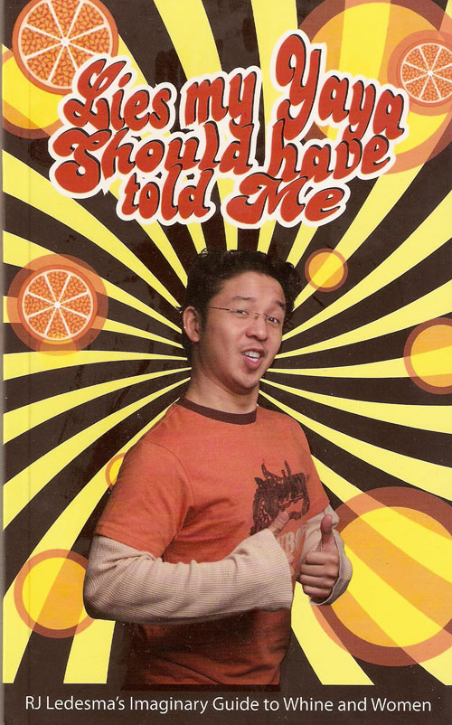
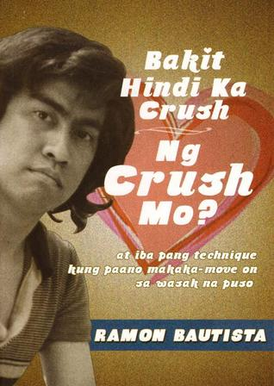
> Trending: Quirky titles

Slide 43
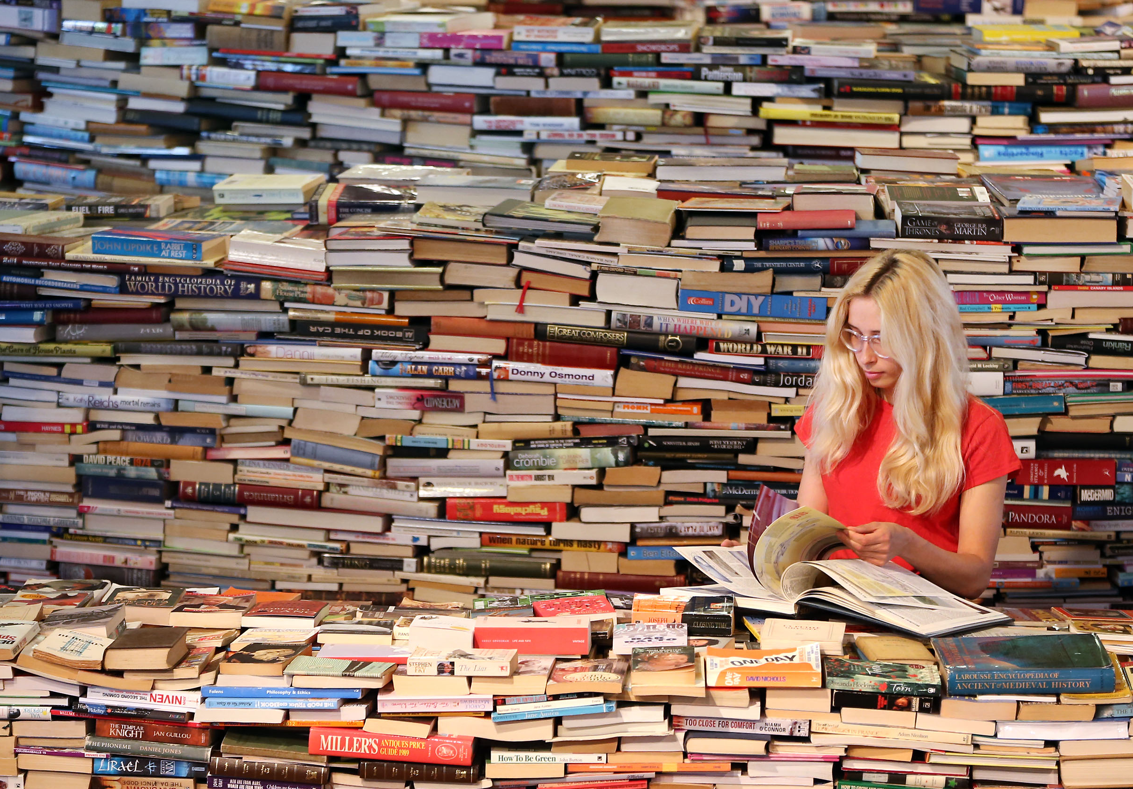
A short, hopeful conclusion
Still, a lot of possibilities in other nonfiction categories and markets for commercial publishing
Sciences (natural, social)
Sports
Politics and Economics
Senior-citizen market
ASEAN and global markets

Slide 44
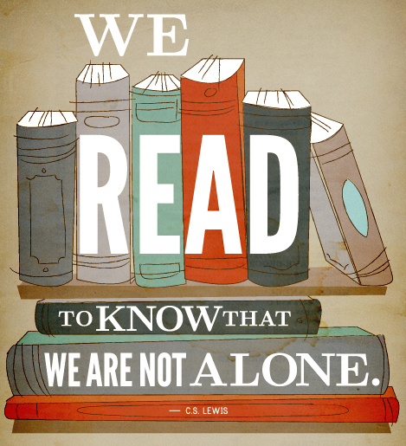
Maraming salamat!

