Slide 1
The Era of the Proteur
Asian Publishers Fellowship Program in Seoul 7 oct 2015
Tạ Hương Nhi
Nhã Nam Publishing and Communications, Vietnam Last updated 1-Oct-2015

Slide 2
About me
- BA in Literature, Vietnam National University, Hanoi, 2007
- MA in English Literary Studies, University of York, UK, 2010
- Editor at Nhã Nam Publishing and Communications Jsc. 2007-2009, 2010-now
Co-manager of the Foreign Language Department since 2014
Head of CJK Sub-department since September 2015
- Translator (English to Vietnamese)
Margaret Atwood’s The Handmaid’s Tale, The Blind Assassin
Poetry and appendices in J.R.R. Tolkien’s The Lord of the Rings
other titles
Notes:
You will see all my biases in the way I read publishing: a focus on translated literature, and somewhat familiarity with the younger or youngish side of readers.

Slide 3
About us
Founded in 2005, first wave of private sector publishing
1160 titles as of 4 Oct 2015
Strong focus on translated literature (84%)
Quality, aesthetics and trust
Pushing boundaries
Relationship with readers & social media presence
Notes:
Big fish of the small pond

Slide 4
Vietnamese collections
A Thousand Years of Attire: How the Vietnamese Dressed from 1009-1945, Trần Quang Đức, 2013.
Sách Hay (Book of the Year) Award 2014
Now the go-to reference book of period movie makers
Notes:
- Socio-cultural books and studies of Vietnamese history: new translations; reprints of important out-of-print books; visual documents; new commissions

Slide 5
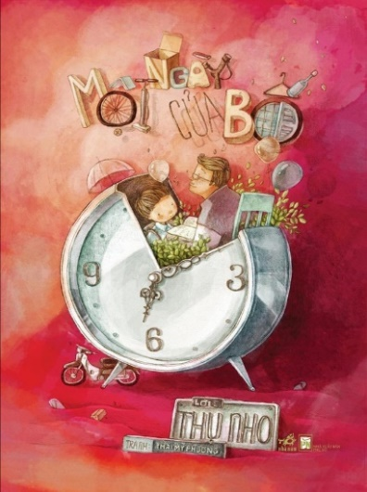
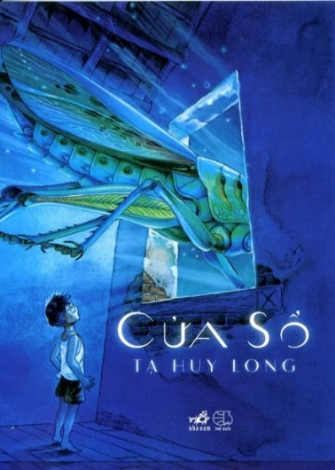
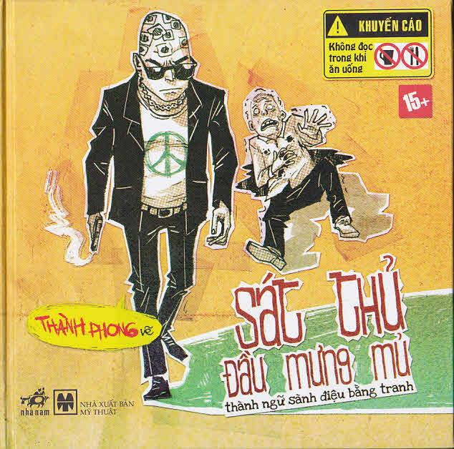
Vietnamese collections
“Việt Nam danh tác”
(Modern Classics): reprints of first or out-of-print editions
33 titles so far
One-shot picture books/literary comics
Left to right: Tamypu’s A Day in Dad’s Life; Tạ Huy Long’s The Window; Thành Phong’s Pictorial Proverbs
Notes:
- Việt Nam danh tác (Vietnam classics): a series in a unified, beautiful format
- Vietnamese-made picture books: launching pad for many talents: Thai My Phuong, Thanh Phong… some of which are now very successful freelancers with contracts from all over Asia. Nha Nam as celebrity-makers, as seen by the next example.

Slide 6
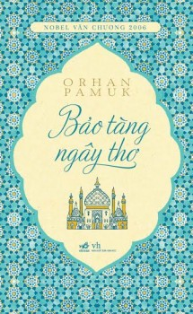
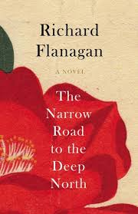
Keeping up globally
Left to right: Orhan Pamuk’s Museum of Innocence; Milan Kundera’s The Curtain; Patrick Modiano’s Missing Person
Award-winning literature
Genre and popular literature
YA and children’s books
Notes:
Literary awards: Nobel, Man Booker, Goncourt
Best in genre literature: romance with Marc Lévy, Musso, Nicolas Sparks..., thriller/mystery with etc,
YA and children’s books

Slide 7
Asian literatures: Japanese (36 authors)
- Murakami Haruki (15 titles) - Yoshimoto Banana (7 titles) - Higashino Keigo (7 titles) - Ichikawa Takuji (5 titles) - Suzuki Koji (3 titles) - Ogawa Yoko (3 titles) - Ekuni Kaori (3 titles) - Yumoto Kazumi (3 titles) - Yamada Amy (3 titles)
Murakami’s Men without Women, published September 2015
Notes:
We’re following a number of other authors. Ichikawa Takuji and Yumoto Kazumi are especially popular with readers in their youth.

Slide 8
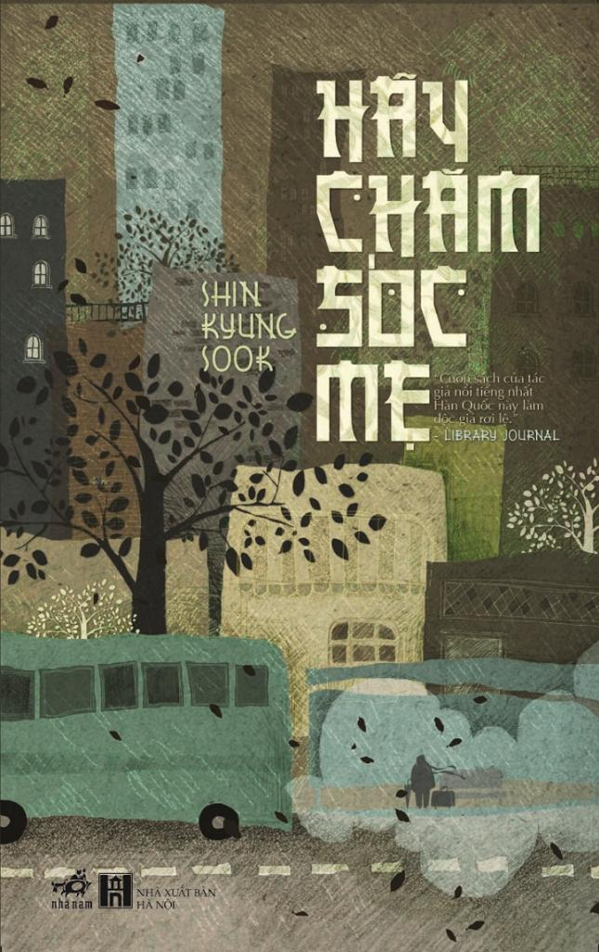
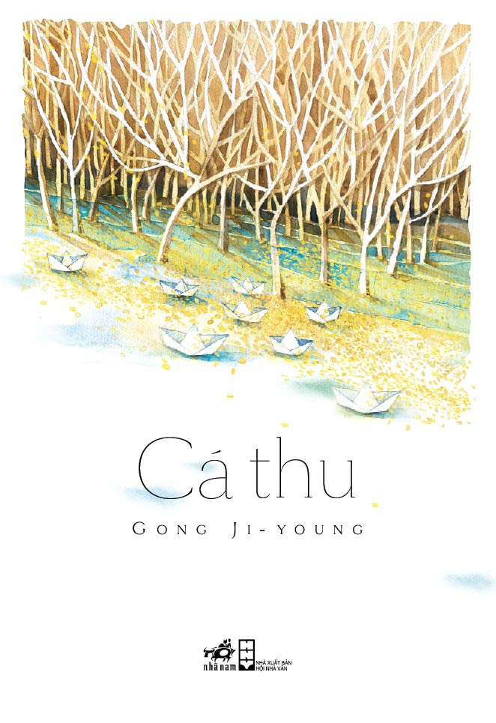
Asian literatures: Korean (37 titles acquired)
Shin Kyung-sook, Please Look After Mom
Gong Ji-young, Mackerel
Hwang Sun-mi, The Hen Who Dreamed She Could Fly
Notes:
Chinese literature: already strong presence in Vietnam and going.
Chinese romances, Japanese and Korean manga/manhwa and light-novels are already popular in Vietnam since decades ago.
But we’re proud to bring Japanese and Korean literature into Vietnam and make them not as scattered titles soon falling into oblivion, but a substantial presence and expectation.
Korean literature: the main difficulty is lack of trustable translators and sources of information. Korean publishers and authors have been proving very helpful and Vietnamese readership always show great enthusiasm towards our titles, the main reason arguably being similarities of social and moral conditions between the two nations.
Shin Kyong-sook, 4 titles
Gong Ji-yong, 4 titles
Hwang Sun-mi, 3 titles
Three of six titles published with the support of LTI

Slide 9
Future development
Diversify
Retail
Community
Notes:
Extend the scope of our Asian collections. Currently we are examining South East Asian literatures with several titles, Indian literature with Salman Rushdie and the likes, as well as Turkish literature beyond Orhan Pamuk.
Working on our Spanish and Portuguese collections, both in Europe and Latin America. Lack of translators – must translate from another language.
Structural change in our portfolio and collections, in tune with the times: you will see it better going into the main part of this presentation.

Slide 10
What Era of the Proteur?
Where do editors find ourselves?

Slide 11
A new era
WORLD | Information revolution
VIETNAM | Robust online “marketplace”: Self-expression Exchange of ideas Exposure to foreign cultures & values (esp. Western) Grouping of like-minded people Sense of empowerment Competition of values
Notes:
As in everywhere in the world, especially out of the Euro-American sphere,
Of course the changes and the newness I’m speaking here has a strong urban bias. Most of them are observable among the young, Internet-browsing, English-spouting groups, while the older groups stay much the same. (But that’s why we are talking about “change” here, isn’t it? To most older people, there is no change; or else there is some change that they’re left outside it, baffled and incomprehensible. Too depressing. Let’s stop this train of thought.)
Easiness of grouping and discussing of similar tastes → sense of empowerment of youths and marginal groups
The phenomenon of the procteur is mostly an online phenomenon.

Slide 12
A new reading scene
- Platform: digital
- Demographics: young, urban, well-connected
- Taste & style: fast, pop, universal – “quotability”
- Expectations: trendy, accessible, tailor-made – expected to be pleased
- DIY approach: blurred lines between content creators and consumers
Notes:
All these are correlational.
Platform: people now are much more likely to be reading on their computer or hand-held devices than books, if given the choice.
Demographics: young people are reading, buying and discussing books more than ever, spurred on by a connected network of nation- and world-wide peers. They are actively seeking out what’s hot in the world and in the local bookstore, and they are who tell their parents what to read and what to buy.
Expectation: People want to be up-to-date with the world, whatever section of the world they’re attached to: American, French, Chinese, Korean. They want content to be accessible, which means both convenient (one click website, not running to the bookstore) and free. So many young people were raised on online and pirated books, both Vietnamese and foreign-language, that the concept of piracy doesn’t mean anything to them anymore. (I confessed that I was one of them until I entered workforce.) They have power, and they’re used to putting pressure on authors and publishers until they get what they want (and throw great tantrums if not met).
DIY: because of the connectedness and convenience that the internet era brings about, more and more persons have the means to create and broadcast their creation. Just think about the number of heated, insult-filled internet arguments that you’ve had with someone just to find out that they are a 11-y-o boy from a remote district! And because the young is impatient, when they don’t see something they want to be existing, they proceed to make it themselves. I use the word “content creators” to indicate this is a universal phenomenon that permeates all aspects of the reading life. People put their short stories and novel serializations on blogs and forums; people translate whole series of books and collaborate to edit it; people review or trash their books on Goodreads and book blogs. At the extreme of it, people are importing small-scale foreign books to sell in Vietnam or opening whole publishers to have the kind of books they want on offer. Nha Nam is also the result of such an endeavor, and many of our editors and translators stem (including me) from similar communal or lone-wolf attempts. We are now still recruiting among media personalities.
Taste: fast, pop and universal. Quotable lines, true-to-type plotlines and characters, a certain form of liberality and rights.
Smart-mouthed, bitchy, “evil”.

Slide 13
Japanese Literature Week
December 2014
“I love Japanese literature” Collection of fan-fiction contest winners
Notes:
Here is a photo from our “Japanese Literature Week 2014” co-organized with the Japanese Foundation in Vietnam: an exhibition of 42 (?) titles of Japanese authors published so far. We also held a fan-fiction contest which accrued wide response and resulted in a printed book handed out as gift for exhibition.
We’re always seeking such opportunity to cooperate with our international partners and bring out a more immersed experience for readers.

Slide 14
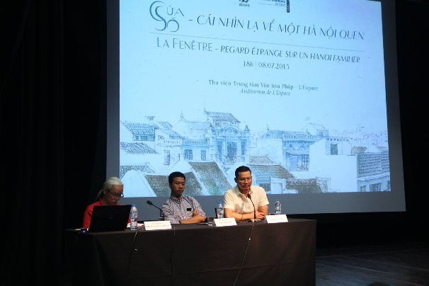
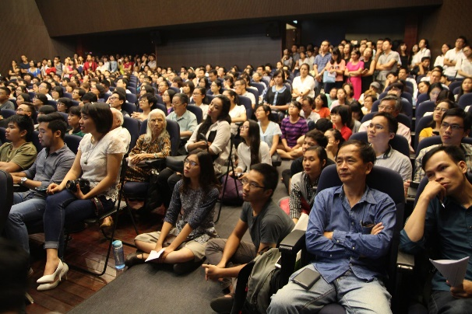
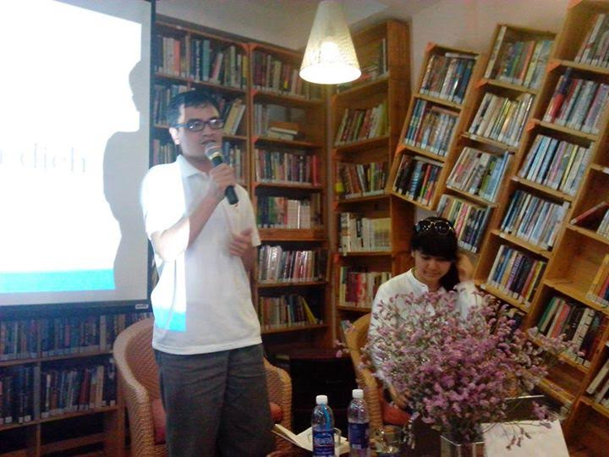
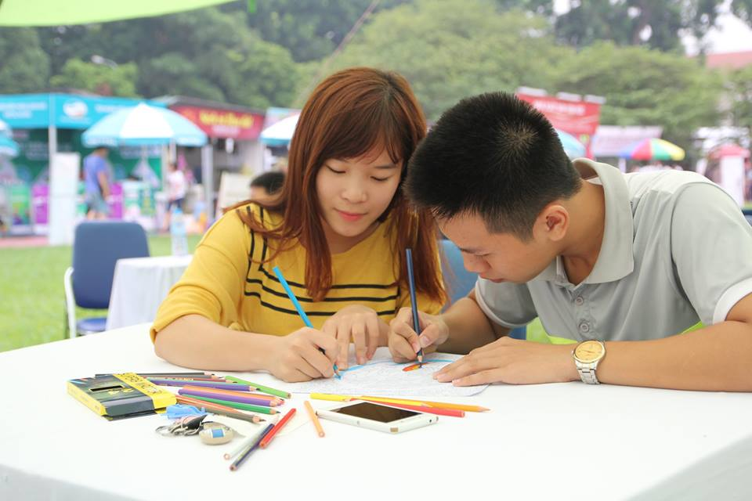
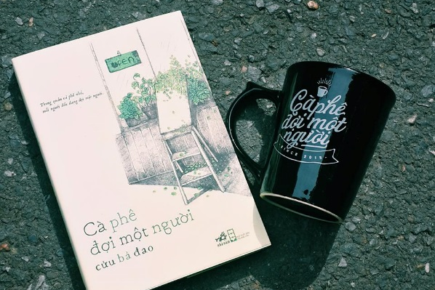
Not a product, but an experience
Book talk: “The Window: old Hanoi, new vista”
Book talk: “How has Hanoi changed?”
Book talk: “Lolita, the untranslatable girl”
Counting book activity
Colouring contest
Book and accessory
Notes:
As publishers, we have been selling, or providing, books; but modern publishers don’t sell books, but an experience. To readers as well as authors.

Slide 15
Who publishes?
63 official “publishers”
- Owned by an official entity
- “to promote the social and political goals of the org.”
- Strictly regulated
- Run by bureaucrats with editorial staffs of mostly writers and critics
- Supported partly by govt.: capital, infrastructure, outlet, training
Still hatching “book companies”
- Privately-owned
- to fulfill owners’ vision or make a profit
- Negotiating regulations
- Run by entrepreneurs with less experienced but passionate book lovers
- Entrepreneurial, “proteurish”
Notes:
It’s pretty limited what we are allowed to do or not to do by the law: not legally recognized as publishers, must have approval of a “proper” publisher, no logo on book covers until recently
We’re freer to operate, but more disadvantageous as for talents

Slide 16
What is published?
- Textbook
- “Literature”
- Reference books
- Textbook (foreign languages)
- Fiction + essays: best-selling + social sciences and history + genre literature, YA + visual + highbrow literature + niches
- Self-help + Parenting + Cookbook + Body and mind
Notes:
The structure of books on the market, on the portfolio, and on the bookshelf is changing. The Vietnamese perception has also broaden to accommodate many other genres.

Slide 17
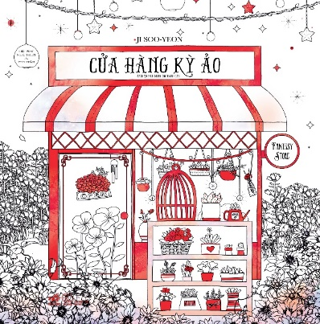
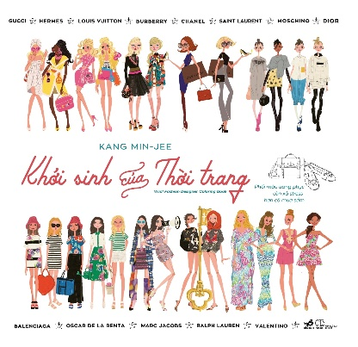
15/7/2015: Millie Mirotta, Animal Kingdom, Nhã Nam
1/10/2015: 38 titles by 6 different publishers

Slide 18
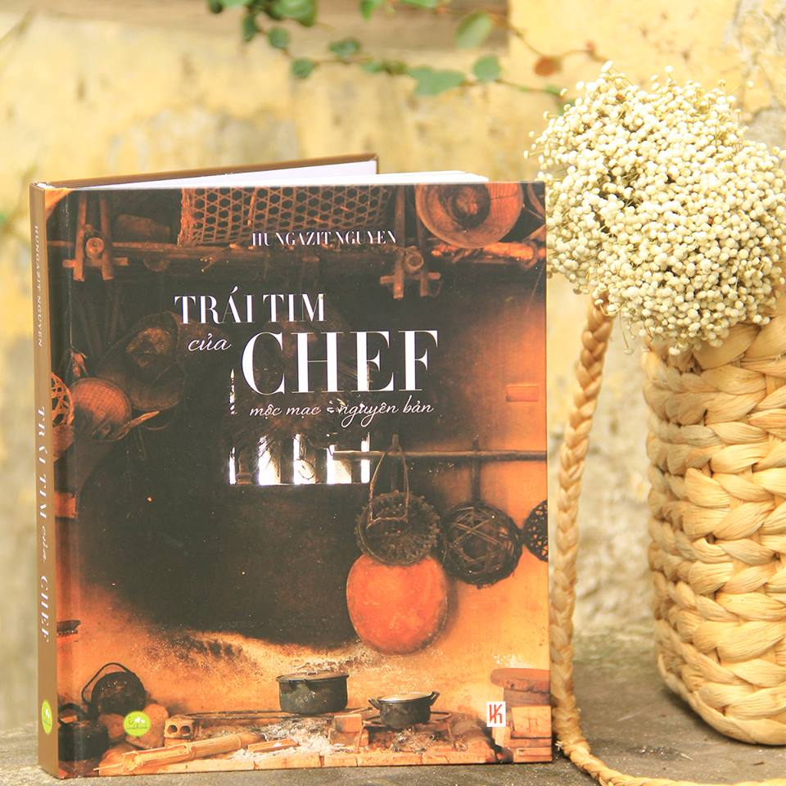
555 Vietnamese Dishes
492 pp.
2.22 USD
A Chef’s Heart
312 pp., hard cover
10.9 USD
Notes:
While most text-based books (and even a few illustrated ones) are migrating from paper onto screen, many genre books are heading in the opposite direction: after garnering a lot of attention online (and building a powerful fan base), the authors or fan are seeking to give it a physical appearance. The goal is often less fame or money (though these tend to be best-sellers anyway), but validation and aesthetics.
The result is that cookbooks, comic books, essays of this caliber do not suffer from the fate of their run-of-the-mill cousins, but truly luxury products, acting as gifts and house decorations more than content holders (the content is freely available online anyway).
The DIY approach of content creators also is limiting the role of publishers in certain instances.
(Cookbooks then and now)

Slide 19
Making authors:
Publishers’ adaptation

Slide 20
Who is the proteur?
Proteur
Writer, Artist
Celebrity
PR team
Casual blogger
Notes:
Who is the proteur? (author)
The writers and artists are mostly familiar with traditional publishing and marketing, or at least, with an aim to attain it. They are either taking a break from it to take matters in their own hands, or they are experimenting new avenues that are not easily made by traditional ways as a side project.
The PR team are smart, organized and conduct their writing/drawing with great understanding of the public. They have a clear plan as to when, how and why they do it, and they are ready to withdraw when the going gets tough, too.

Slide 21
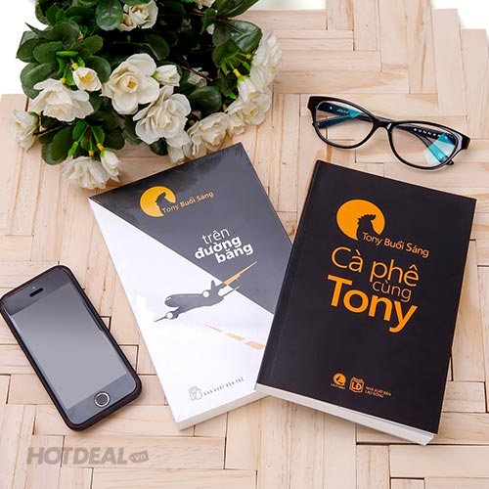
“Tony Morning”
(“Uncle Tony”)
Facebook since March 2014
534,614 likes
Sep 2015: announced “he” would quit writing
Average first print run in Vietnam: 2000 copies.
- Coffee with Tony, 2014
- On the runway, Aug 2015: 90,000 sold (as reported 29/9)

Slide 22
Who is the proteur?
Upsides:
downsides
- Modern, cosmopolitan, media-savvy
- Strong, ongoing, interactive relationship with fans (and anti-fans)
- Good business and management skills
- Jack-of-all-trades
- Lack of professionalism and/or awareness of ethical practices
Notes:
(a degree of talent is taken for granted)
Young, hip, modern, cosmopolitan, media-savvy: many talents, no specialization
Have a strong, ongoing, interactive relationship with fan (and anti-fan as well): power in number
Already courted by many publishers, have their pick
Lack of professionalism and/or awareness of ethical standards: inflated egos, ready to quit, noncommittal, failure to fulfill contracts etc.

Slide 23
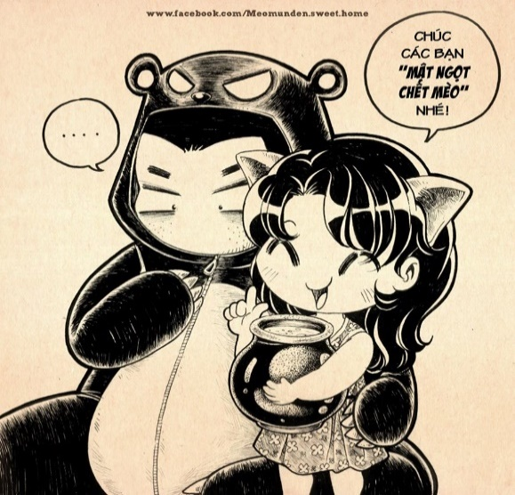
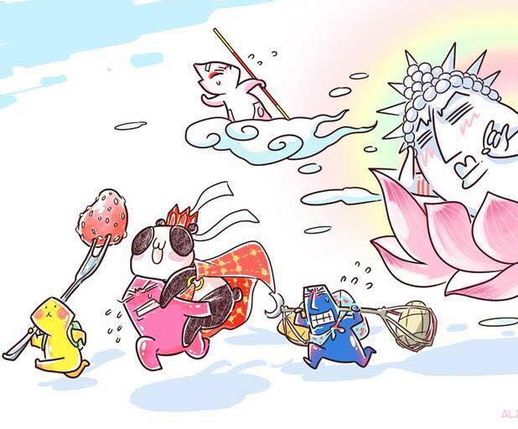
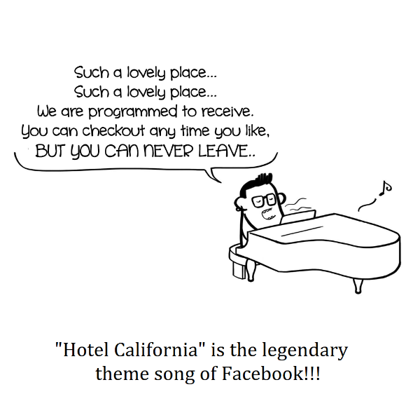
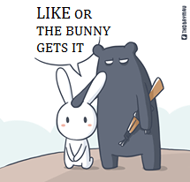
HONEY Kills the Cat 79,489 likes
393,178 likes
Yellow and Friends 72,500 likes
The Frolicking Bean 263,177 likes
Le Bitch 85,158 likes
Seven-Coloured Bunny 539,798 likes
(As of 1 Oct 2015)
Notes:
Thanks to the popularity and resourcefulness of creators, many of them only need a publisher to provide legality, printing and distribution. Content is already prepared and money is raised through crowdsourcing. Some of them even take distribution and promotion into their own hand as well.
Nha Nam is one of two publishers with most Facebook likes at the moment.

Slide 24
Advertisement
Thái Mỹ Phương (Tamypu), 101,409 likes
Picture book artist, book cover designer, illustrator

Slide 25
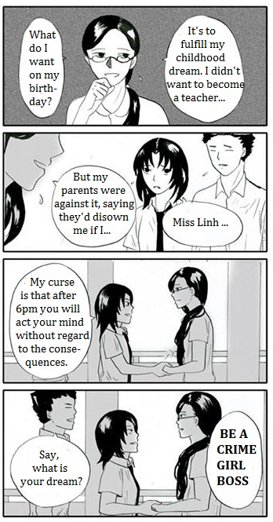
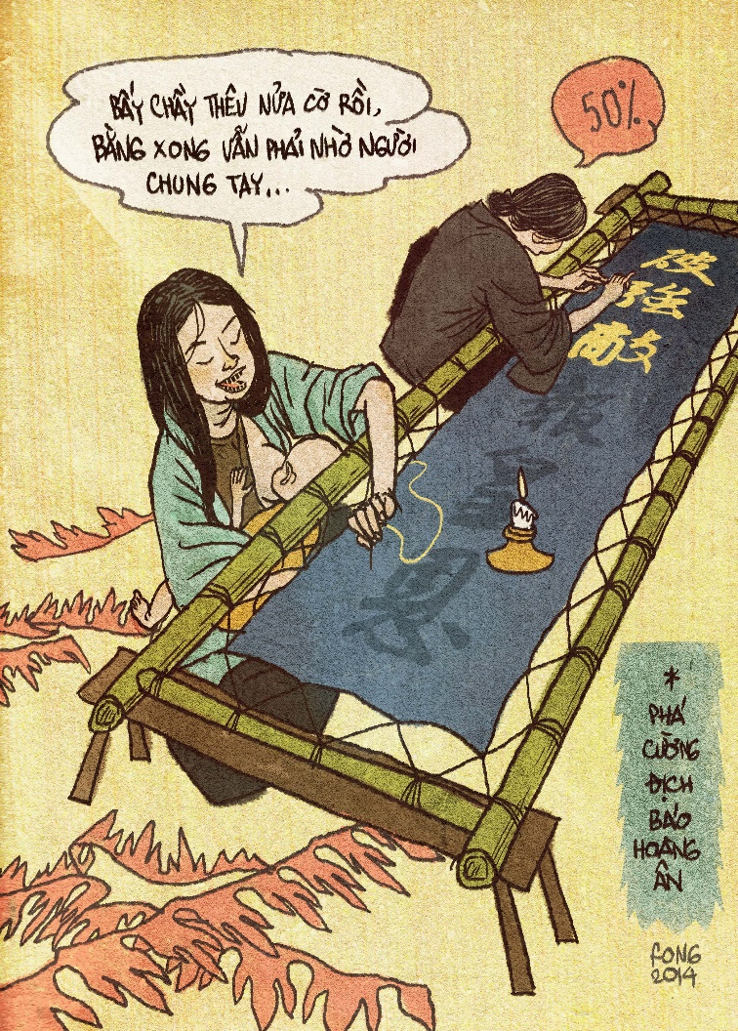
Crowdfunding
Bad Luck
Exclusively online
Magical girl, high school, off-color humour, LGBT
6,360 USD
The Dragon General 2 Paperback and hardback
Time travelling, epic historical, thriller
11,200 USD
Average comic paperback: 1.5-2.5 USD

Slide 26
Why publishers anymore?

Slide 27
Editors: new expectations
- Be proactive: technology, young, adaptive
- Change of priorities: juggling between taste and popularity (“art and business”)
- All-in-one: sales officer, marketer, negotiator
- New dynamics between authors and editors
Notes:
The editors must broaden their hunting ground, from literary magazines or circles to “what’s hot at the moment” (because many trends are short-lived). They must learn to speak young and ready to change their evaluations, or their concept as for what is a book or what is literature. They must frequent media sites, keeping up with movies and foreign trends. They must be open to new concepts of beauty, morality, different versions of history or what’s good and true from what they have always known. Meanwhile, they still have to do all their old jobs.
They must accommodate different priorities: and this is something I have witnessed first hand since Nha Nam was still a tiny maverick, committed to only bringing what’s best to the market, with an over-worked, underpaid staff of youngsters not knowing anything better. Now Nha Nam is a huge machine with one of the best workers’ policy to support and a big staff to pay, and leaders simply cannot follow only their vision at the expense of our employees.
Now editors are those who sell their services and brand names to authors, not authors who sell manuscripts to publishers any more. So editors’ interpersonal skills must be at a different level than the old autistic stereotypes. In our company, they must also be interacting with fans and readers, checking their suggestions, answering their complains and a myriad of other customer services stuff.
This is especially challenging since, as I’ve mentioned before, unpublished authors nowadays are very different from before. They are often very young, very smart; they already have a large fan base, which is good for promotion, and they probably know more about the content and promotion than general editors. Editors can learn a lot from them. On the other hand, they are often less open to editing suggestions, or if they do, their fans don’t always tolerate it. This is especially problematic with translations since the author is not here to endorse and defend our editorial decisions. And as I’ve said, the new authors don’t really have a grasp on how to work professionally, so problems arise with contract fulfillment, brand management, rights etc. Another usual woe is some hot blogger or celebrity, after signing contract for a number of books, fail to provide the following books on time or at all. That’s when their “amateur” side makes things difficult to us. We don’t really have a framework to refer to and must invent solutions on the fly.
Marketing ideas: gifts, mini games,

Slide 28
What doesn’t change?
Notes:
The fact is that procteurs remain just a small are the equivalent of Korean idols in the realm of books, and they themselves are mostly in it for the quick fun: celebs want a new experience to percentage in the publishing and book life, though maybe the most visible. It’s like the “vocal minority” in most of discourse and (Internet) argument that we’ve heard every day. The figures may be impressive and Tony Morning may sell more than all Modianos and Shin Kyung-sooks combined, but overall they are just one small part during the ongoing, silent and deep-reaching process of appreciation and creation. Not to say how much of the figure is driven by curiosity and fashion rather than by real admiration and application.
And though procteurism is in toto an intimidating phenomenon, each of those procteurs normally don’t last long. We’ve talked about how the favours of the crowd change day to day; the energy and <> of these procteurs do the same. They change their humdrum days of fame and fan swooning, the casual blogger finds himself run out of ideas and switch to other enterprises, PR team ends this or that particular project when it’s run its course. A few percentage of them, mostly already committed writers/artists, endure and continue to create, but they inevitably switch to professionalism to help nurture their talent and weather the competition. And it’s in this real competition, by talent and stamina rather than by media fuel and fans’ adoration, that the future is made.
Back to the era of the Internet revolution. The Internet revolution occurs in different paces in different places of the world; it may have died down where it originates and people there have learnt by first hand experience how to take the amateur literary products, or journalism, or disseminated ideas with some hefty amount of salt. Here in Vietnam we have just started to learn that. But gradually the knowledge is being made, that judging by one’s own taste is always better than by the majority consensus (an old and clichéd lesson, but oh! – how often we must learn it all over again). And in the long run, it’s the professional – in this case, established, authoritative publishers with a strong idea of standards – who decides the future.
When I was young in college, I was merely a consumer with some dabbling in creativity, and I thought then that authors are who write the world. After a while working in the publishing industry, I gradually came to knowledge that it is publishers. We may or may not engage in the act of creation itself – though many editors are themselves writers, translators, artists, or critics – but we organize and make, and decide what is given to the world. In the midst of all crashes of values and an attitude of everything-goes(as-long-as-its-profitable), we are the guardians of standards – or if those are too big words, let’s say a filter of worthies. And that’s what editors have been doing and will be doing, while the world changes, amid all its sound and fury.
To old-fashioned editors – and I’m feeling more and more turning into one – it can be overwhelming living in this fast-paced world of publishing, if you’re used to a leisurely, minutely way of editing and reading. You can feel at times disappointed and disheartened, having to negotiate all the times over what book to offer? What language to use? When to allow and when not to yield? Where do we draw the lines between profit and taste? Those were traditionally questions authors have to face, standing between their creations and the bizarre demands of a greedy editor, but now the editor is facing it as well, standing between their vision when they first start this job, and a market that seemingly doesn’t really know what it wants.
But there’s one thing that haven’t changed since ……
When I was young, and a mere reader only, I thought authors are those who shape this world. When I studies literature at university, I thought it was the critics. But since I started job as an editor, I came to understand that they are the editor. Of course that may go to prove that I have a strong egocentric bias. But one thing that hasn’t changed, that is the role of the editor as guardian of standards; or if the word is a bit worn-out and pretentious, let’s say it’s a filter of values. In a society that’s more and more diversified and <>, how can we embrace multiculturalism and accommodate all differences while maintaining a bottom line of what’s good and what’s true, and what’s “useful”, when the very notion of goodness and truth is under attack from deconstructivist analysts? That is the question that all generations of editors must have asked themselves, and it’s this question, not any possible answer for it, that will be our beacon when we proceed amid the jungle of contemporary times.

Slide 29
Thank you for listening
Many thanks to my colleagues at Nhã Nam for their valuable information, insights and feedbacks during preparation for this presentation.
For inquiries please contact tahuongnhi@nhanam.vn.

