Slide 1
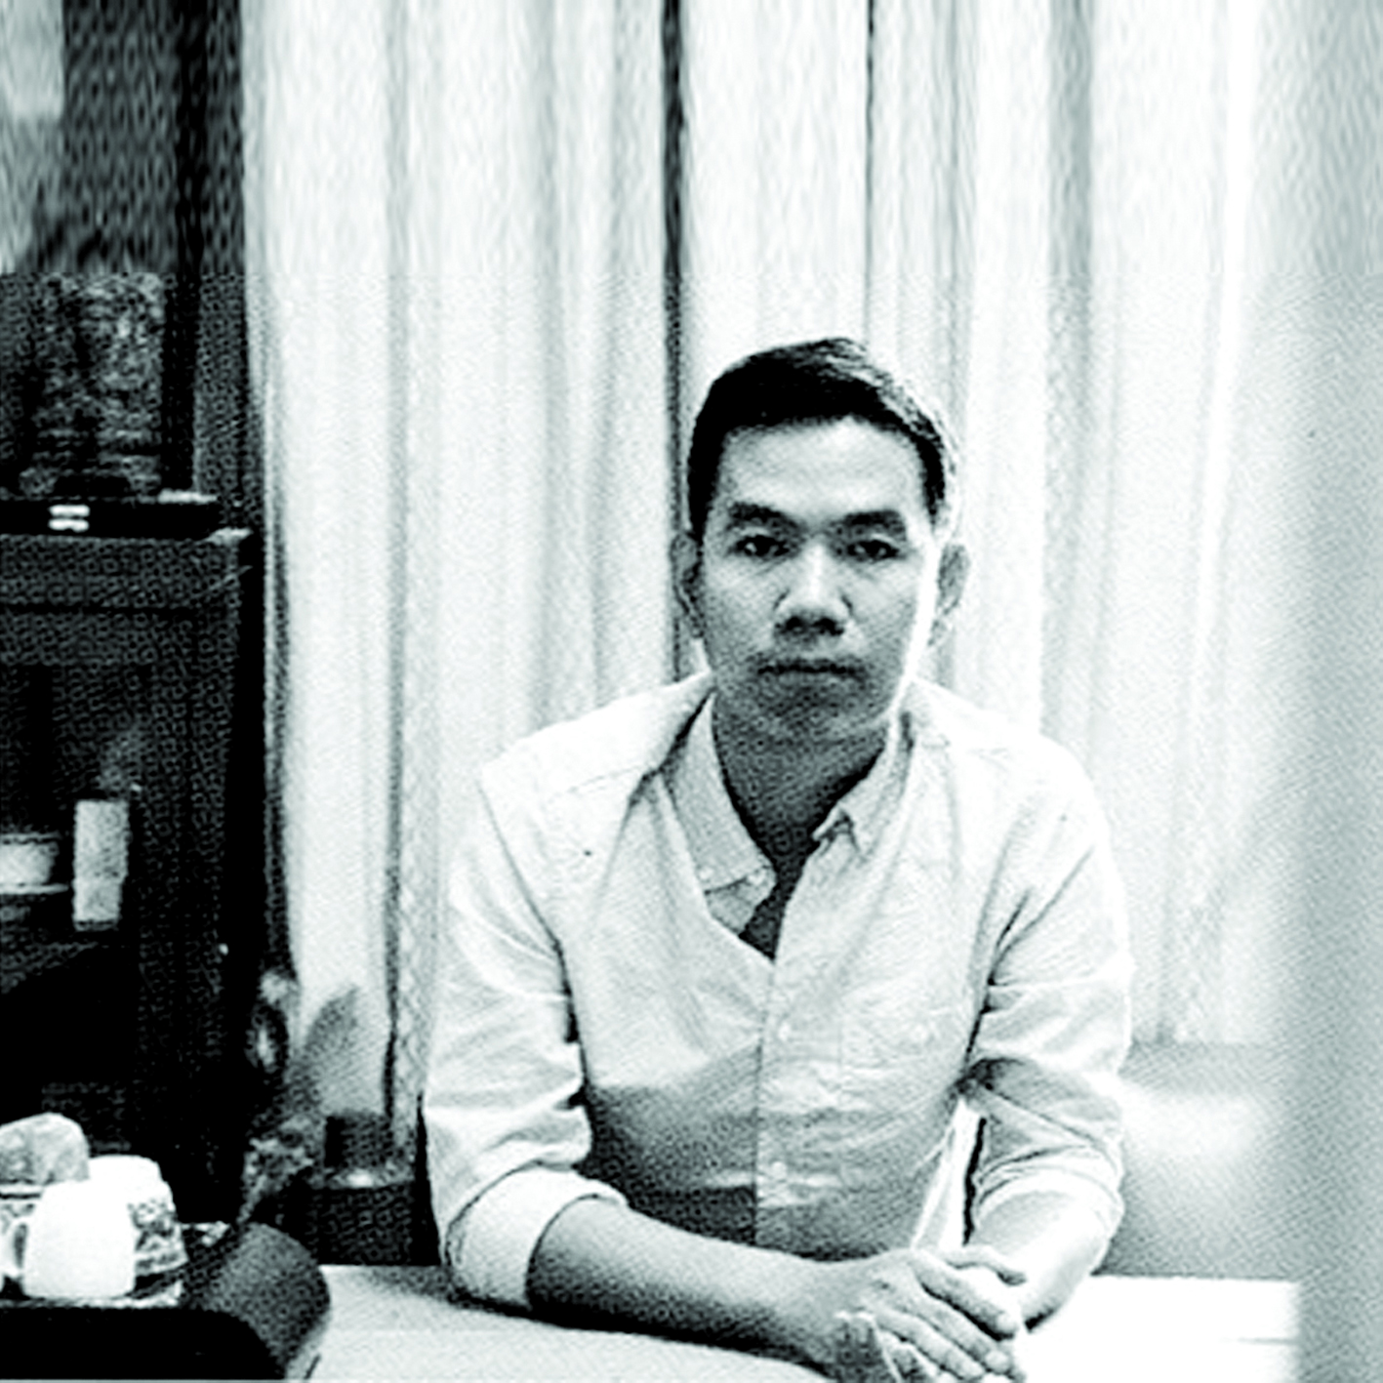
About Myself • 2002 - 2006 - Senior Graphic Designer at Open Magazine • 2007 - 2008 - Certificate in Textiles for Interior at Central Saint Martins Collage of Art and Design, University of Art London • 2010 - Present - Co-Founder, Editor-in-Chief and Art Director of Openworlds Publishing House • A Book Cover Designer

Slide 2
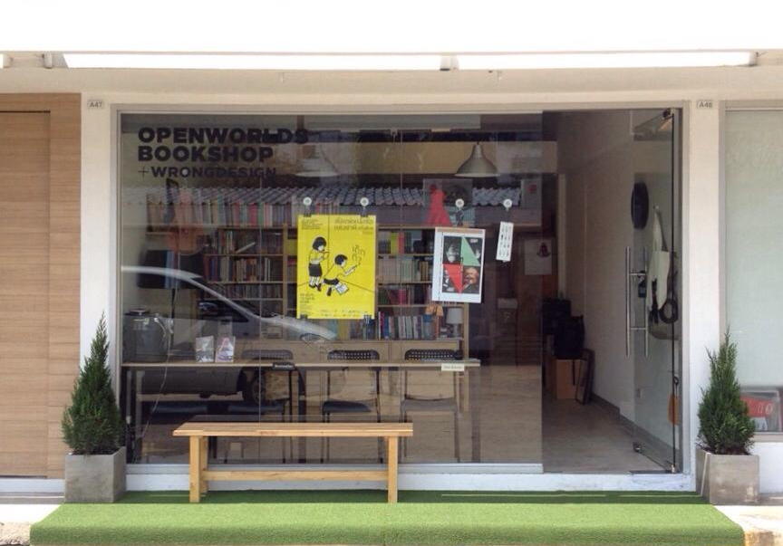
About Openworlds
• Founded in 2010, Openworlds believe that loads of foreign books are valuable
and they are waiting for Thai people to read.
• Our motive is translating them and making the perfect way to convey them
to Thai readers. We focus on non-fiction books such as economics, politics,
modern business, interesting history, or any kind of knowledge for studies.
Including art and design.

Slide 3
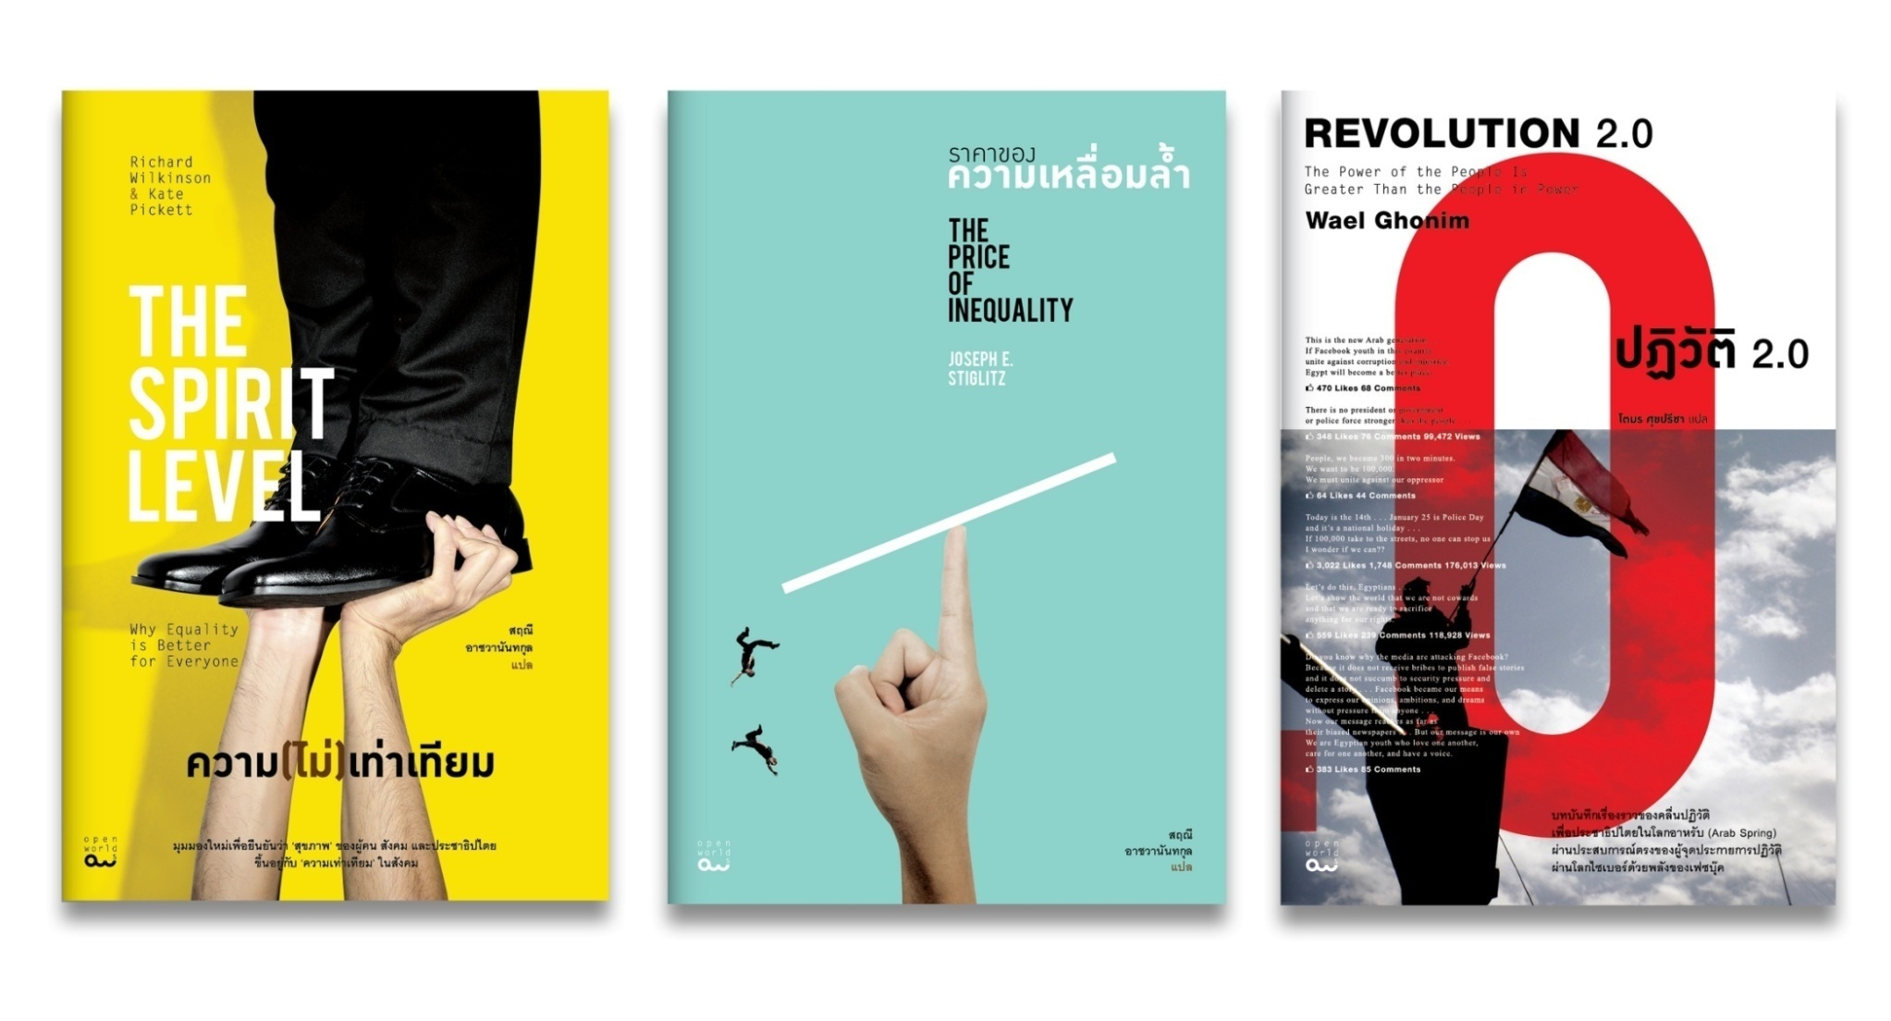
Economics and Politics

Slide 4
Interesting History

Slide 5
Art and Design

Slide 6
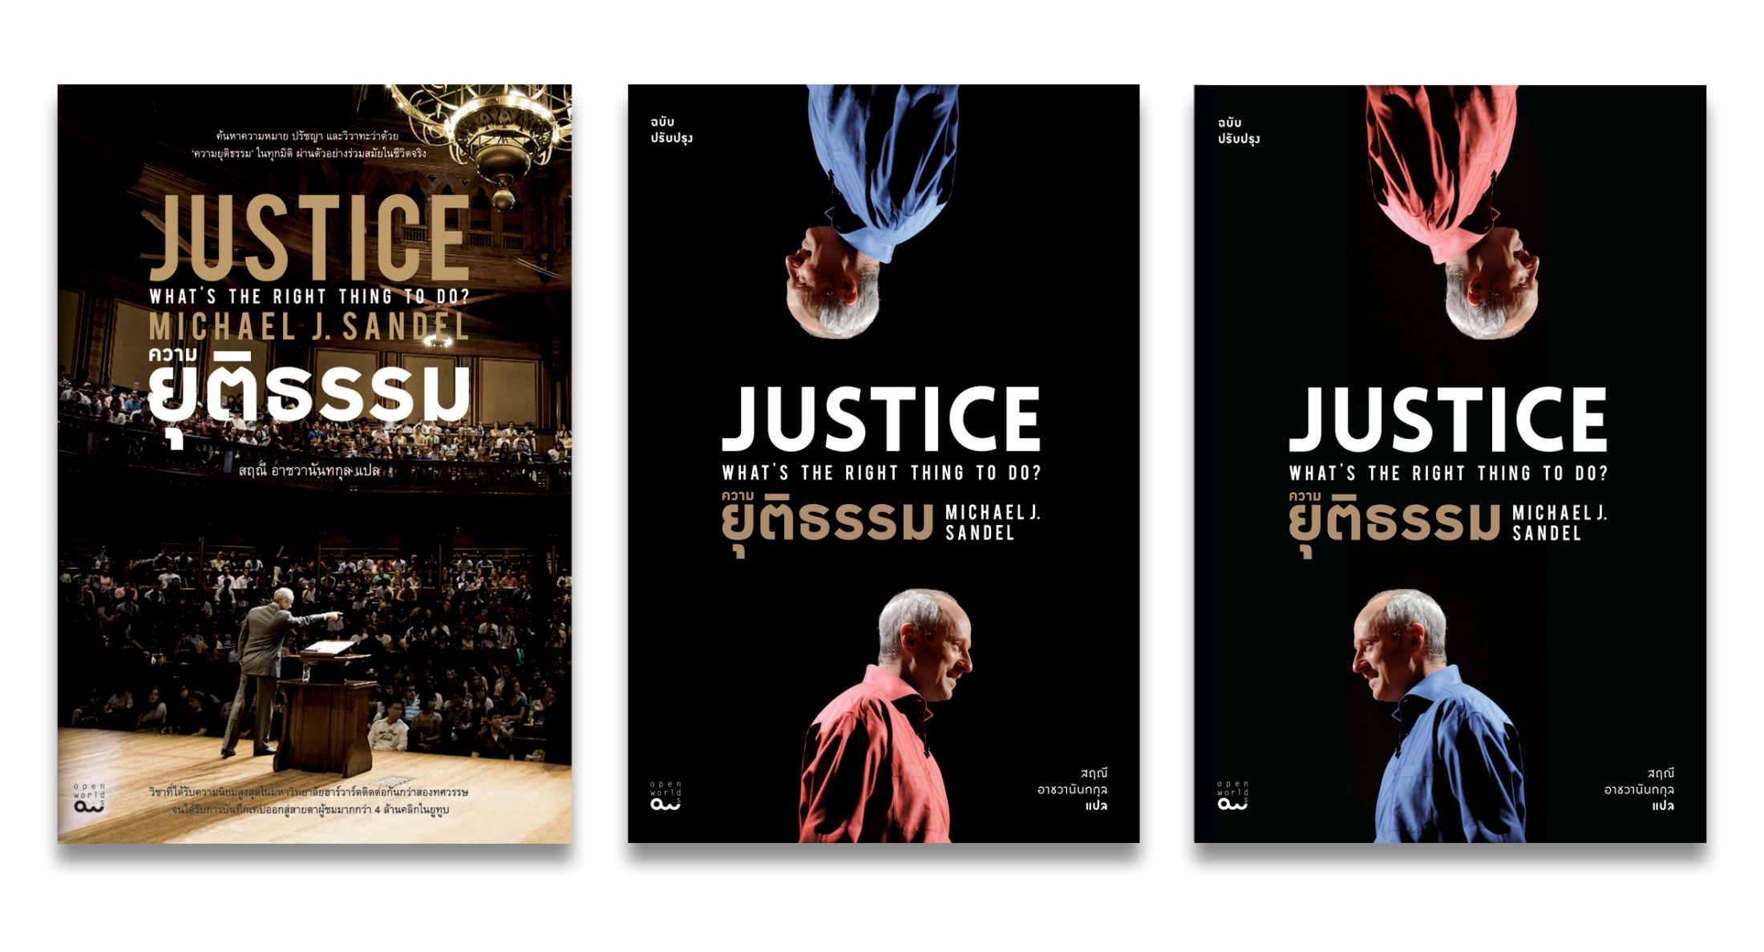
Justice : what is the right things to do
by Prof. Michael J. Sandel

Slide 7
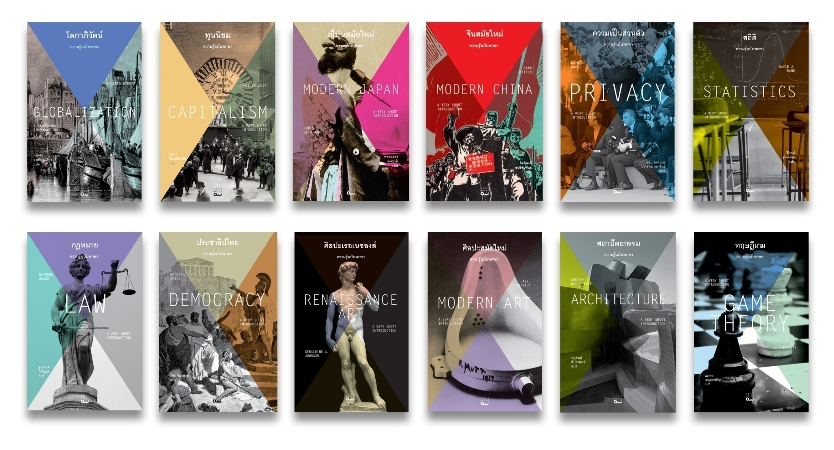
A Very Short Introduction Book Series
by Oxford University Press

Slide 8
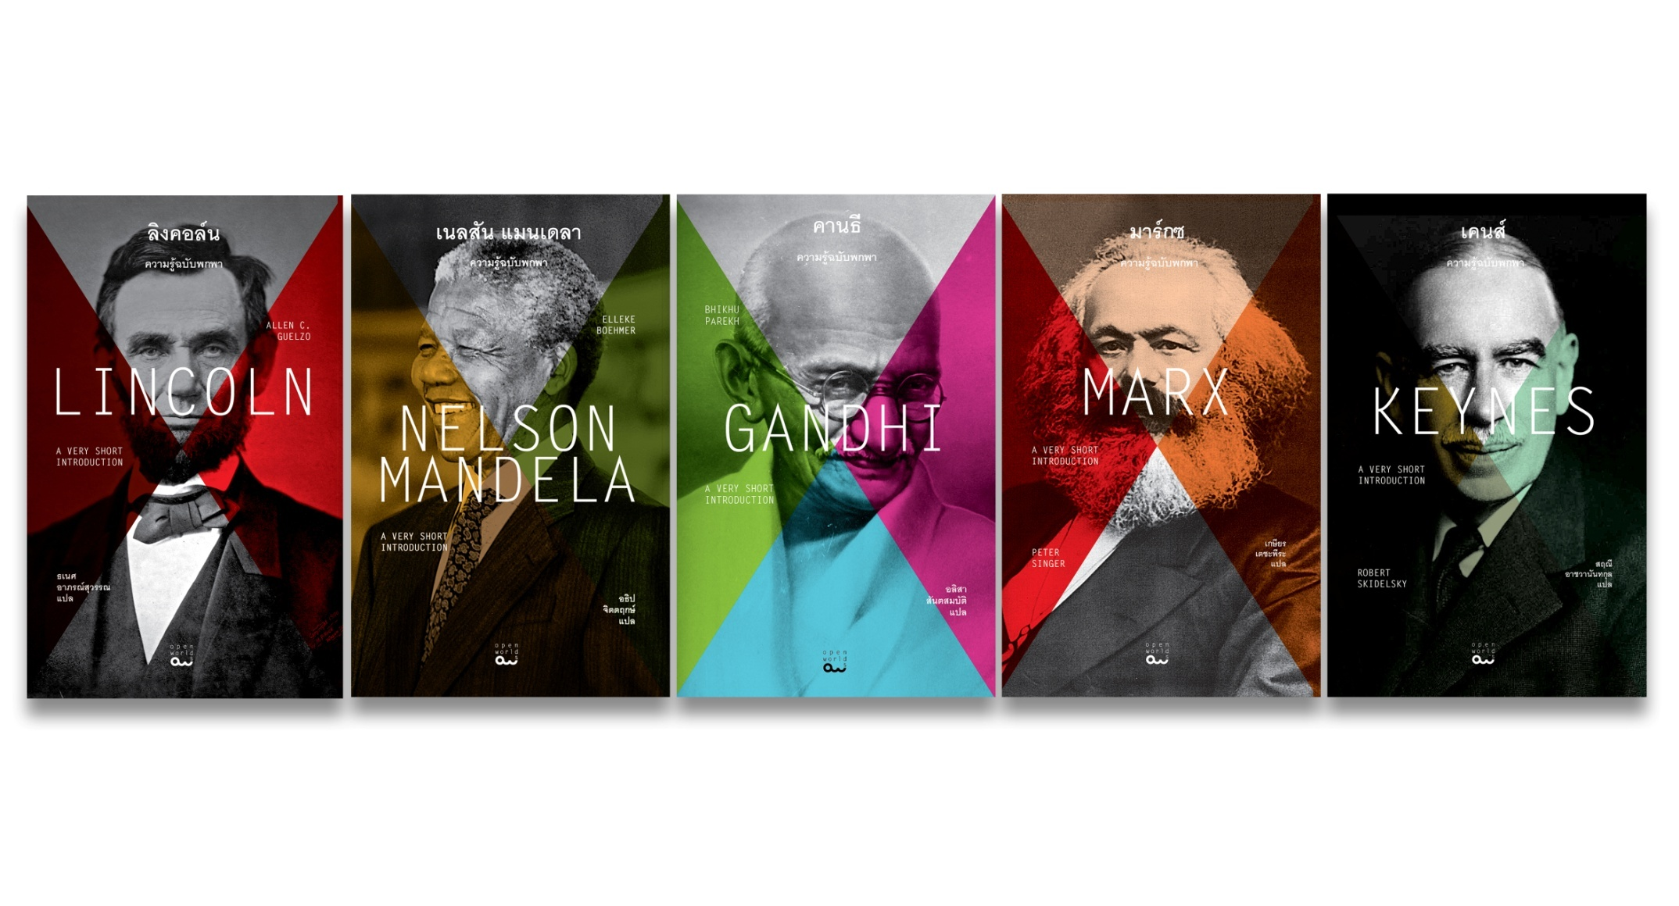
A Very Short Introduction Book Series (Cont.)
by Oxford University Press

Slide 9
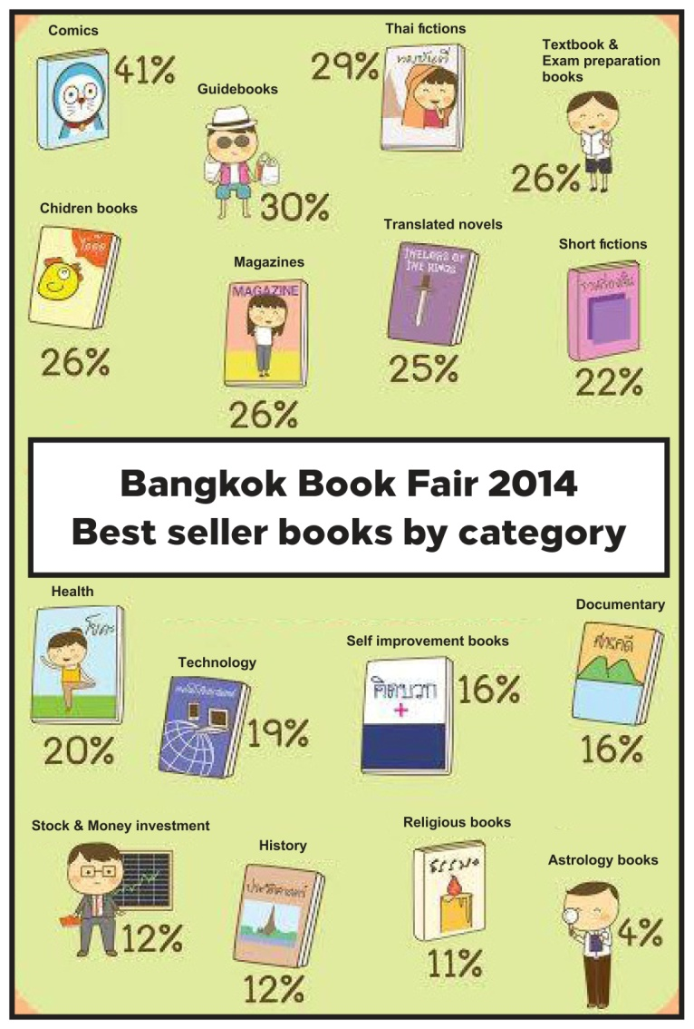
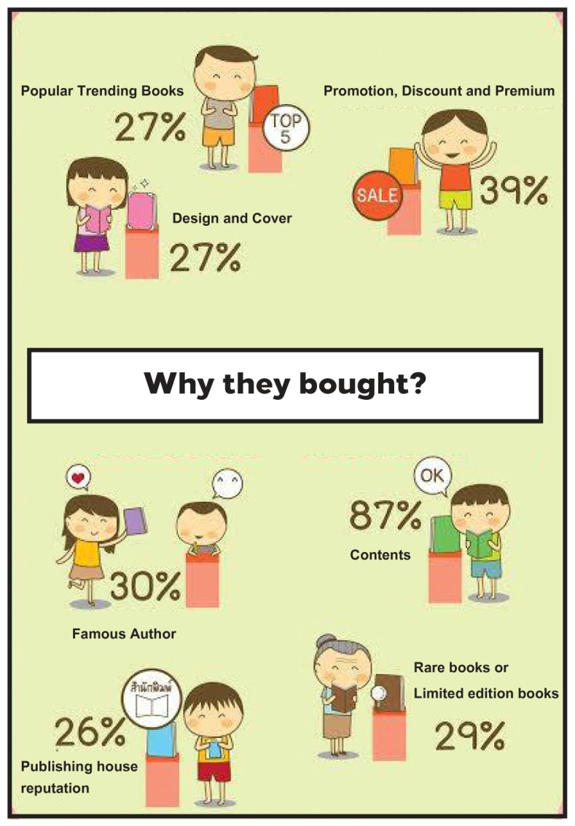
Publishing Trend in Thailand
• The trends keep changing
over the past 10 years.
• Bestsellers were varying
from ethics and morality
to guidebook, from
how-to to modern
business, from business
book to travel and
journey.
• Currently, investment and
self-improvement are
pushed on the trend.
Courtesy of PUBAT (THE PUBLISHERS AND BOOKSELLERS ASSOCIATION OF THAILAND)

Slide 10
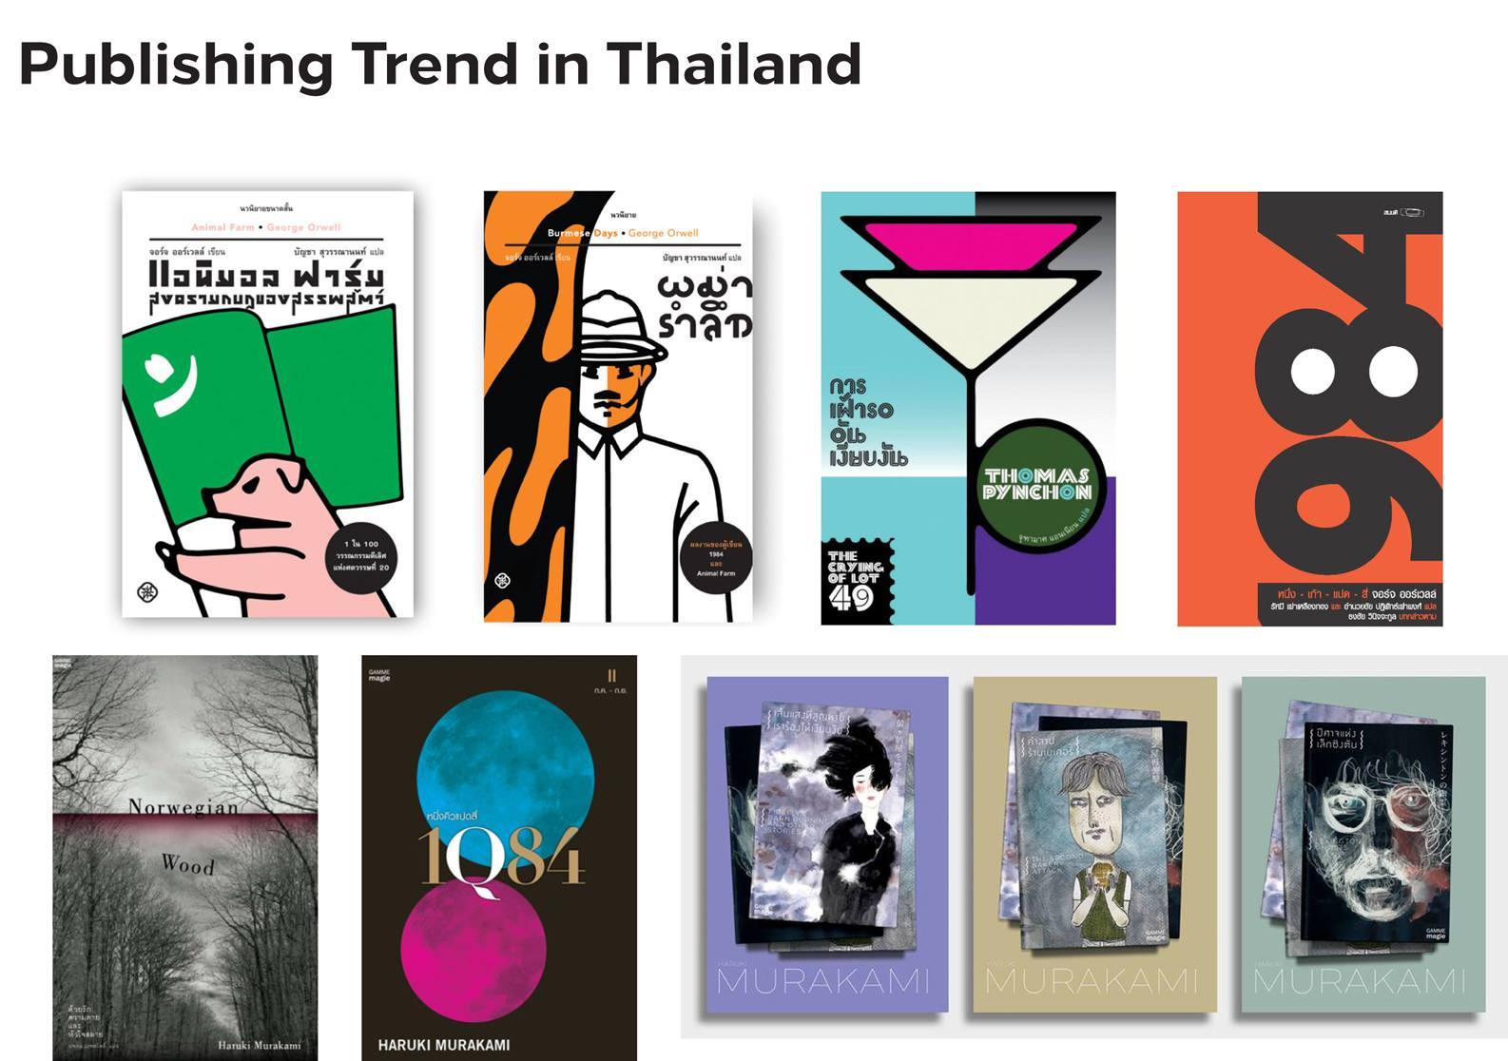

Slide 11
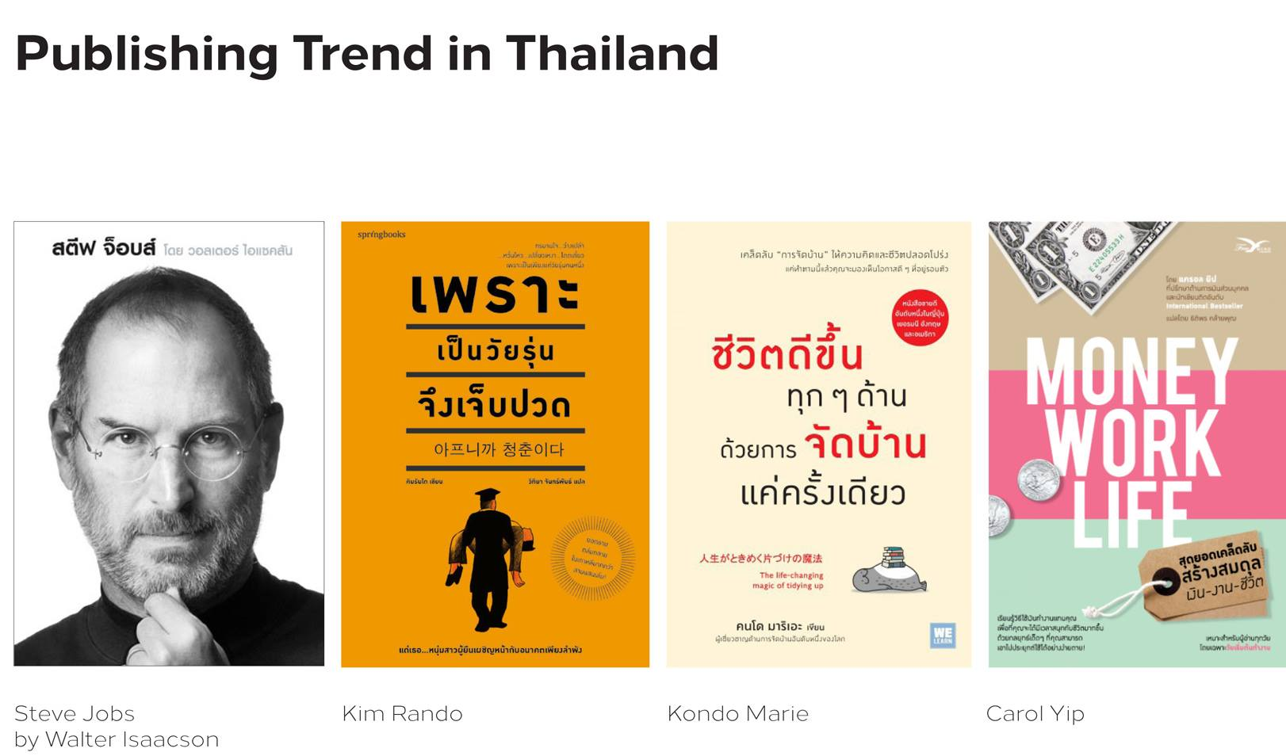

Slide 12
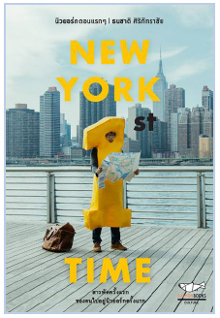
The Era of the Proteur:
Changing Roles of Editors
in Thailand
In this decade with developing technology in the internet use, we have a lot of newbies who write their journals on personal blogger.
Most often, their first published book is a compilation of their online journals.
Those books have various range of contents, but the most trendy one is about travel experience.
Thailand’s leading publishing houses assign their editors to seek newbie writers who are popular or having heaps of followers.
‘Tokyo Has No Leg’ is the book about journey in Tokyo with only $350 in 9 days. It was written by a young guy who had worked in advertising company. Since it was first published in 2004, It was reprinted more than 10 times and inspired Thai youngsters to get out to see the world.
‘New York 1st Time’ the book which is one of the most successful book in 2014. It’s telling the stories and experiences of a Thai photography student in New York. Most of critics said even the writer wasn’t a professional writer but its wording is a huge fun and can communicate to a wide reader.

Slide 13
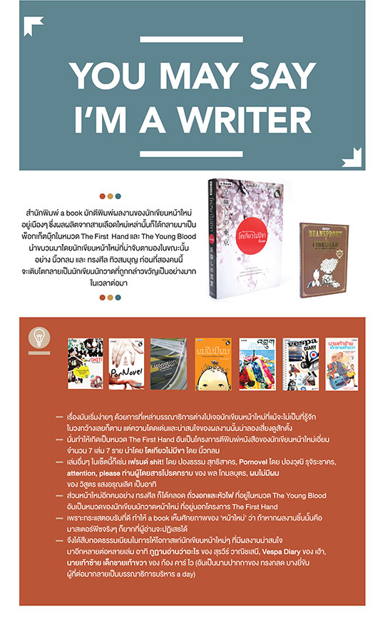
The Era of the Proteur:
Changing Roles of Editors
in Thailand (Cont.)
The publishing houses ‘a book’ introduced a project called ‘The First Hand.’ It is the project that lets the editors screen a book from newbies who have never had their book published before. a book published the first book from 6-7 selected newbie as a project. Then published all at the same time to gain public interests.

Slide 14
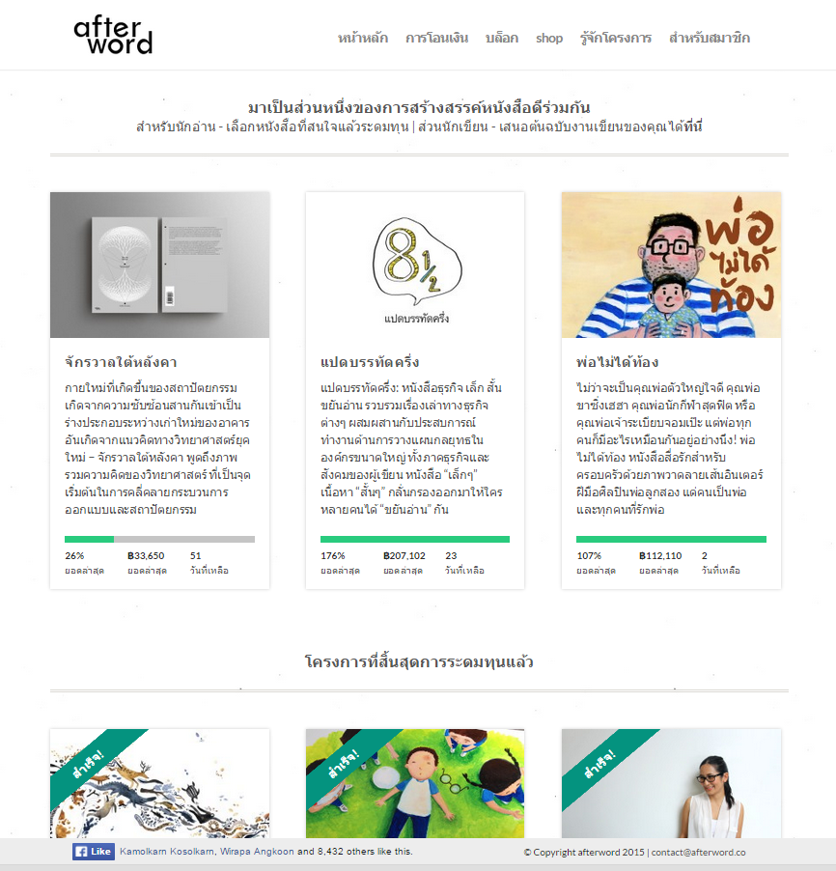
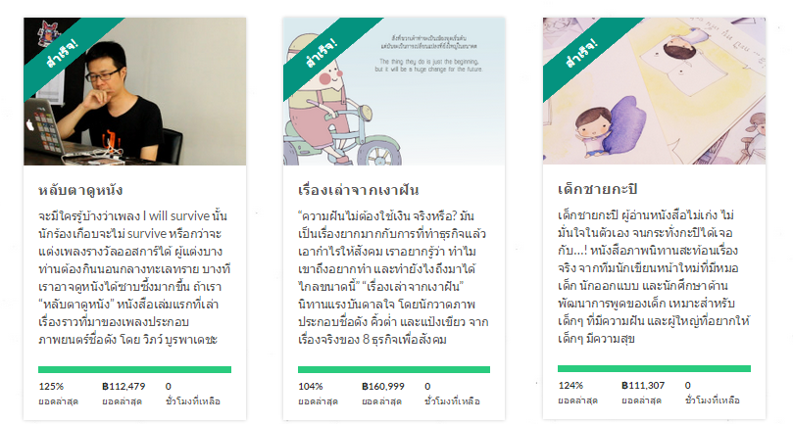
The Era of the Proteur:
Changing Roles of Editors
in Thailand (Cont.)
Afterword.co is the websites that raise fund for book publishing.
Afterword.co does not limit type of the books, all types are applicable. But It has criteria for consideration.
Afterword’s operating system identifies certain days of fundraising, description of the book, an outlay required for each project, interview clips of the writer and relevant parties for PR.
Afterword has been successful in raising fund for all projects. One of the reasons is that the budget is not set too high. Each project costs around a hundred thousand baht (2,800 USD).

Slide 15
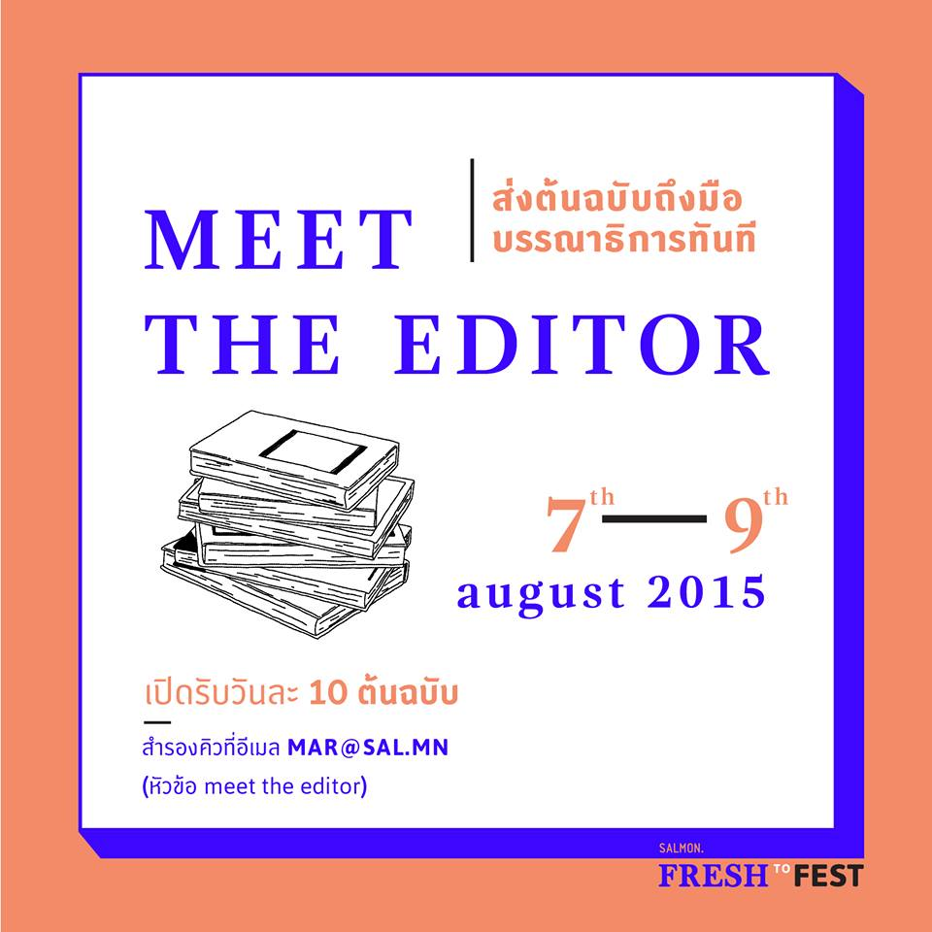
The Era of the Proteur:
Changing Roles of
Editors in Thailand
(Cont.)
In one small book fair in August, 2015. Salmon Publishing House provided the event - ‘Meet the Editor’
The event give an opportunity for anyone who wants to be a writer to present his work to the editors.
Out of hundred books submitted by the candidates, they chose 30 presenting their work on the date of that event and they could also have a discussion with the editors.

Slide 16
The Era of the Proteur:
Changing Roles of
Editors
Understand the change and be adaptive
Technology fastens communication: building sales and connection with readers
Listen to other opinions and open up to possibility of meeting newbies in publishing work
Maintain standard, detail, and professionalism at work
‘Global Change’
Openworlds publishing house
2015

