Slide 1
The Era of the Proteur
Presentation to Asian Publishers Fellowship Program
Alex Hedley
Publisher, General Non-fiction
Penguin Random House New Zealand

Slide 2
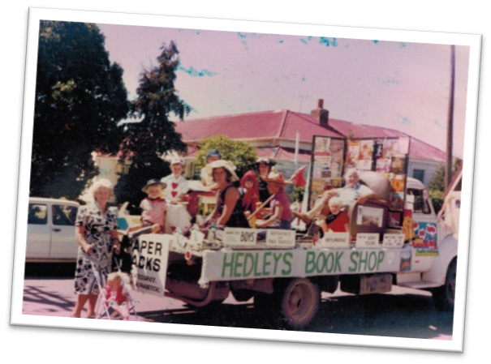
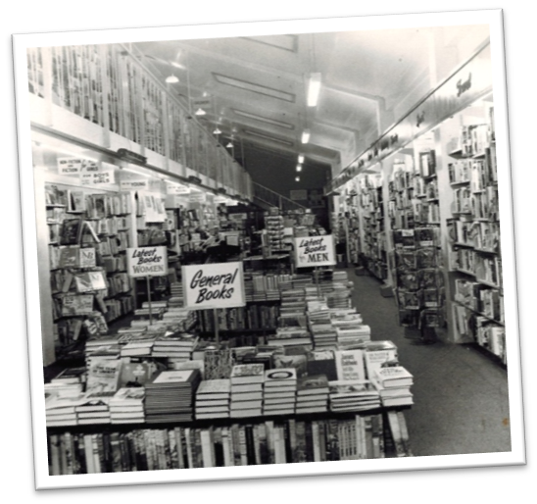
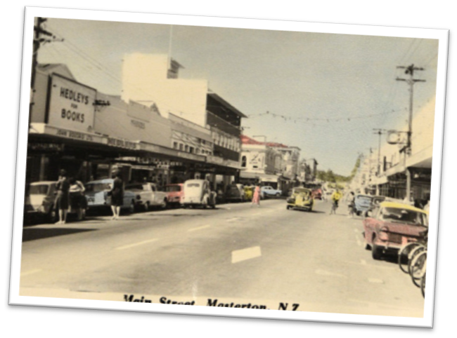
About me
Christmas parade
Hedleys Bookshop
Masterton
Notes:
About me
I come from a bookselling family. My great grandfather started Hedleys Books in a small rural town called Masterton in 1907. It has survived two world wars, the flu epidemic, the Great Depression, advent of television, the Internet and Amazon.

Slide 3
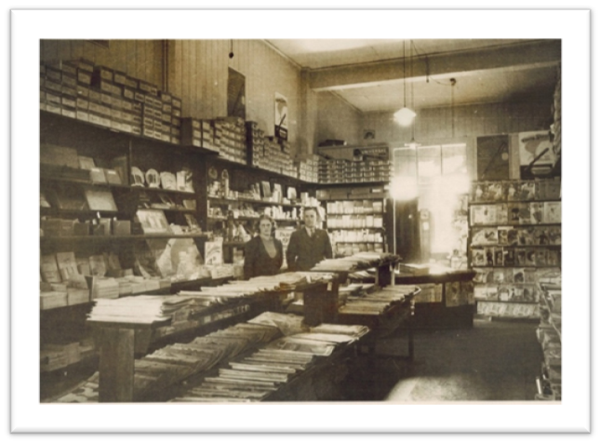
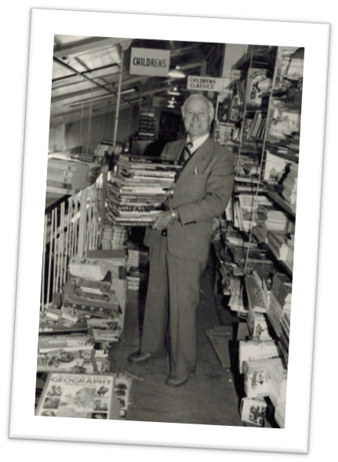
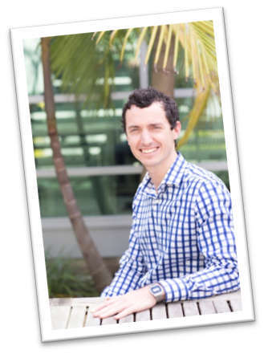
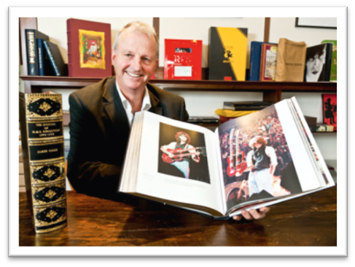
My great-grandfather
William Hedley
My grandfather
Alex Hedley
Me
My father David

Slide 4
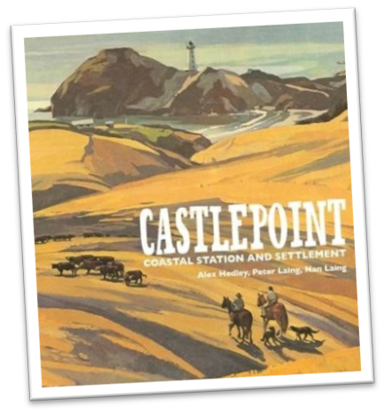
Author and photographer
Author
Author and photographer and design

Slide 5
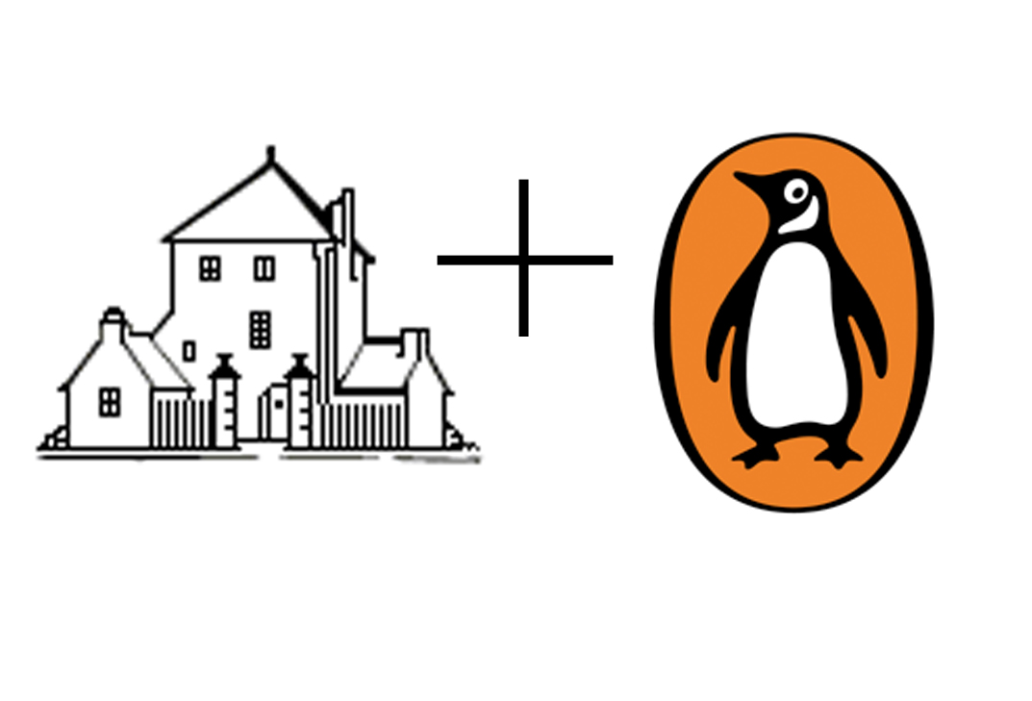
Change is always constant!

Slide 6
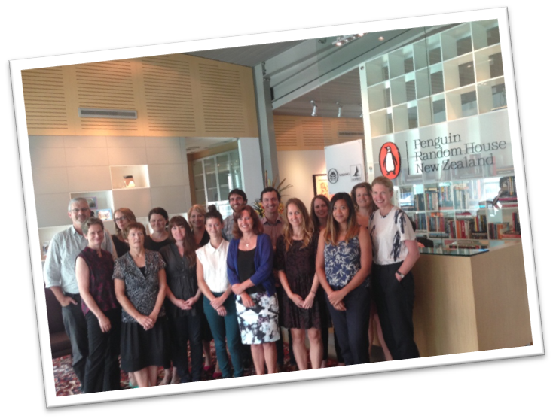
New publishing team
New Auckland office

Slide 7
My job
Generate book ideas
Publish 15 books per year
Spot trends and listen to popular culture
Commission authors
Commission writers
Brief editors and proofreaders
Direct designers and photographers
Oversee the editorial and production
Sell the book in-house

Slide 8
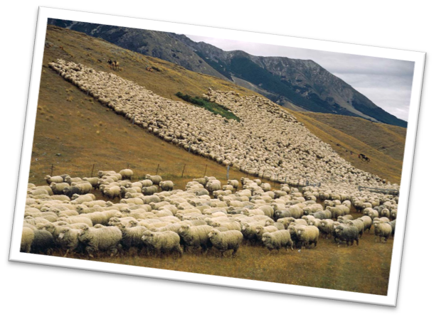
The New Zealand Book Industry
Small market of 4.5 million people, but we love reading books!
84% of adults read at least 1 book per year
Library usage and literacy among world’s highest
77% prefer print
14% prefer digital

Slide 9
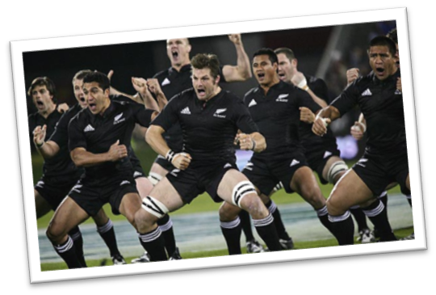
The New Zealand Book Industry
90 active publishers
2000 books a year
3500 revisions
USD $295 million p.a
408 bookstores
217 public libraries
We like books about rugby, the outdoors, the natural world, hunting, inspiring New Zealanders, and food
We like real Kiwi stories - locally published titles make up 50% of all non-fiction sales
Average first print-run of 3000-4000 copies

Slide 10
NZ-published share of total market and main subjects
Source: Nielsen BookScan

Slide 11
Top 50 non-fiction (2012) by country of publication
Source: Nielsen BookScan
Notes:
Stats a bit old but market flat since then.

Slide 12
New Zealand non-fiction High value and high volume
Notes:
New Zealand non-fiction that sells

Slide 13
Top 50 fiction (2012) by country of publication (dominated by international titles)
Source: Nielsen BookScan

Slide 14
New Zealand fiction (mostly literary)
International
bestseller
Man Booker
shortlist
Man Booker winner 2013

Slide 15
Retail
Source: Nielsen BookScan

Slide 16
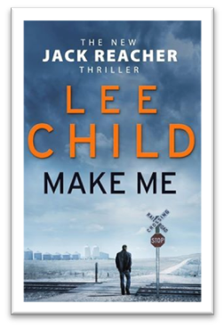
Publishing trends
Cookbooks
Mindfulness
International
fiction
War history
Heartland

Slide 17
Penguin Random House publishing (2015)
30% New Zealand market share
16 childrens titles
43 adult non-fiction titles
16 fiction
75 total

Slide 18
The Era of the Proteur
In New Zealand we don’t have literary agents
One third of our non-fiction books are generated by commissioning editors
We are ‘hunter’ publishers - we look for gaps and trends, trawl through media, spot new talent
This hasn’t changed (what has changed is where we look for them)

Slide 19
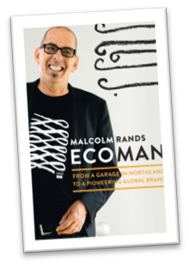
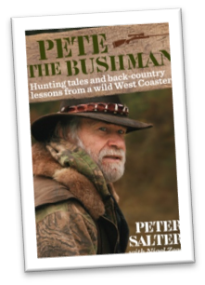
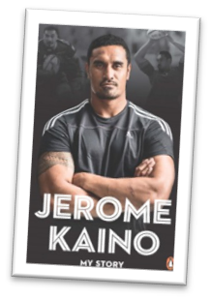
73% publisher-generated
Notes:
14 of 19 generated ideas

Slide 20
Working with authors (who aren’t writers)
Need to be convinced
Need to be educated about the process
Need to be hand-held every step of the way
Need early feedback on writing samples
Help to translate visual content
Help with their target market
YouTube sensation with over 10 million Facebook likes.

Slide 21
Celebrities and pop culture personalities need extra support
Often need:
Ghostwriters
Heroic editors
And on:
Tighter margins
With less time
Tiger Woods and Adam Scott’s caddy
Notes:
They have great stories but aren’t great story-tellers. We have a tradition of using ghost-writers and very skilled editors for our narrative non-fiction.

Slide 22
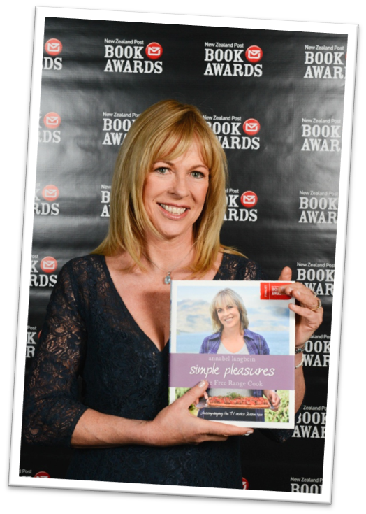
Proteur publishers (authors who self-publish)
85 publishers registered in NZ
Big brand authors
Chefs
Niches
Fiction
Annabel Langbein
sells cookbooks in 70 countries
Notes:
Rise of the small press

Slide 23
Publishing professionals who start a small press
But what about?
Can do one part of the process very well
Distribution
Sales reps
Publicists
Printing off-shore
Shipping and customs
Metadata and SEO
Piracy protection
Returns
Writers
Ghostwriters
Photographers
Designers
Editors
Marketers
Media outlets
Notes:
Often have different profit-share models and simplified contracts.
The pitfalls of ‘having a go’ are infinite. The finished product to the untrained eye, might look like anyone could do it, yet as we all know, building a book, to a budget and to a schedule, is fraught with danger.
The inevitable mistakes, typos, design flaws, unsuitable design and packaging of the self-published world discredits the book industry as a whole.
The role of the editor is more important than ever. We’ve always strived for perfection, but in an era of unprecedented self-published works, reader trust in our content is vital.
And for our non-fiction authors, particularly anything in the self-help, cooking and instructional markets, needs to have a credible publisher behind it for booksellers to take seriously. In this respect, the power of reputable publishers has never been stronger.

Slide 24
Jonathan Galassi Poet and publisher
‘I think that people who think that publishing is going to become self-publishing, and that this kind of activity is outdated are wrong, because writers need editors to understand them, and interpret their work — because they shouldn’t be doing that. They need other people doing that. So that fundamental activity of editorial activity is still the same as it always was, and that’s not changing.’

Slide 25
What to do?
We can’t ignore the future…
We must also ‘stick to our guns’
Believe in the traditional book format
Believe in our editorial processes
Believe in our editorial expertise
Believe in our attention to detail
Believe in our credibility (only credible content is King)
Editor more crucial than ever
Success is about community

Slide 26
Thank you!

