Slide 1
Initial Speech for the Round Table at
the
Asian Publishers Fellowship Program
by Fengbei Xie(Jieli Publishing House, China)
Sep 22, 2014

Slide 2
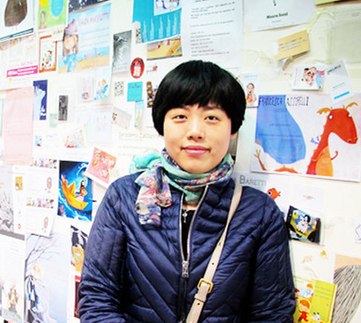
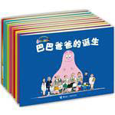
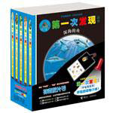
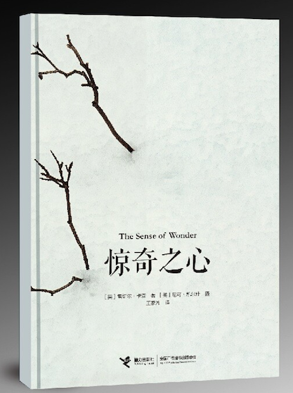
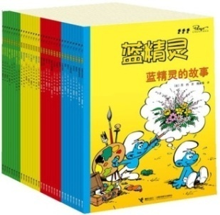
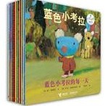
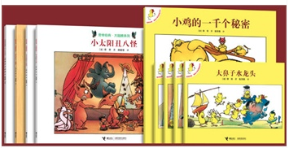
About Myself
Graduated with a M.A. degree from University Paris VII Denis Dideor 2006 in France.
Internship experience in Albin Michel Jeunesse and Actes Sud junoir in France as editor assissant and rights assissant in 2007
Rights manager and editor in Jieli Publishing House since August 2007.
translator for Barbapapa series, Claude Ponti's picture books etc.
Chinese Books I edited or handled rights for
Books I translated

Slide 3
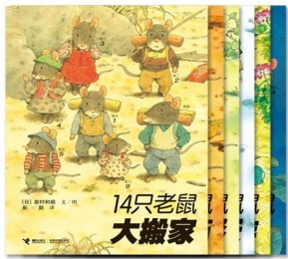
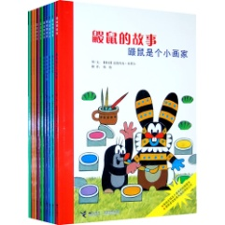
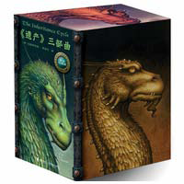
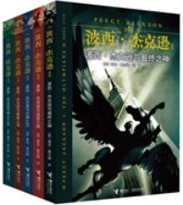
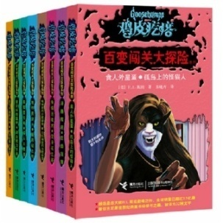
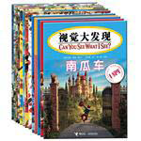
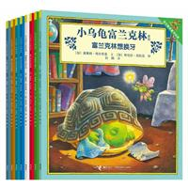
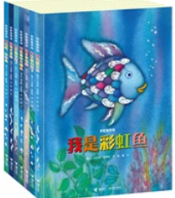
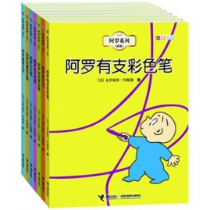
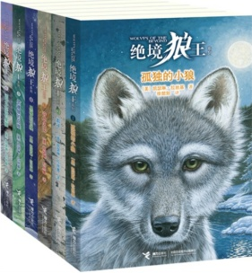
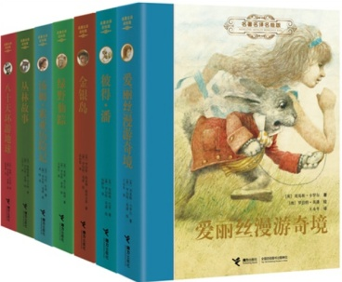
About Jieli
The word “Jieli” in Chinese means from generation to generation.
Founded in 1990, Jieli Publishing House is one of the leading publishers of children and young adults books in China, recognized and respected worldwide for its tradition of high publishing quality, professional team of editors, marketing and distribution for young readers.

Slide 4
A Book, 20 years and on…
Jieli is home to many children’s classics and bestsellers series, including Smurf, Barbapapa, little mole, 14 Mices, My first discovery, Goosebumps, Percy Jackson, Twilight, and to some of the biggest names in children’s literature, including Stephenie Meyer, Peyo, R.L.Stine, Rick Riordan, David Walliams
Jieli has established long-term relationship with international publishers like Scholoastic, HarperCollins, Random house, DK, Penguin, Hachette, Gallimard, Bayard, etc.
Jieli aims at long-term growth of a great brand in China.
Since 2002, Goosebumps has sold 8.09 million copies in China.
Jieli has been working with DK on The Complete Book of mother & babycare for 20 years.
Since 2003, The Mole has sold 1.3 million copies in China.

Slide 5
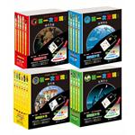
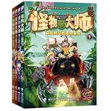
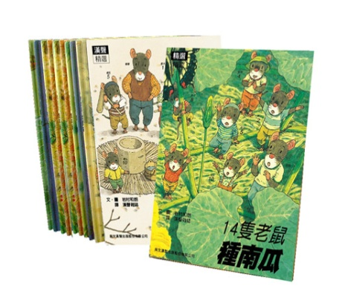
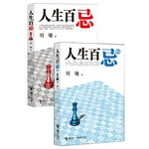
Jieli's Bestsellers
My First Discoveries has 4.15 million copies in print in China.
The Smurf has sold 2.18 million copies in China.
Barbapapa has sold 2.26 million copies in China.
Monster Master has sold 3.8 million copies in China.
Spot has 1 million copies in print in China.
I Spy has sold 4.16 million copies in China.
Twilight has sold 3.6 million copies in China.
Liu Yong’s books has 6.4 million copies in print in China.
Fourteen Mice has sold 1.41 million copies in print in China.

Slide 6
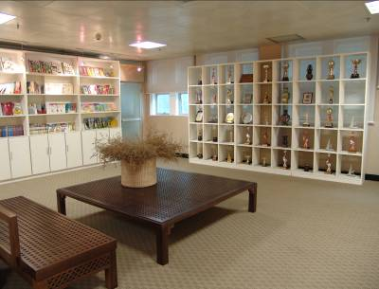
Guangxi Provence’s scene
Headquarters of Jieli

Slide 7
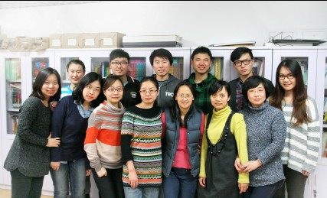
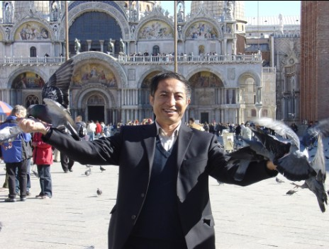
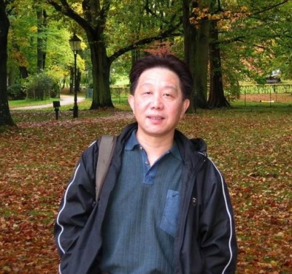
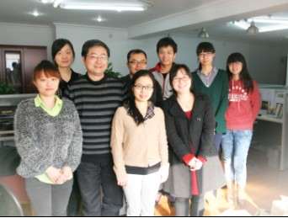
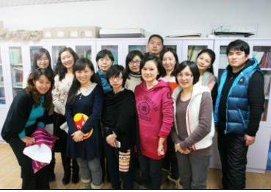
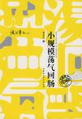
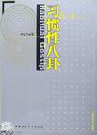
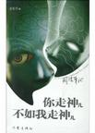
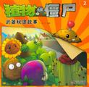
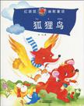
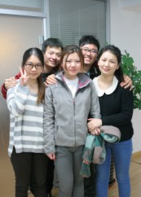
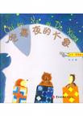
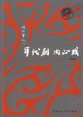
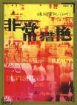
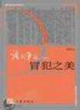
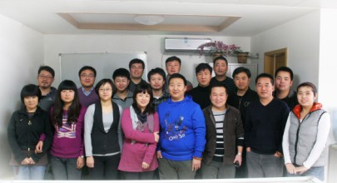
Jieli’s Team
Editor-in-chief of Jieli Publishing House, respected publisher, bestselling author, winner of multiple prizes, member of the children’s literature committee, Chinese writers’ association.
Vice Editor-in-chief of Jieli Publishing House, publisher, acclaimed author and "words collector“.
Editors:

Slide 8
Jieli's Global strategies
&
vision of the publishing industry in Asia

Slide 9
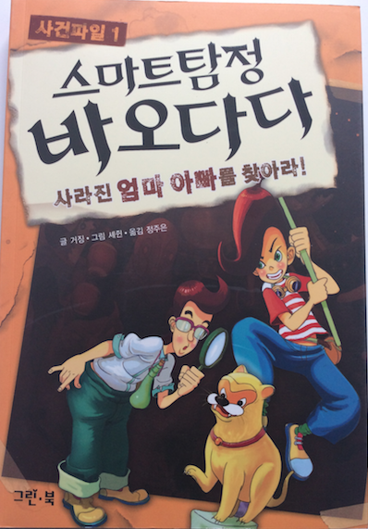
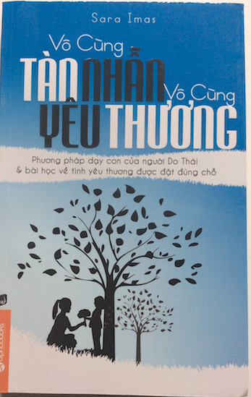
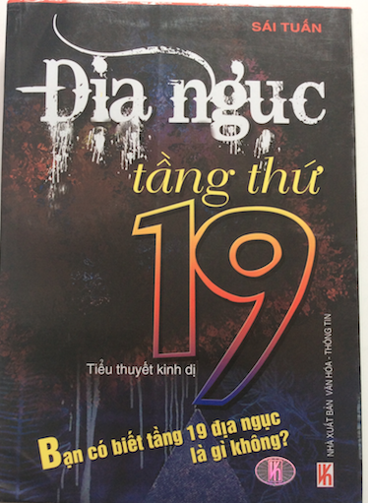
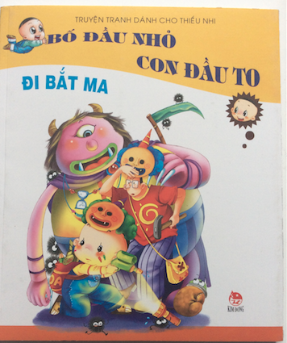
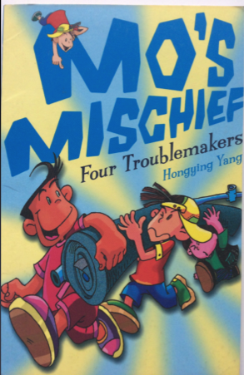
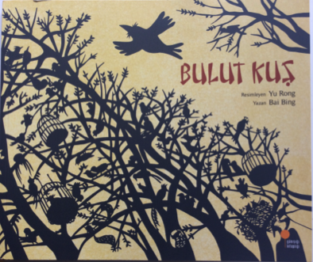
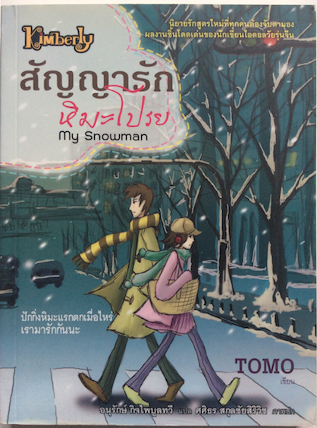
MORE AND MORE RIGHTS EXPORTATION:
Korean editon
Vietman eidtion
Thailand Edition
UK Edition
Turkey Edition

Slide 10
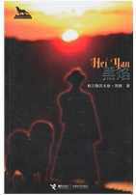
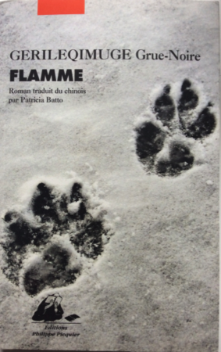
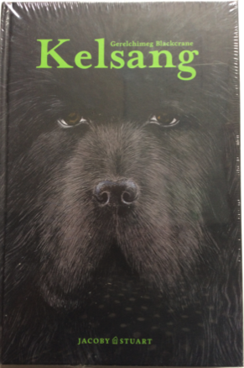
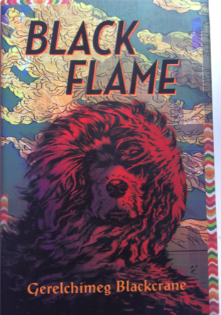
A very successful example:
Chinese Edition
French Edition
German Edition
English Edition
Korean edition is coming soon !

Slide 11
MORE AND MORE FOCUS ON ONLINE PUBLICITY
address directly to reader with website,blog,wechat etc.
Jieli official website，now is updating for new version.
Jieli official weibo, more than 30,000 followers
The influential parenting and social networking sites with good relationship with Jieli

Slide 12
ONLINE PUBLICITY: AUDIO BOOK, PROMOTION VIDEO
A primary school girl reading Chinese edition of Out of My Mind
Promotional video of Maximum Ride translated into Chinese.

Slide 13
ONLINE PUBLICITY ON ONLINE BOOKSTORES
Ponti collection Theme page at dangdang
The Smurf Theme page, with notice of reviewer lucky draw
Franklin collection Theme page at dangdang
Maximum Ride Theme page at dangdang

Slide 14
MORE AND MORE DIGITAL PUBLISHING:
My First Discovery’s 2 application on iPad and iPhone, was on the Top 10 list of 2012 Best Application for Children in China.

Slide 15
cooperation and partnership with Publishers in Asia would be further developed in a multi-level, multi-formula and all dimentional way
Creation
Copyrights Trade
Co-edition
Co-production

Slide 16
Successful example of collaboration between Chinese authors and foreign illustrators
A Feather is released in 2014, a collaboration between Chinese author Cao Wenxuan and Brazilian Roger Mello, both the creators have been nominees of the Hans Christian Andersen Award, Roger Mello won 2014 Hans Christian Andersen award. Rights sold in Swedish, Danmark, Korean, Brazil, Tunise,Mayalsia
An Japanese illustrator work with a Chinese writer for a picture book Story of Panda

Slide 17
Copyrights trade

Slide 18
Thank you and expect to have more discussion with you all!

