Slide 1


ARIOBIMO NUSANTARA
GRASINDO Publishing
KOMPAS GRAMEDIA

Slide 2

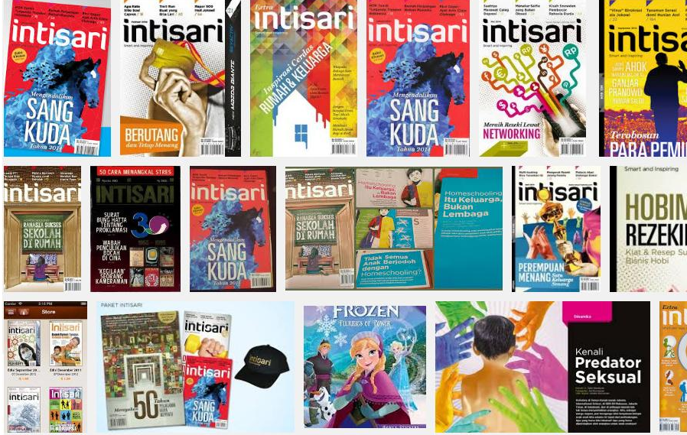
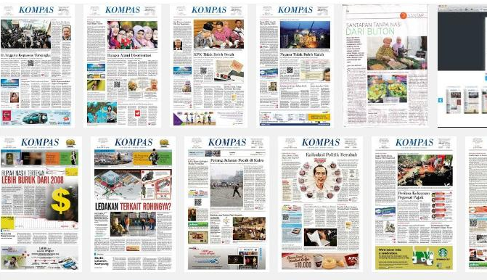
Kompas Gramedia was founded by Jakob Oetama and PK Ojong in 1963 by release Intisari monthly magazine.
On June 1965 they launched the first issue of a national newspaper called Kompas.
Intisari has grew into many business form, start with the first Gramedia bookstore in 1970, Gramedia printing network (1972), and Gramedia Pustaka Utama as the first publishing house (1973).
Kompas Gramedia now becomes the largest media company in Indonesia with 11 lines of businesses:

Slide 3
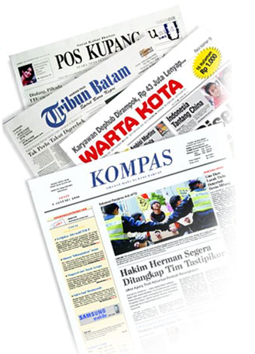
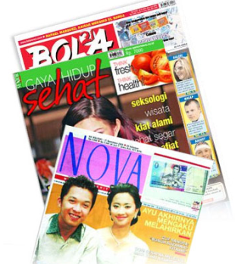
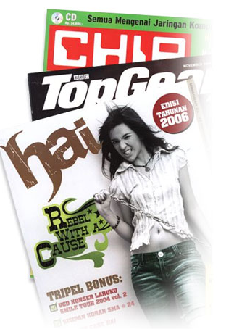
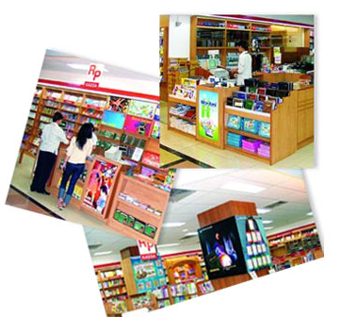
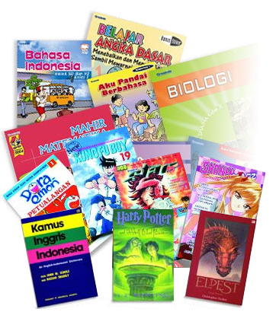
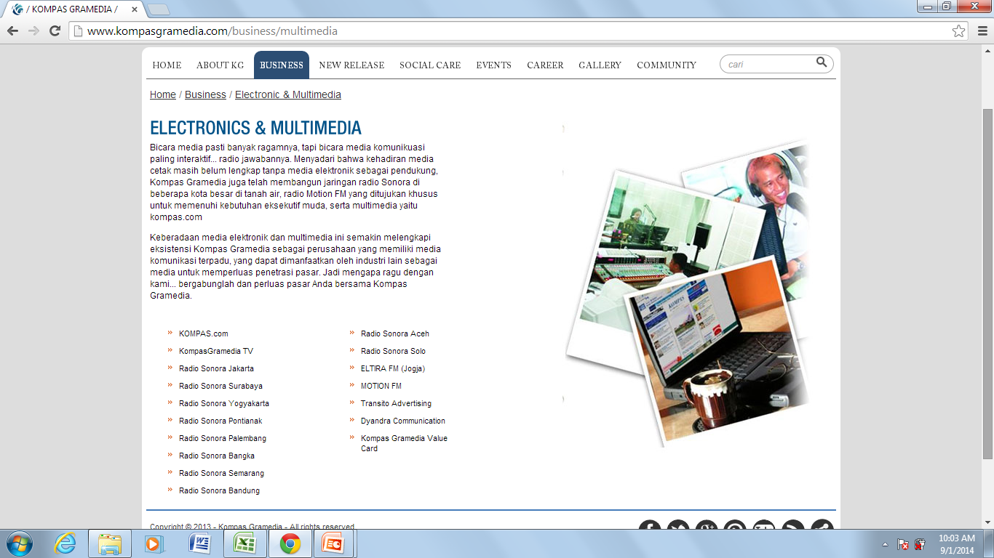
NEWSPAPERS: 27 national, local, and regional
TABLOIDS: 13 tabloids
MAGAZINES: 35 magazines
BOOK STORES: more than 100 book stores all over Indonesia.
PUBLISHERS: 7 units (Gramedia Pustaka Utama, Elexmedia Komputindo, Grasindo, KPG, M&C, Bhuana Ilmu Populer)
PRINTING Network
ELECTRONICS & MULTIMEDIA: (Radio Sonora, Kompas TV, Kompas.com)
TRAINING & EDUCATIONS: English Language Training (ELTI), Computer learning (BSW), Universitas Media Nusantara (UMN)
MANUFACTURES
HOTELS & RESORTS: Santika, Amaris
BUSINESS OF EVENT & VENUE

Slide 4
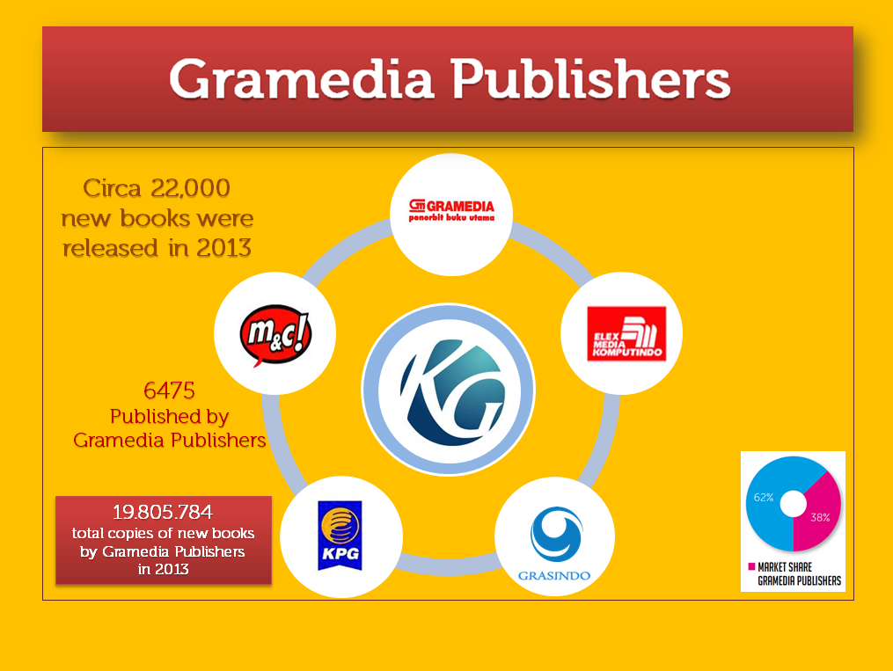

Slide 5

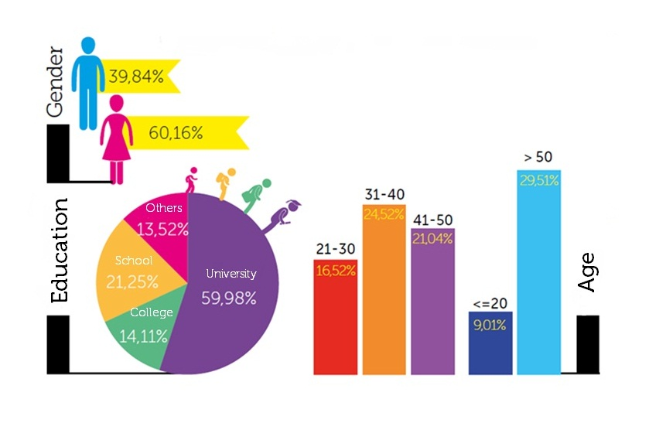
Source: InfoKita, Feb.2014

Slide 6
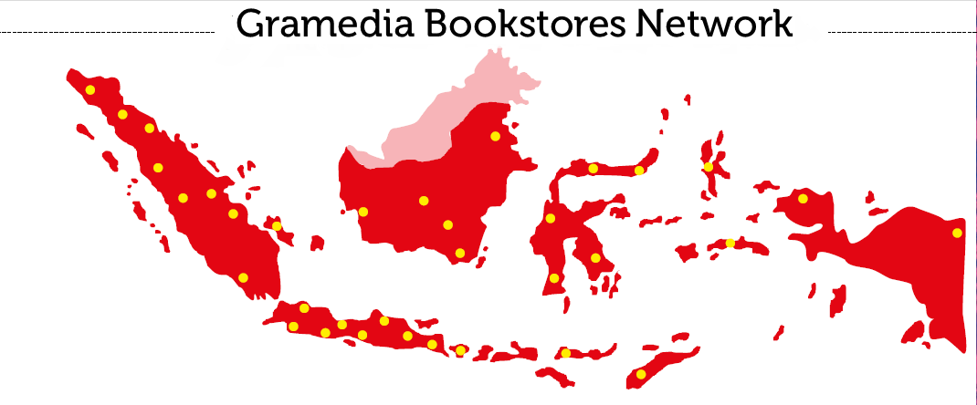
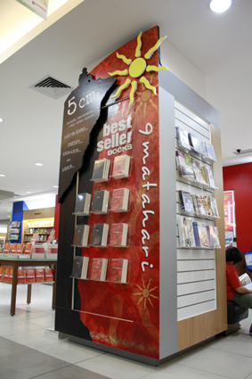


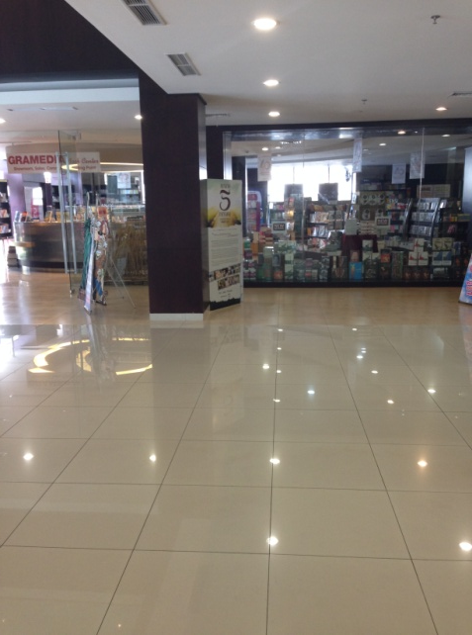
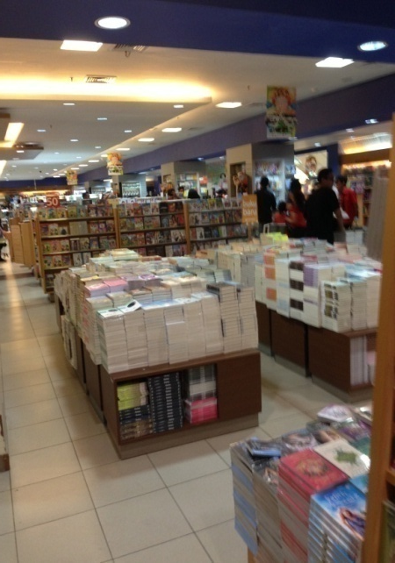
Source: InfoKita, Feb.2014

Slide 7

GRAMEDIA WIDIASARANA INDONESIA
Grasindo was founded in 1990, the same year as the National Act on Education was established in Indonesia.
The first publication were textbooks for kindergarten, elementary, high school, and university students.
As the need for teaching and educational material has grown, we have developed books of traditional folktales and expanded our list to include educational reference books, Indonesian literary fiction, and religious texts.
Annually we publish circa 500 titles.
Since 2014, Grasindo starts to develop interactive digital schoolbook by dealing a strategic alliance with a reputable educational software developer.

Slide 8


Slide 9

Market Share of Top 5 Departments
Children books
(incl. comics)
Fiction & Literature
Religion & Spirituality
Schoolbooks
Psychology/Reference & Dictionary

Slide 10
Top 50 Sales Rank of Aug 2014
million

Slide 11

Number of books published in Indonesia is not comparable with the Indonesian population number.
Average 3,000 to 5,000 copies of one new book title would be printed when it is considered without doubt will be bestselling.
Classical fact is the low rate of buying power and reading habit.
Buying power has its impact on the book price which should be made cheaper.
In 2014, there are 295 publishers in Jakarta, comparing with 2005 when there were only 175 publishers.
Growth in the publishing industry is evidence in children book and Islamic book departments.
40% of books printed in Indonesia were absorbed in Jakarta which should makes this city as the barometer of Indonesian publishing industry.
Encyclopedia book has been gradually replaced by Electronic books and Internet (such as Wikipedia).

Slide 12

1. New Format, New Channel
2. Special Product Line
3. Collaboration Project

Slide 13






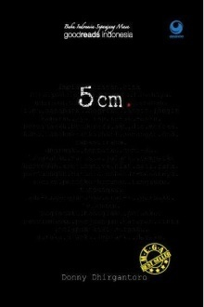
1. New Format, New Channel
Now is the revival era of national film in Indonesia. Many producers thirst for story ideas that they race to approach publishers or writers with interesting publication to be adapted into the films or the TV dramas.
Gramedia Publishers is considered as one of the big storage of story ideas.

Slide 14


5 cm firstly published in 2005 and remains to be one of our best seller novel.
The film was launched in 2012 with the same title and has been viewed by more than 3.000.000 viewer.
Book publisher and film producer do the join promotion program.
When the film hit the cinemas in December 2012, the book was re-launched with it’s new fresh cover. The sales then was increased.

Slide 15



Coming soon in Cinemas (2015/2016):

Fira dan Hafez
(Fira and Hafez)
Akademi Harapan
(The Hope Academy)
Haji Koboi
(The Cowboy Haji)

Slide 16
2. Special Product Line
Korean wave have been hit all over the world, including Indonesia in the 1990s with one of the most popular Korean drama ‘Winter Sonata’.
Since then, many dramas and films have made it on to the televisions of Indonesian houses.
Young generations tend to look to Korea for their lifestyle and fashion as well. The influence of K-Wave is to be far greater in Indonesia.
The love for Korean language, music, cinematography, and culture provides great bridge between the two countries.

Slide 17




















Slide 18

Who are the authors?
Most of K-fiction authors are local author—mostly young author.
Most of them have to never visit Korea as well.
Most of them are K-Pop or K-Drama fanatic fans.
Before becoming a professional writers, they start writing on their own blog, for their own pleasure.

Slide 19
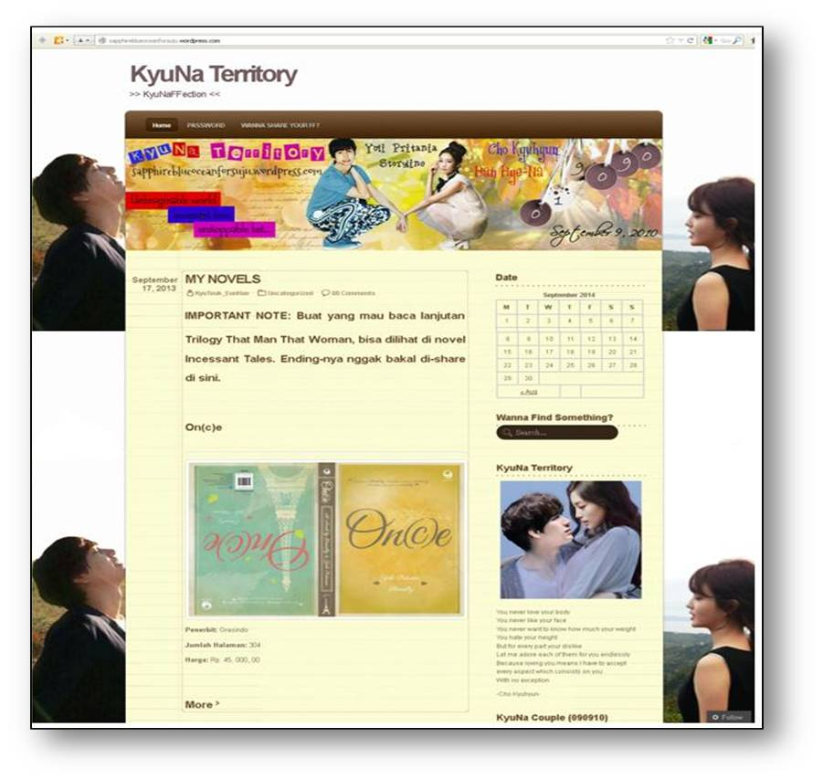

Yuli Pritania’s blog http://sapphireblueoceanforsuju.wordpress.com
Writing in personal blog in chapters form.
Getting comments from blog readers.
Chapters then are compiled as a script and submitted to the publishers.
The book is promoted through the blog.
Byanka Sastra’s blog
http://ImaginePiggy.wordpress.com

Slide 20
3. Collaboration Project
just an idea…
Co-writing amongst Indonesian and South Korean authors.
Work together to build up th plot, character, storyline. Each author can develop their own story proportionally.
Once completed, the script will be handled by Indonesian and South Korean editors.
The script will be printed in two version: Indonesian and Korean or even in English for international market.
Cultural dialog is expected to occur during the process between author/editor of the two countries.
This idea can be developed to involve author/editor from other countries.


Slide 21

ariobimo@gramediapublishers. com
©Asian Publishers Fellowship Program
Seoul 2014

