Slide 1
PUBLISHING and COMICS IN MALAYSIA
Asian Publishers Fellowship Program in Seoul 2011
19 - 23 Sept 2011

Slide 2
Malaysia Publishing in General
Current Population: 28.8 million
Malaysia is a multi-ethnic, multi-cultural and multi-lingual country
The book industry is estimated to be worth about RM1.5 billion a year (USD 499 million)
500 publishing companies in the country, only about one-third are active

Slide 3
Statistics of Books Registered under the Library Depository Act, 1986
LEVEL | 1997 | 2005 | 2006 | 2007 | 2008 | 2009
Textbooks | 1,553 | 3,863 | 5,493 | 2,325 | 4,366 | 3,969
Children | 2,383 | 2,470 | 3,929 | 5,040 | 4,440 | 4,189
Adult | 1,621 | 3,977 | 5,141 | 3,658 | 7,238 | 7,609
Total | 5,557 | 10,310 | 14,563 | 11,023 | 16,044 | 15,767

Slide 4
Over 600 bookstores nationwide, varying sizes for all of 28.8 million people; about one bookstore for every 48,000 people
45% outlets are concentrated in Kuala Lumpur and Selangor area, 20% in the northern especially Perak and Pulau Pinang, 10% in Johor are actively involved in book selling
Some bookstores aren’t just bookstores; they also carry other products such as school and office supplies, etc.
This is typical of Malaysian bookstores, from a peddler sitting on the pavement to the luxurious air-conditioned showrooms in the shopping malls

Slide 5
Literacy Level & Reading Habits
Are Malaysians really into reading?
Today, our literacy level is above 90% and the actual practice of reading, although mostly for learning purposes, is 87%
Yet, a major concern is the shrinking number of those who can read but do not read!
The absence of a strong reading culture among Malaysians - 8 to 12 books (or even lesser) in a year

Slide 6
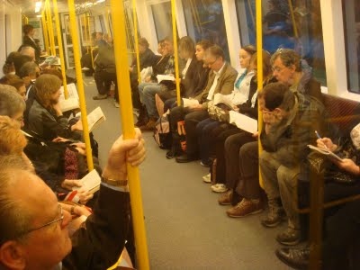
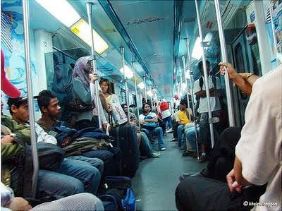
Reading habit is an essential life skill -
increase our knowledge
build maturity and character
sharpen our thinking
widen our awareness in social, economic, political, and environmental issues
Westerners
Malaysian

Slide 7
Government Initiatives & Supports
Continuous effort in education and promoting reading culture
400 public libraries - branch, regional, town, rural & mobile.
300+ special libraries, about 8,000 resource centres in schools
Book Fairs & Reading Campaigns – National & States/Area Level
Positive Results = Increased reading habit!
more visitors to book fairs
more publishers are entering the trade
more titles are published yearly
more mega bookshops are opening up

Slide 8
Driving the Local & International Book Fairs
Population
GNP
Literacy
Reading Awareness
Positive growth to the industry
=

Slide 9
Local publishers venture into the regional and international markets
Kuala Lumpur International Book Fair (KLIBF) – into 30th consecutive year, over 1 million of visitors
Trade & Copyright Centre (first introduced in 2009, in KLIBF) – seek to become the hub for literary industry within the SEA and bring the literature of our diverse and culturally-rich region to the world stage
Taking initiative via active engagement of international audience at leading trade fairs, such as the Frankfurt Book Fair, Beijing Book Fair, etc.

Slide 10
Kuala Lumpur Book City (KLBC)
KLBC reflects the government’s commitment to enhance the publishing industry
Intended as the heart of Malaysia’s readers, authors and publishers activities, it’s a hub for publishing, printing, marketing & distribution for Malaysia, as well as SEA
Under One roof concept - exhibition/sales area, copyrights trading, discussion among industry writers/publishers , events, etc.
Launching Grant of RM30 million, to start developing this year end

Slide 11
Trends & Challenges
Children’s Book considered the safest and most reliable for educational publications
188 titles (1980s) → 2000 titles (1990s)
Malaysian parents are becoming more education-conscious
Increased spending on books, due to tax exemption for buying books & other literature
GST implementation, what happen next?

Slide 12
Impact of new media – online & digital platforms
Internet - negative impact on reading
Electronic Publishing (Vs) Conventional Print
A few publishers have published digital & online books, market response is lacking
World is becoming borderless with the advancement of electronic technology, more foreign publishers are also entering the local industry - stiffer competition

Slide 13
Comics in Malaysia
Those days traditional black & white localized contents
1990s - Manga make waves into Malaysian comics
Comic is perceived as ‘negative influence’ for youngsters
So, how does comic industry evolve in Malaysia?.....
Through more publicity & related entertainment on ACG

Slide 14
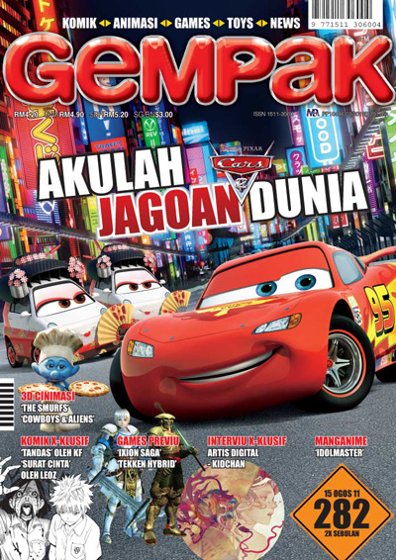
Art Square Group & its 1st Infotainment Magazine
1998 - published GEMPAK magazine; no profit until issue #18
Gempak - first Malay language mag with comics & infotainment (ACG, effect-laden movies, toys, events) for the youth
Educate society with related information/knowledge/news through articles writing while giving priority to comics
Become one of the best selling comic magazine in Malaysia

Slide 15
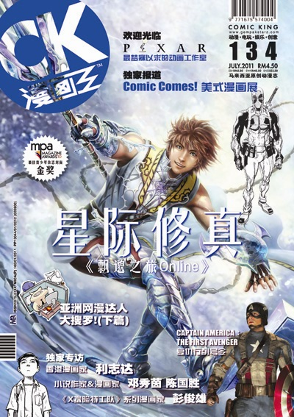
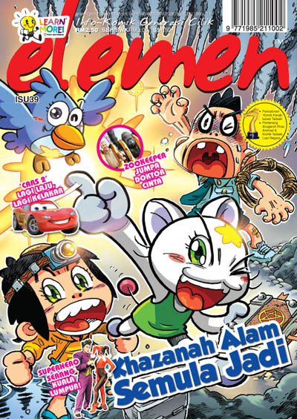
Expand to more magazines (Comic King, Elemen, Little Monitor, Go Go Class), graphic novels & illustrations books
Encourage the culture of reading & relaxing simultaneously
Art Square Group emerge as one of the top player in the industry; renowned with its branding:

Slide 16
Our Graphic Novels
Various genres published
Various drawing styles; mostly international influence
Some are awards winning titles in Malaysia & abroad

Slide 17
Educational Comics
Comics can help kids to gain interest in reading again
Learning through visual
Opening their eyes to whole new worlds or being able to express themselves, nurtured in kids and in turn adults too

Slide 18
Events & Merchandising
Change perception on comic in society as more local entrepreneurs investing in comic industry now
Develop local comic industry with events – 100% Gempak Starz, roadshows, school visits, etc.
Also support the society through global sharing idea internationally i.e. Oriental Animation & Comic Competition (OACC, China), International Comics Artist Conference, Crossover projects, etc.
Merchandising – promotion purpose, extra attribute to comics, enlarge niche of comic markets.

Slide 19
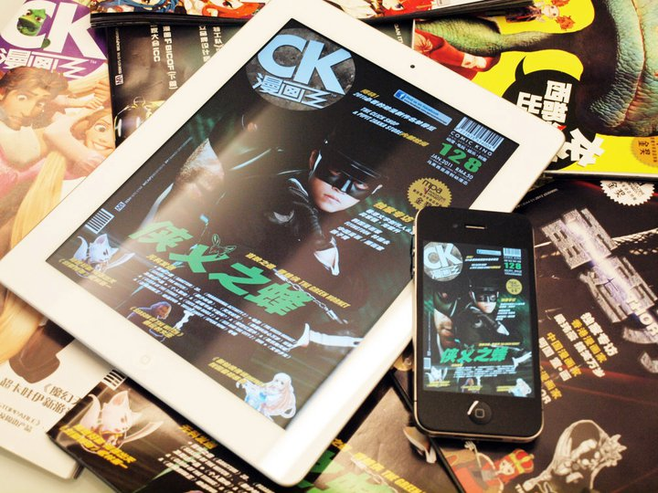
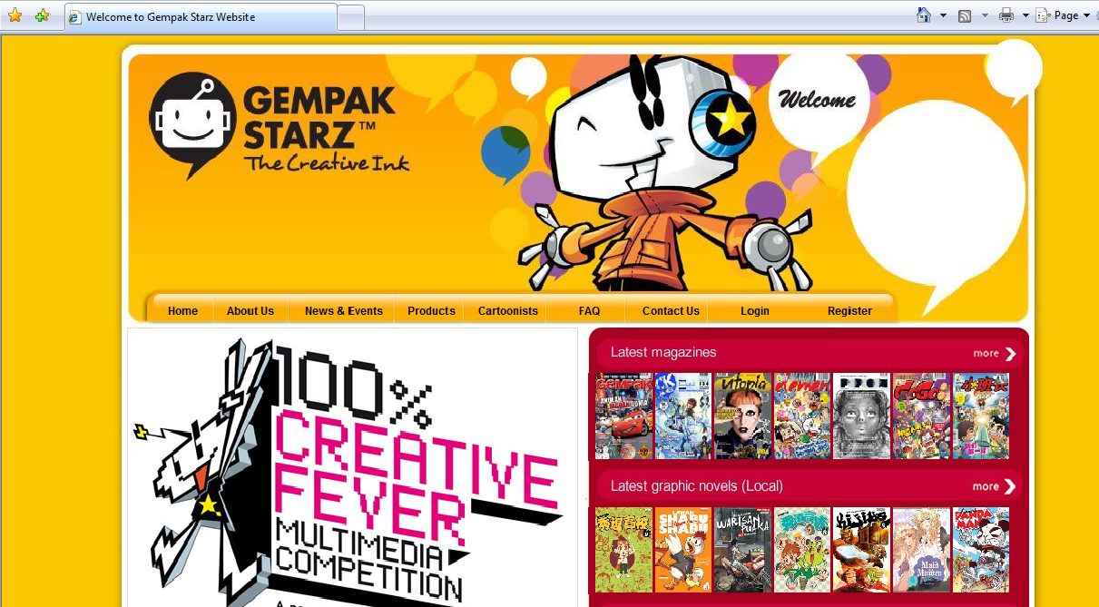
Digital Ink & Mobile Ink
Ink has gone digital; forward reaching global audience
Online presence; comprehensive views of our works, updates, offering, e-comics, etc.

Slide 20
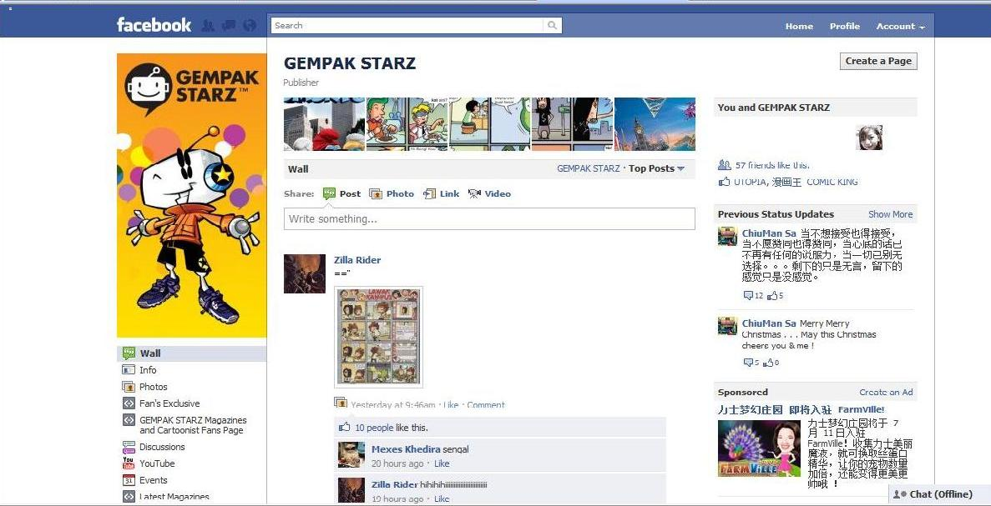
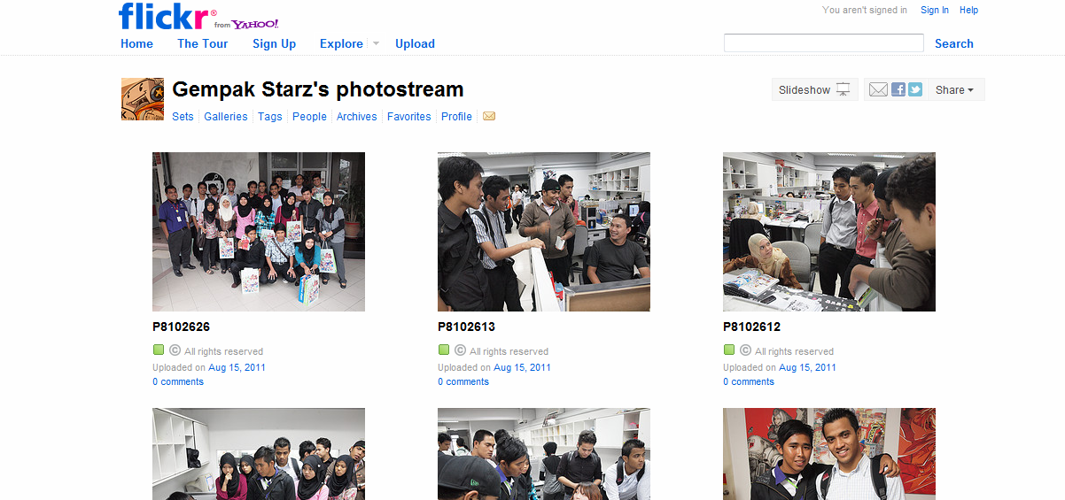
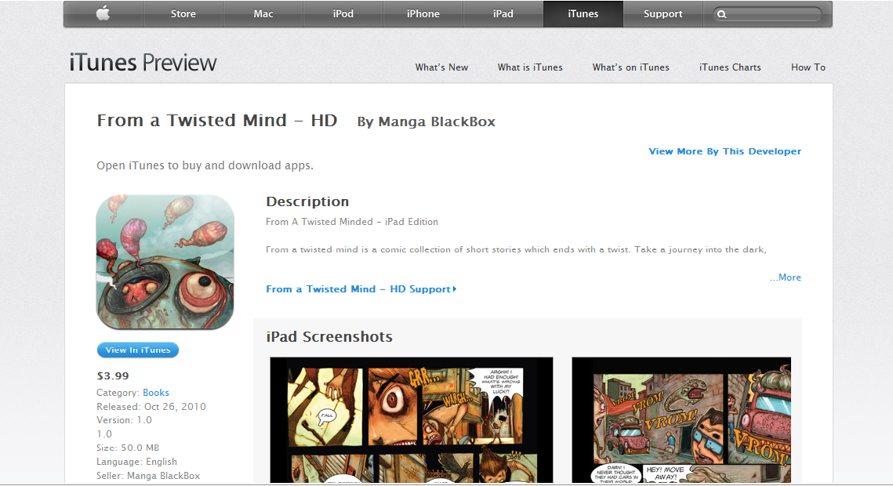
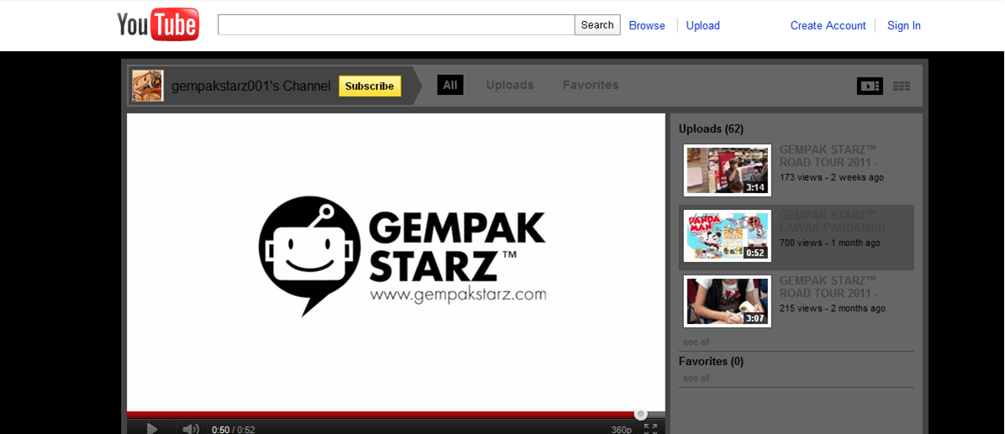

Slide 21
THANK YOU ,
TERIMA KASIH (in Malay)
www.gempakstarz.com

