Slide 1
PUBLISHER & MULTIMEDIA
Gramedia Building 2nd Floor Tower
Jl. Palmerah Barat 29-37, Jakarta 10270
Indonesia
Phone: 62-21-53650110, 53650111
Fax: 62-21-53696656
http:/www.elexmedia.co.id

Slide 2
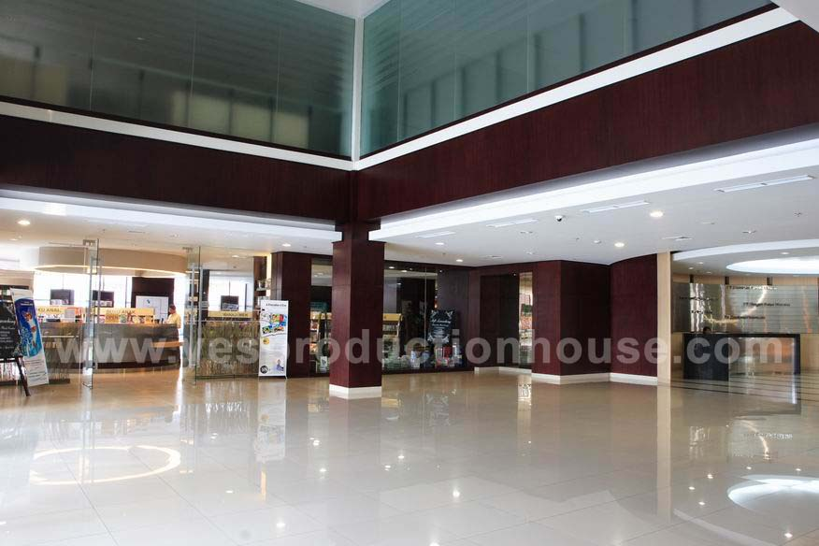
Kompas Gramedia Building

Slide 3
Brief History
PT Elex Media Komputindo was founded on January 15th, 1985. The company is a part of Kompas Gramedia Group corporations.
Type of business: general publisher (books, software) with majority in comic books (fiction and education)
In 1991, we established Software and Multimedia Division. This division produces software for professional and educational uses.
In 1994, the Merchandise Division was introduced. This division handles the merchandising of various products, mainly in edutainment and collectible items.

Slide 4
Publishing Division
Create and publish books and comics from local or international sources.
Books:
Comics (fiction and education)
Children Books (education, story book, picture book, activity book, etc)
Novels (romance, adventure, mystery, etc.)
Computer & Information Technology (IT) Books
Management & Business
Others (health, parenting, cooking, dictionary, hobby, etc.)

Slide 5
Merchandise Division
The division produces and distributes local or licensed edutainment materials and variety of collectible items.
The products consist of:
puzzles, edutainment cards, and posters
variety of collectible items
and other creative products

Slide 6
Software & Multimedia Division
The division produces software for educational and professional uses. Up to this time, we have released more than 800 software packages.
Recently, we have established the Elex Digital. The purpose is to create and develop web pages for private or enterprise uses.

Slide 7
Our Distribution Networks
Our distribution networks cover all major cities in Indonesia. Currently, we have 8 representatives in Surabaya, Bandung, Medan, Semarang, Yogyakarta, Pekanbaru, Makasar, and Palembang (capital cities in Java & Sumatera island).
We use the following distribution channels in order to maximize our coverage:
Bookstores (more than 200 major bookstores)
Distributors/Agencies (around 130 newsstands/kiosk)
Retail stores (minimarkets, supermarkets, hypermarkets)
Direct selling (subscriptions, telemarketing, educational institutions)

Slide 8
Distribution Network
Distributors/
Agencies
Bookstores/
Kiosk
Readers
Publisher
Supermarkets
Bookstores
Subscriptions
Direct
Selling
Telemarketing
Educational
Institutions

Slide 9
Our Partners
Besides cooperate with hundreds of local authors, we have set up mutual relationship with more than 100 international publishing companies. Some of those partners are:
Korea:
Yearimdang
Iseum
Ludens Media
Daewon
Woongjin
Daekyo
Glsongi
Gobooky
Jigyungsa
Korea:
Topaz Agency
Carrot Agency
Agency Liang
Shinwon
Haksan
Seoul Cultural Publisher
Samyang
Japan:
Kodansha
Shogakukan
Shueisha
Akita Shoten
Hakusensha
Soyosha
Futabasha
Kadokawa Shoten
Poplarsha
Gakken, etc.

Slide 10
Our Partners
Asia Pacific:
Asiapac Pte.Ltd.
Konsep Lagenda
Newton Publishing
Handknocks Factory
Dai Won
Doolynara
Yacom
Renaissance
Interself Foundation
USA:
Scholastic
Harper Collins
McGraw Hill
Pearson Education
John Wiley
Sybex
IDG Books
Barron’s Educ.
Warner Books
Microsoft Corp.
Disney Int.
Penguin Groups
etc.
Europe:
Egmont
Andromeda
Random House
Vogel Burda Int.
Dorling Kindersley
Doubleday Publ.
Element Ltd.
Ebury Press
The Watts Publ.
How to Book Ltd.
Nicholas Brealey
The Economist
etc.

Slide 11
KOMPAS GRAMEDIA GROUP
Newspaper Division
Regional Newspaper Division
Magazine Division
Sport Media Division
Printing Division
Book Publishing & Multimedia Division
Radio Station Division
TV Station Division
Retail Business Division
Hotels and Resorts Division

Slide 12
MARKETING & PROMOTION STRATEGY EXECUTION OF ANSOF MATRIX BASIC STRATEGY

Slide 13
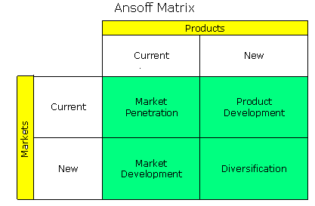
Eksekusi Strategi Dasar
http://www.valuebasedmanagement.net/
Notes:
13

Slide 14
Market Penetration (Current Products & Current Market)
Product knowledge
To ensure target market segmentation.
Maintain availability of product at the outlet
To minimize or even prevent lost sales and to make sure the customer can access our product.
Maximize product display
To maintain Elex Media product display is strategic, easy to catch the customer attention.
Notes:
14

Slide 15
Market Penetration (Current Products & Current Market)
Sales Promotion
Add ‘value’ to all Elex Media products compare to other publishers product to create and boost impulse buying and up-selling.
Instore promo
Discount
Special prize program
Special display (POP)
Customer Relationship
Maillist, Facebook, tweeter, events, etc
Notes:
15

Slide 16
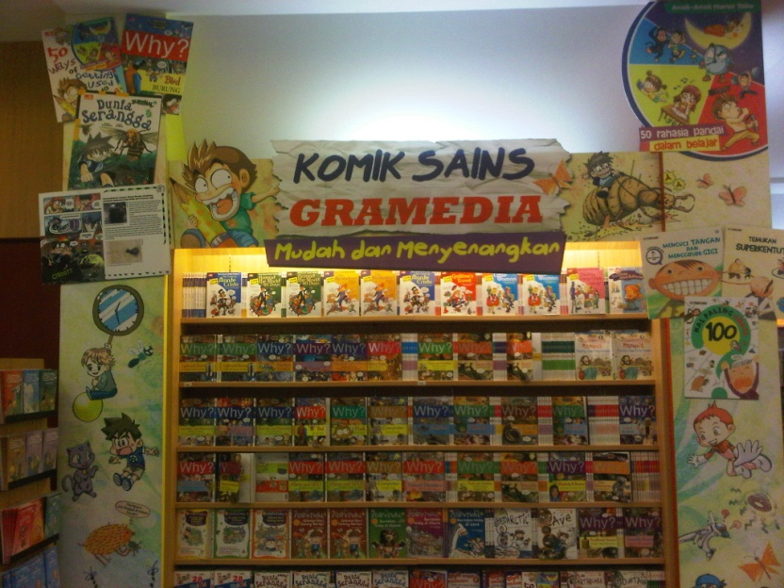
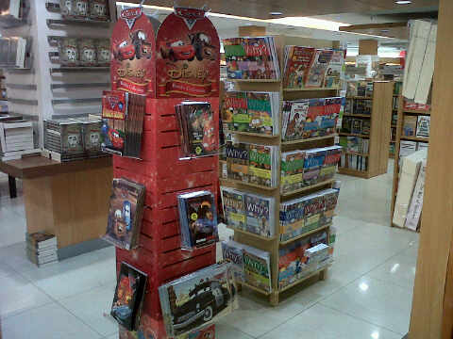
SPECIAL DISPLAY & INSTORE PROMO
To create and boost impulse buying

Slide 17
Product Development (New Products & Current Market)
Product knowledge
To determine target market.
Maintain availability of product at the outlet
To create customer’s awareness towards Elex Media new products before products from other publishers reach the market.
Maximize product display
To maintain Elex Media product display is strategic, easy to catch the customer attention.
Notes:
17

Slide 18
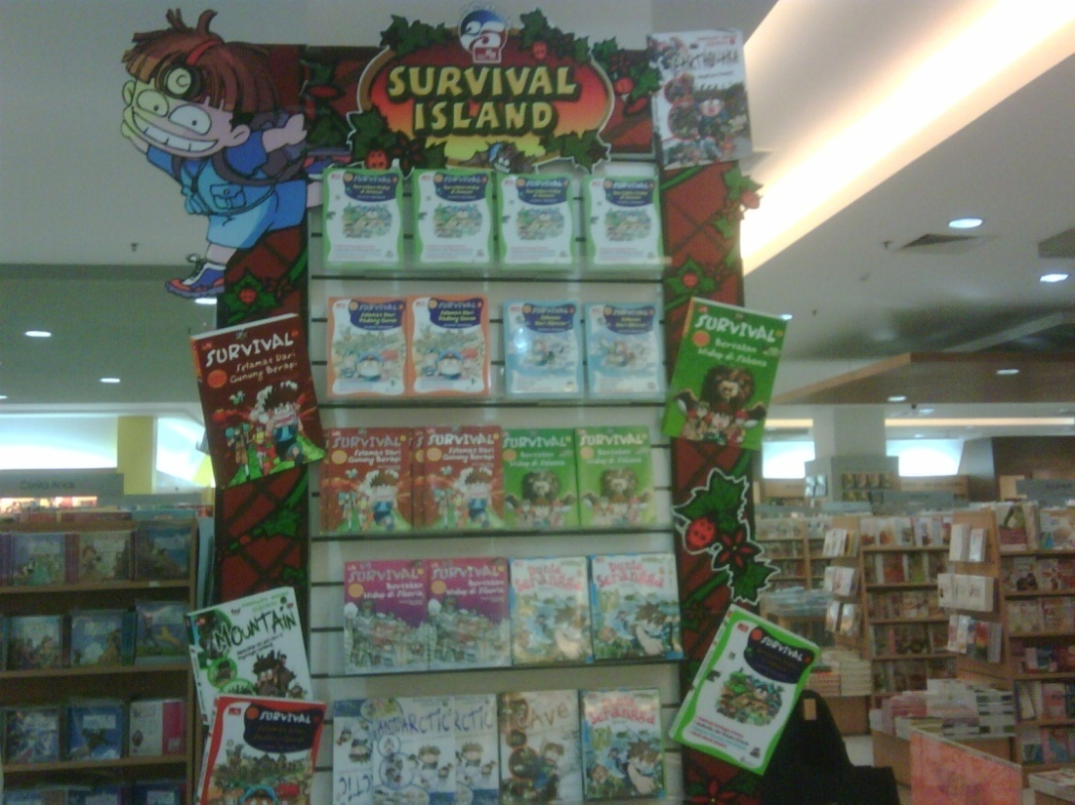
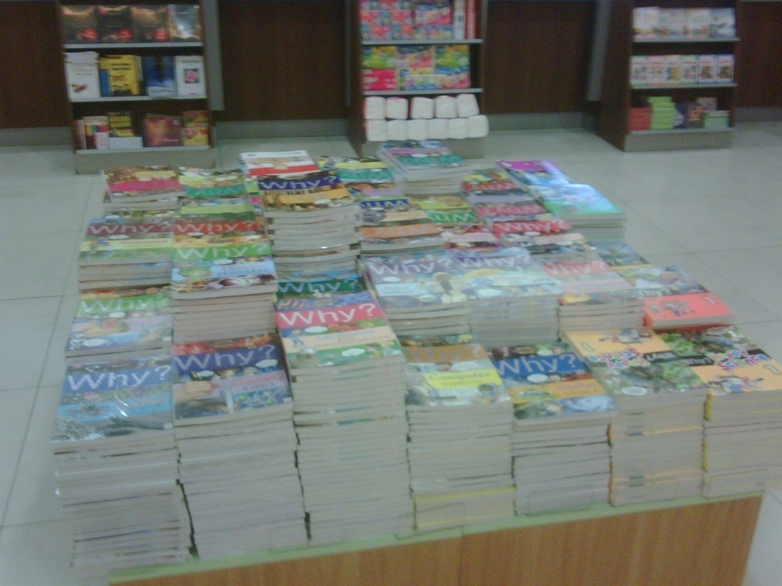
Book Stores and Display

Slide 21
Product Development (New Products & Current Market)
Product Campaign
To create customer awareness towards our new product
Executing below the line & above the line edvertising
Above the line: advertisement in print media, electronic media
Below the line: in store promotion materials, direct mail, flyers, etc
Sales Promotion
Add ‘value’ to Elex Media new products
Instore promo
Event → to give ‘experience’ towards future customer
Discount
Special prize program
Special display (POP)
Notes:
21

Slide 22
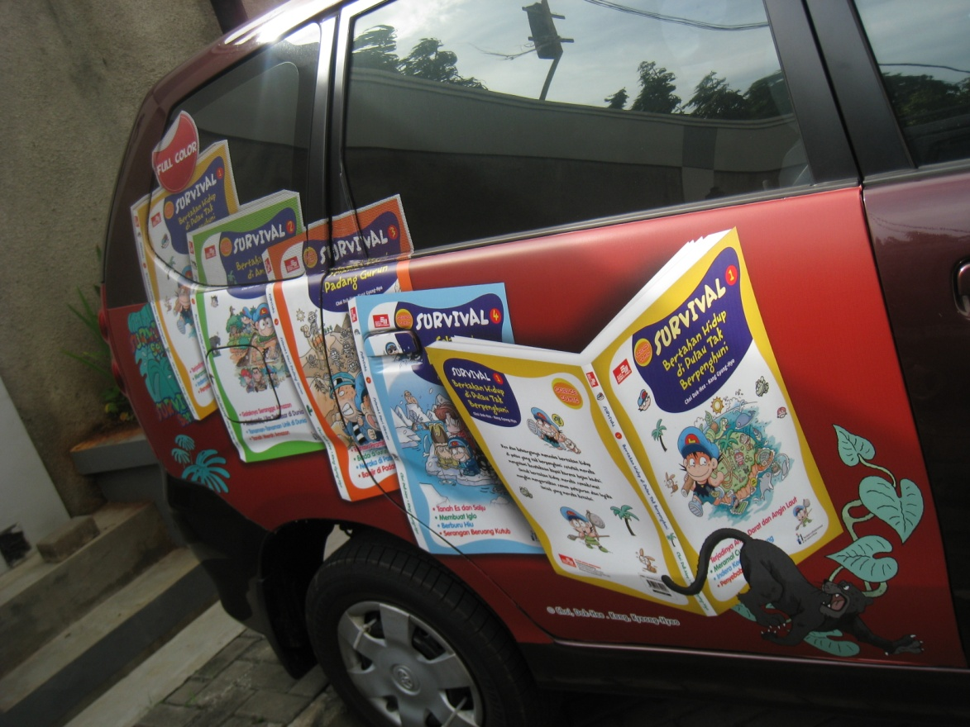
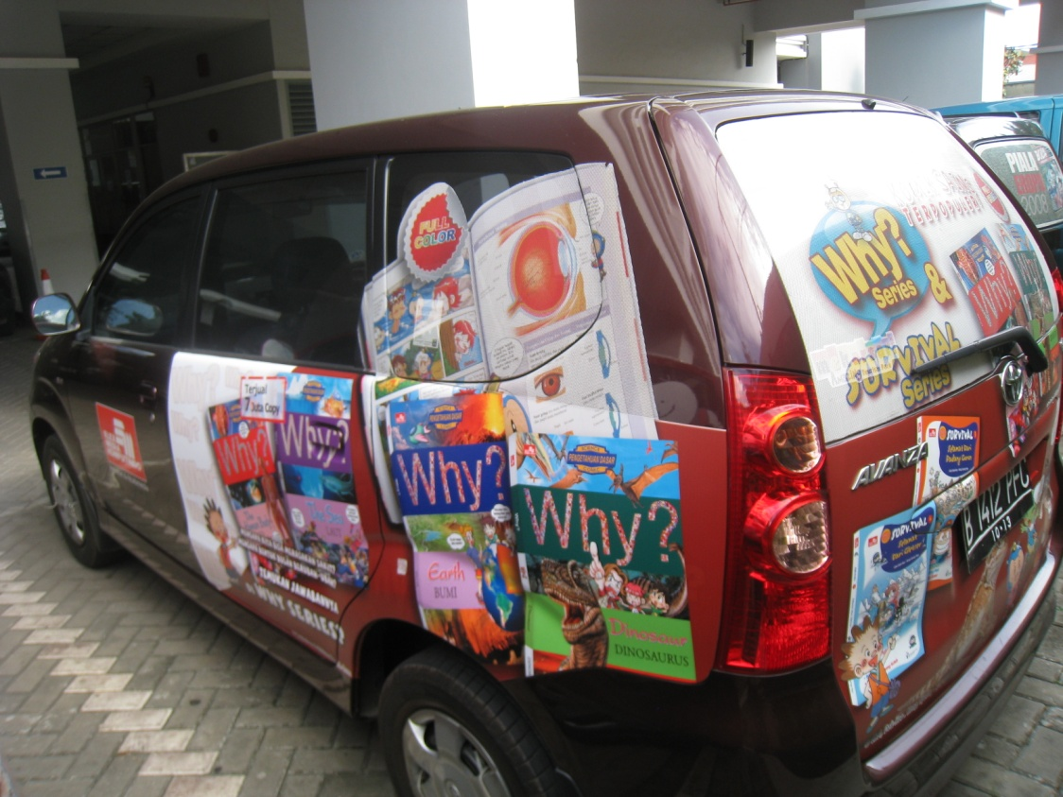
Advertisement Car

Slide 23
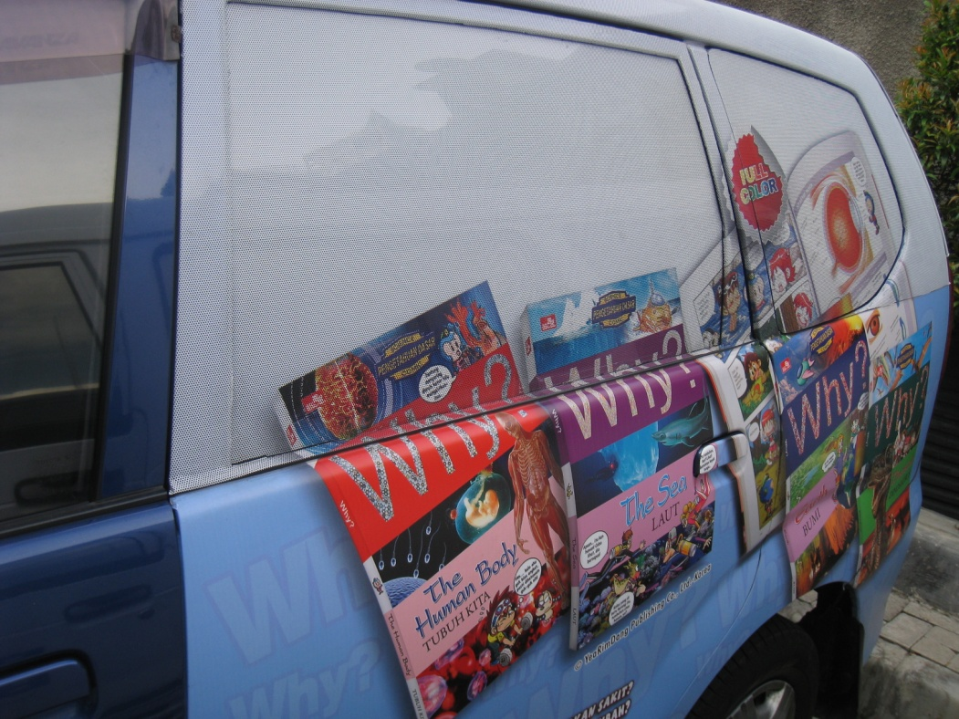
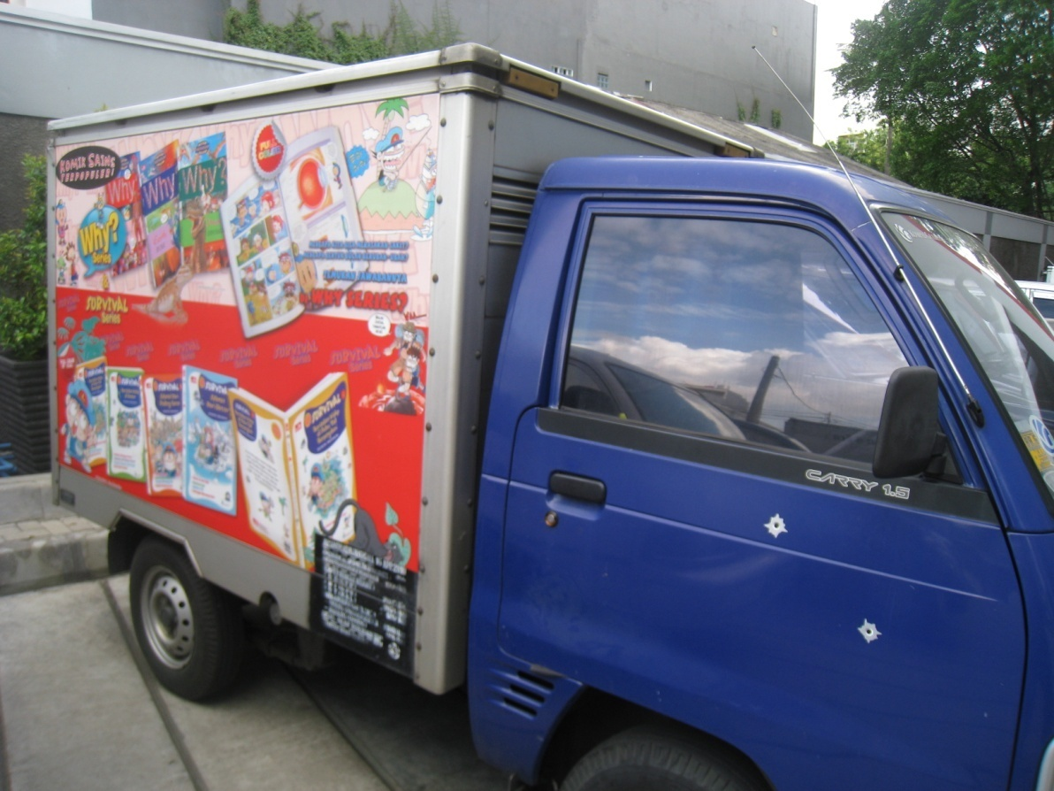

Slide 24
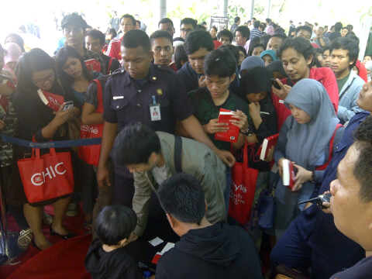
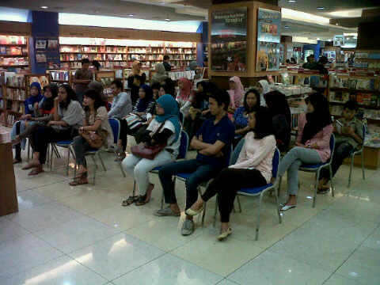
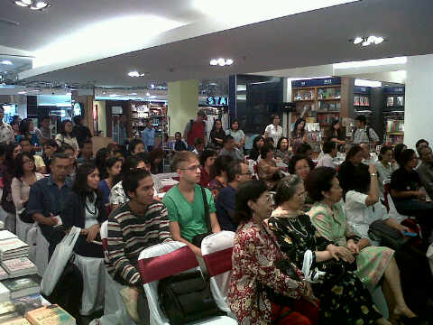
EVENT LAUNCHING & TALKSHOW
To create customers awareness & ‘experience’

Slide 25
Market Development (Current Products & New Market)
Market expansion
Create new distribution outlets
Executing Business to Business and Business to School projects
Notes:
25

Slide 26
Market & Product Development (New Products & New Market)
Product and Market Expansion
Open partnership with other industry to make customize books.
Notes:
26

Slide 27
Publishers
IKAPI
1.009 Publishers

Slide 28
Elex Media Komputindo
We have published around 2,900 books in 2010 and estimated 3,000 in 2011

Slide 29
Sales-in data Jan-Jun 2011 in Gramedia Bookstore
Elex Media market share = 14,86% from total 35,52%
Kompas Gramedia market share = 40% from total published books in Indonesia
The strongest share from Elex Media Komputindo is in comic = 48,75%, self development books = 30,67%, computer books = 29,43%, fiction books (novels) = 2,26%, religion books = 3,7%.
In the first Semester of 2011 vs 2010 the growth is 4,01%. This means we have a stagnant growth.

Slide 30
Total population
Survey in 2010: 237 million
Total male: 119 million, and female 118 million
Problem:
Population in the village : city = 60% : 40%
Archipelago (17.000 islands) = transportation and distribution problems
GNP per capita around USD 3.004,9, a 13% increase compare to 2009 USD 2.349,6

Slide 31
Publishing industry in development country:
Less fund
Limited distribution network
Low buying power
Low reading habit
Piracy

Slide 32
Piracy
Where to look for pirated books:
Newstands, Supermarket/Convenience Store, Comic rental shops, Bookstores outside Gramedia Group, internet.
Impact:
- Lower sales on the licensed titles that was pirated
- Lawsuit/protest by parents group/government board for products not published by us
- Pornographic stigmata for comic books industry as a whole
Hurdle:
Weak law enforcement, lack of knowledge of pirated/licensed version of comics in agents/newspaper stalls

Slide 33
Digital Version
Prospect:
Indonesia’s Facebook user is the 2nd largest totalling 38.5 million users (www.checkfacebook.com)
Newspapers/magazines have online version for Ipad (Kompas, Tempo, Bazaar, Popular, Sekar, FHM)
Digital bookstores available (wayangforce, digibookgallery.com, XL Baca)
Hurdle:
Internet connection
File size
Scheme of payments

Slide 34
THANK YOU

