Slide 1
China Times Publishing Company Taiwan

Slide 2
Representative
Name: Charlotte Yu
Post: Rights Executive
Experience: Translator, Editor Assistant
Personal Interest: Literature, History, Self-help in business.

Slide 3
China Times Publishing Company
Established in 1975.
Listed in 1999.
Principle: Respect Wisdom and Creativity.

Slide 4
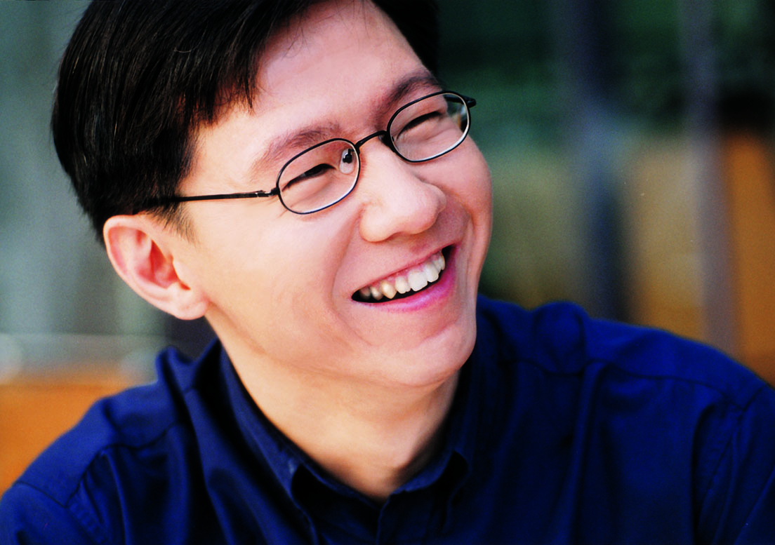
Famous Writer
Tom Wong

Slide 5
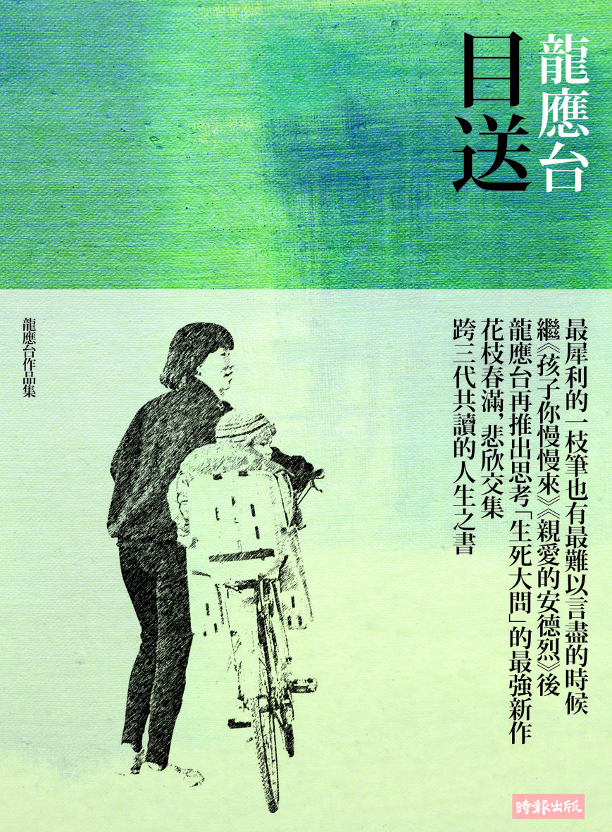
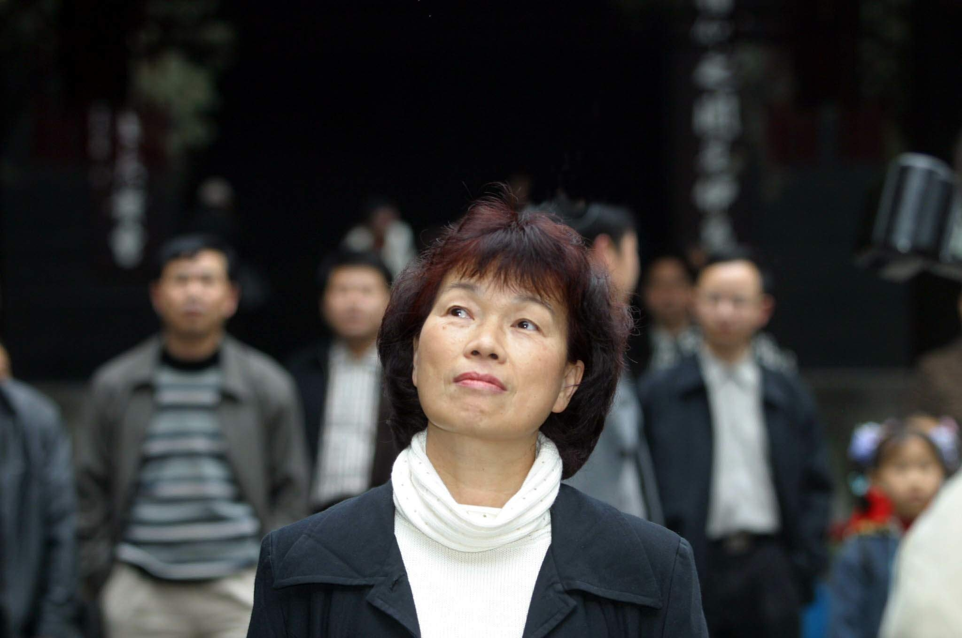
Lung Ying-Tai

Slide 6
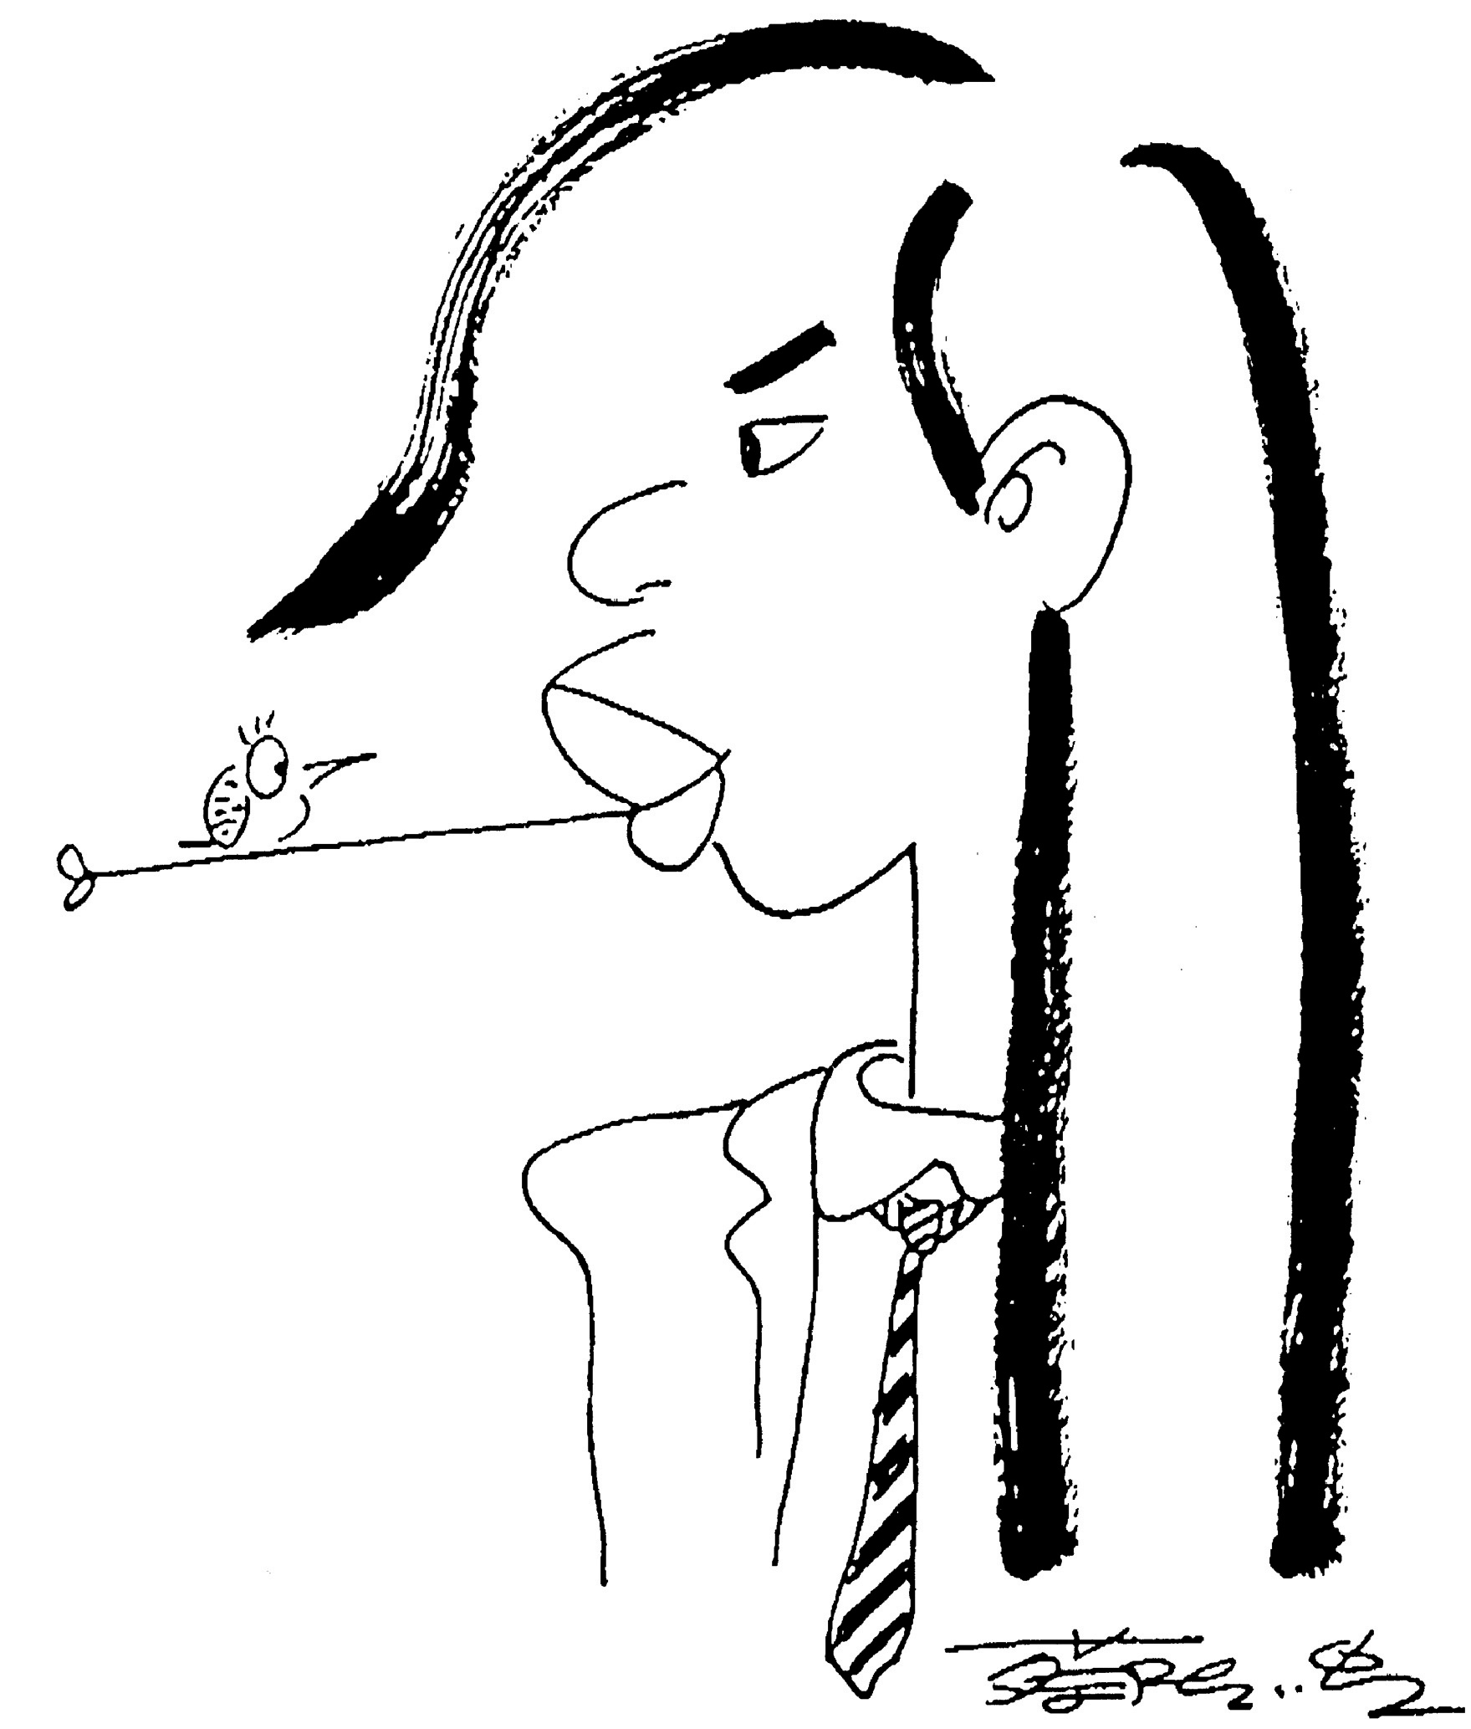
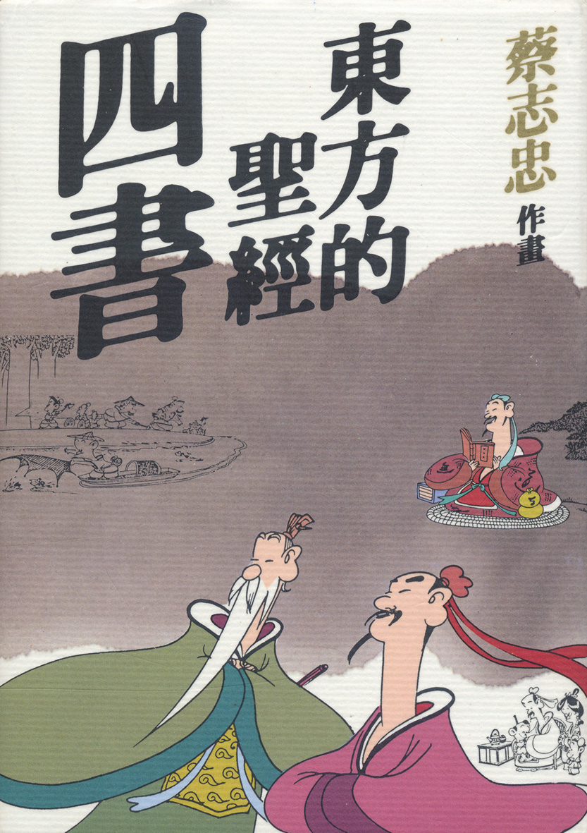
Famous Writer
Cai Zhizhong (채지충 )

Slide 7
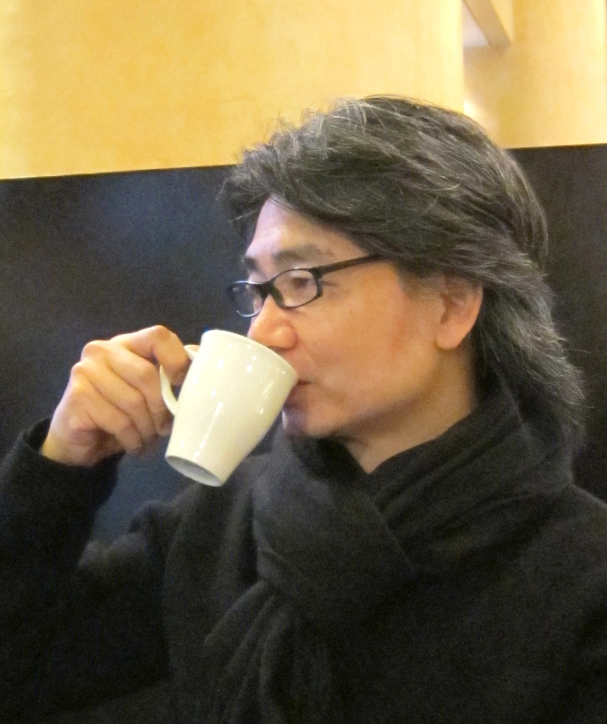
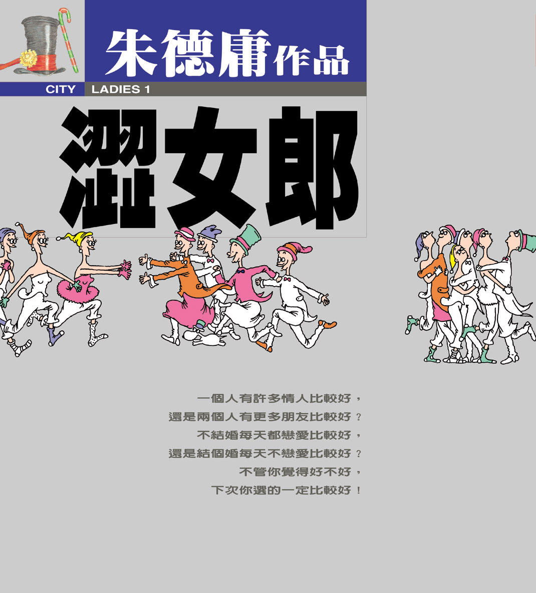
Famous Writer
Chu De-Young

Slide 8
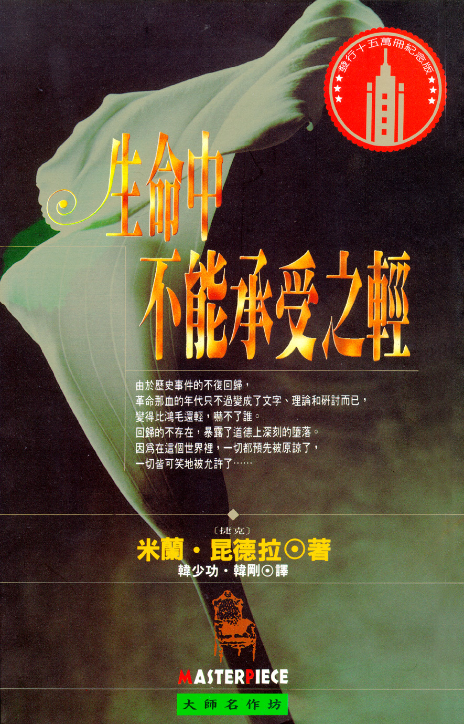
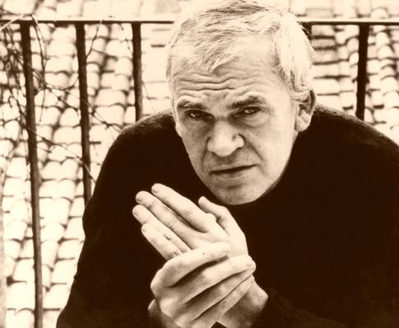
Famous Writer
Milan Kundera

Slide 9
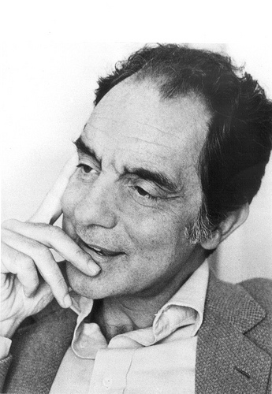
Famous Writer
Italo Calvino

Slide 10
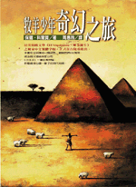
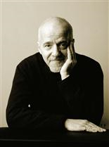
Famous Writer
Paulo Coelho

Slide 11
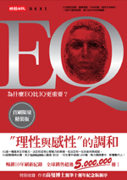
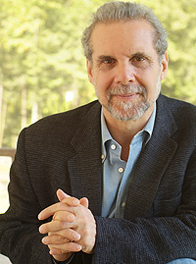
Famous Writer
Daniel Goleman

Slide 12
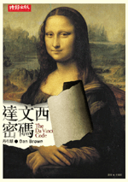
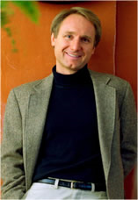
Famous Writer
Dan Brown

Slide 13
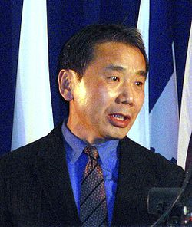
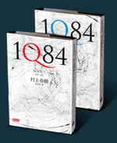
Famous Writer
Murakami Haruki

Slide 14
Famous Writer
Yoshimoto Banana

Slide 15
Publishing in Taiwan
Small market with numerous publishers.
Large demand for foreign (including Mainland China) works.
Three main distributors: Eslite, Kingstone and Books.com.tw.
E-book.

Slide 16
Our Place
An old and prominent publisher.
Strong in Literature and History.
Brave in opening new trends.
Cultural communication and continuity.

